Slide 1
The cooperative principle

Slide 2
Introduction
Understanding concepts
Maxim of quantity
Maxim of quality
Maxim of relation
Maxim of manner
Observing maxims
Flouting and violating maxims

Slide 3
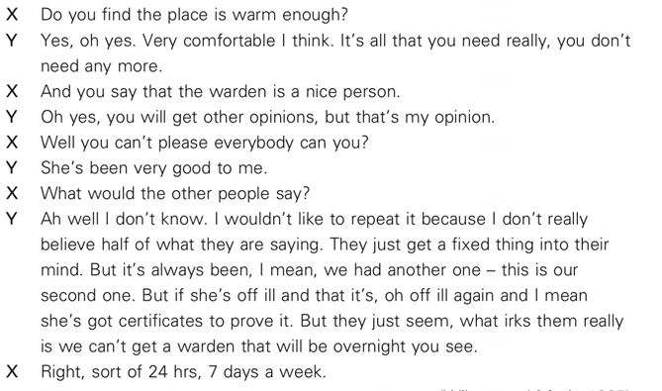
Introduction

Slide 4
Observing the maxims
The maxim of quantity:
Speakers should be as informative as is required; speakers should give neither too little information not too much.
Well, to cut a long story short, she didn’t get home till two.
The maxim of quality:
Speakers are expected to be sincere, to be saying something that they believe corresponds to reality.

Slide 5
Observing the maxims
The maxim of quality:
A I’ll ring you tomorrow afternoon then.
B Erm, I shall be there as far as I know, and in the meantime have a word with Mum and Dad if they’re free. Right, bye-bye then sweetheart.
A Bye-bye, bye.
The maxim of relation:
Speakers are assumed to be saying something that is relevant to what has been said before.

Slide 6
Observing the maxims
The maxim of relation:
A There’s somebody at the door.
B I’m in the bath.
A I mean, just going back to your point, I mean to me an order form is a contract.
If we are going to put something in then let’s keep it as general as possible.
B Yes.

Slide 7
Observing the maxims
The maxim of manner:
Speakers should be brief and orderly, and avoid obscurity and ambiguity.
Thank you Chairman. Jus – just to clarify one point. There is a meeting of the Police Committee on Monday and there is an item on their budget for the provision of their camera.
Conversational implicature

Slide 8
Flouting the maxims

Slide 9
Flouting the maxims
This looks awful on; I don’t want it after all.
I’ll go away and think about it and maybe come back later.
I’m washing my hair tonight. = I’m free but I don’t want to go out with you.
Do you find it’s getting a bit chilly in here?= I want to put the fire on.
flouting the maxims; implicit meaning

Slide 10
Flouting the maxims
Flouting quantity
A Well, how do I look?
B Your shoes are nice.
Flouting quality (hyperbole)
I could eat a horse.
Lynn Yes I’m starving too.
Martin Hurry up girl.
Lynn Oh dear, stop eating rubbish. You won’t eat any
dinner.

Slide 11
Flouting the maxims
Flouting quality (metaphors)
My house is a refrigerator in January.
Don’t be such a wet blanket.
Flouting quality (conventional euphemisms)
I’m going to wash my hands.
She’s got a bun in the oven.
Flouting quality (irony & banter)
If only you knew how much I love being woken up at 4 am by a fire alarm. (irony)
This is a lovely undercooked egg you’ve given me here, as usual. Yum! (sarcasm)

Slide 12
Flouting the maxims
Flouting quality (banter)
You’re nasty, mean and stingy. How can you only give me one kiss?
Flouting relation
A So what do you think of Mark?
B His flatmate’s a wonderful cook.
Heckler We expected a better play.
Coward I expected better manners.

Slide 13
Flouting the maxims
Flouting manner
A Where are you off to?
B I was thinking of going out to get some of that funny white stuff for somebody.
A Ok, but don’t be long – dinner’s nearly ready.

Slide 14
Violating the maxims
A speaker can be said to ‘violate’ a maxim when they know that the hearer will not know the truth and will only understand the surface meanings of the words.
The speaker deliberately supplies insufficient information, says something that is insincere, irrelevant or ambiguous, and the hearer wrongly assumes that they are cooperating.

Slide 15
Violating the maxims
The maxim of quantity
A Does your dog bite?
B No.
A (Bends down to stroke it and gets bitten) Ow! You said your dog doesn’t bite!
B That isn’t my dog.
Husband How much did that new dress cost, darling?
Wife Less than the last one.

Slide 16
Violating the maxims
The maxim of quality
Husband How much did that new dress cost, darling?
Wife Thirty-five pounds.
The maxim of relation
Husband How much did that new dress cost, darling?
Wife I know, let’s go out tonight. Now where would you like to go?

Slide 17
Violating the maxims
The maxim of manner
X What would the other people say?
Y Ah well I don’t know. I wouldn’t like to repeat it because I don’t really believe half of what they are saying. They just get a fixed thing into their mind.
Other forms of non-observance of maxims:
infringing a maxim or opting out of a maxim.
A speaker infringing a maxim fails to observe a maxim because of their imperfect linguistic performance.
A speaker opting out of a maxim indicates an unwillingness to cooperate, although they do not want to appear uncooperative.

Slide 18
Limitations of the cooperative principle
Different cultures, countries and communities have their own ways of observing and expressing maxims for particular situations:
We’ll call you in about two weeks.
My nephew Paul came round last night.
How are you?
Furthermore, there is often an overlap between the four maxims:
A What did you have to eat?
B Oh something masquerading as chicken chasseur.

Slide 19
Limitations of the cooperative principle
Pat How’s it going with Phil?
Melanie One of us thinks it’s OK.

Slide 20
Recommended reading
Cutting, J. (2002). Pragmatics and Discourse. London and New York: Routledge.
Grundy, P. (2000). Doing Pragmatics. London: Edward Arnold.
Levinson, S.C. (1983). Pragmatics. Cambridge: Cambridge University Press.
Mey, J. (1994). Pragmatics: An Introduction. Oxford: Blackwell.

