Slide 1
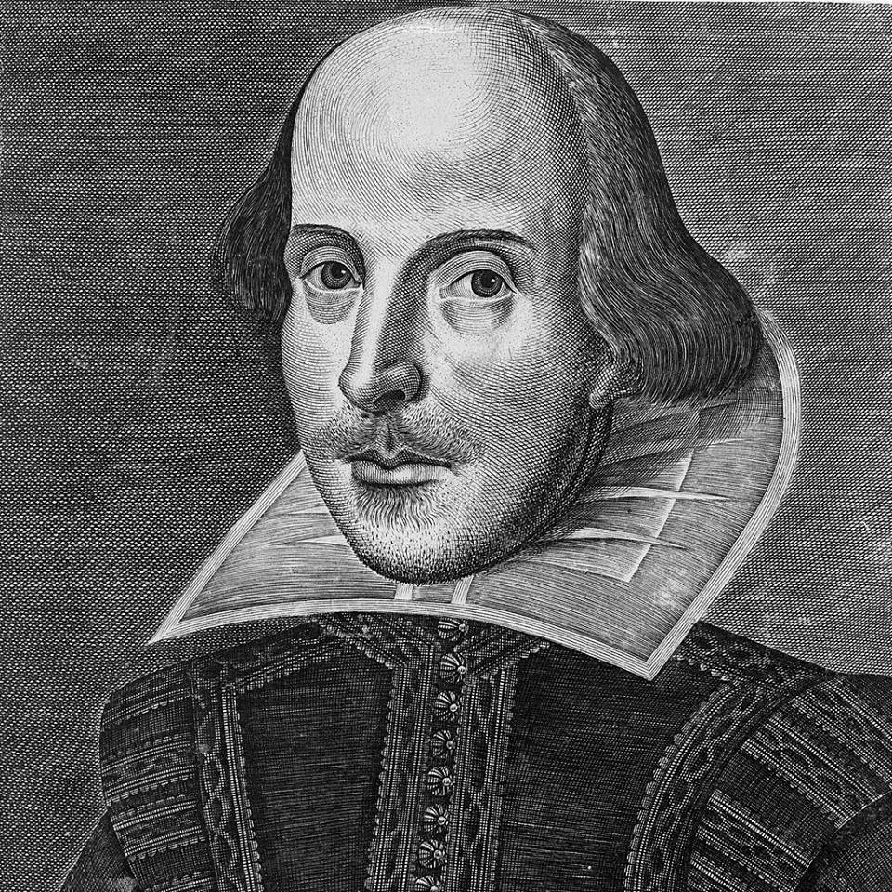
William Shakespeare’s canonical biography

Slide 2
The data based on scarce documents
William Shakespeare was baptised on April, 26, 1564 at the Holy Trinity Church at Stratford-upon-Avon
His father John Shakespeare who was a glove-maker, an alderman of Stratford-upon-Avon, a bailiff (1568), and his mother Mary Arden had 8 children
Shakespeare studied at the Grammar school in Stratford-upon Avon (Cicero, Ovid, Plautus, Virgil, Seneca, Terence and others)

Slide 3
The youth and early works
After 1578 - ?
1582 marriage with Anne Hathaway, a daughter of a well-to-do farmer (children: Susanna, the twins Judith and Hamnet)
1587 Shakespeare leaves Stratford for London where he works for different theatres (Theatre, Rose, Curtain, Globe)
Early 1590s – The Comedy of Errors, history plays Henry IV and Richard III and two poems

Slide 4
Two poems
Venus and Adonis, 1593 had 8 editions published during the author’s life. The Poem was devoted to Henry Risley (Wriothsley), earl of Southampton
The Rape of Lucrece, 1594
In the early period of his work Shakespeare also wrote some of his “Italian plays” or tragedies, like Titus Andronicus, Julius Caesar, Romeo and Juliet

Slide 5
Shakespeare’s work
the second period
the third period
1601-1608
tragedies and comedies
Hamlet, Othello, King Lear, Macbeth, Antony and Cleopatra, Troilus and Cressida etc.
All’s well that ends well
Measure for Measure, etc.
Bitterness and disappointment in the possibility to realise the ideals of good and justice
1608-1613
tragicomedies (romances)
The Tempest
The Winter’s Tale
Pericles
Cymbeline, etc.
The stylistic polyphony – Renaissance, mannerism, baroque

Slide 6
Late years
1613 The Globe is burnt down; the fire is supposed to have laid in ashes Shakespeare’s manuscripts
retirement – Shakespeare returns to Stratford
Apr,23, 1616 Shakespeare died
1623 the 1st Folio is published
1747 Shakespeare’s will is discovered that becomes the starting-point of the authorship dispute

Slide 7
Shakespeare authorship polemics
Who is the author of the two poems, 154 sonnets and 37 plays attributed to W.Shakespeare?
Stratfordians (Shakespeareans) versus anti-Stratfordians (57 theories)
“Good friend, for Jesus sake forebear
To dig the dust enclosed here
Blessed be ye man yt spares these stones
And cursed be he yt moves my bones”

Slide 8
The Droeshout portrait or Droeshout engraving
The portrait of William Shakespeare was engraved by Martin Droeshout on the title page of the First Folio collection of Shakespeare's plays, published in 1623. It is one of only two works of art definitively identifiable as a depiction of the poet; the other is the statue erected as funeral monument in Shakespeare's home town of Stratford-upon Avon.

Slide 9
Critics about the portrait
The engraving is praised by Shakespeare's friend Ben Johnson in his poem To the Reader printed alongside it, in which he says that it is a good likeness of the poet. He writes that "the graver had a strife / With nature to outdo the life" and that he has "hit his face" accurately. He adds that the engraver could not represent Shakespeare's "wit", for which the viewer will have to read the book. The testimony to the accuracy of the portrait. So, this is the only portrait that definitely provides us with a reasonable idea of Shakespeare's appearance
Numerous critics of the engraving say that the clumsy relationship between the head and the body allow to consider the print as a poor representation of the poet. …the face is long and the forehead high; the one ear which is visible is shapeless; the top of the head is bald, but the hair falls in abundance over the ears. ... Light comes from several directions simultaneously… the awkward difference in design between the right and left shoulders The engraving is poorly proportioned and demonstrated many artistic defects.

