Slide 1
Sentences: communicative purpose
Why do people communicate ?
To inform someone of something
To get information from someone
To get someone to do something
To express one’s attitude about something
These communicative functions are expressed in typical sentence patterns:
John is leaving.
Is John leaving?
Leave, John!
How awful John is leaving!What a shock John is leaving!

Slide 2
Sentences: communicative purposes
These are called:
declarative;
interrogative;
imperative;
exclamatory.

Slide 3
Sentences: communicative purposes
Exercise 1: say the words ‘John is leaving’ in such a way that they express the following communicative functions:
informing
asking for information
getting someone to do something
expressing feeling or attitude.

Slide 4
Sentences: participants, process, attributes and settings
Exercise 2: Look at the cartoon in the next slide. Qickly write down three simple sentences you would use if asked to describe what you see. Take 5 minutes for this task. We shall come back to what you’ve written later on.

Slide 5
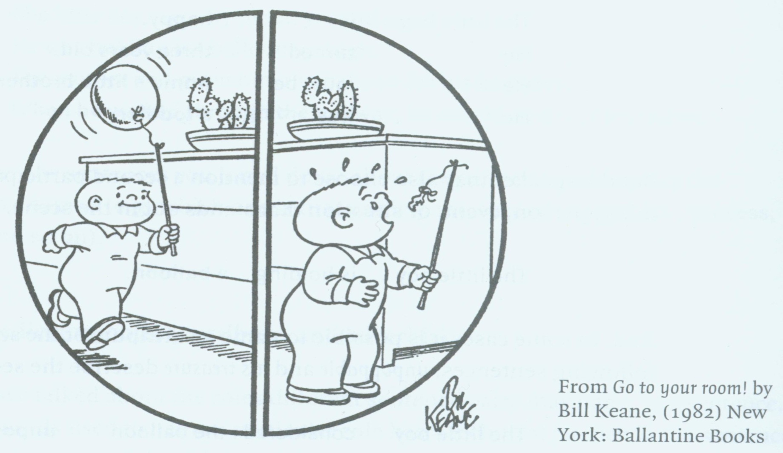
Sentences: participants, process, attributes and settings
Notes:
In a declarative sentence, speakers or writers give information to other people (listeners or readers) abot events or situations. It is very likely that the same event or information will not be described diferently by different people , depending on what they consider the most important, relevant or effective aspects of the event/situation in the moment of speaking. So the sentces describing the same scene in objective reality will depend on what we call the SPEAKER’S PERSPECTIVE (VIEW).

Slide 6
Sentences:participants, process, attributes and settings
The following aspects can be named in an event or a situation:
One or more participants (who/what stands out the most will be called the FIRST participant)
Attributes of these participants (e.g. little, red, prickly)
Information about the setting of event/situation
The process (is holding, is walking, is passing by:
e.g. The little boy is happy. (a quality)
He turned three years old. (a characteristic)
He must be Annie’s little brother. (identification)
He is a toddler. (class membership)
Notes:
Which are the things that stand out the most?
the boy, the ballon, the cactus;
the person or the thing that stands out the most of these

Slide 7
Sentences:participants, process, attributes and settings
Another thing, person that stands out in a scene – the second participant:
The little boy is holding a baloon.
The second participant may also be attributed a quality or characteristic...:
The little boy considered the ballon unpoppable.
The little boy made the baloon his treasure.
When something is transfered from one participant to another , the third participant gets into view:
The mother had given the boy the baloon.
The mother had bought the boy the baloon.

Slide 8
Sentences:participants, process, attributes and settings
The speaker may decide to give information as to when, where, why or in which way , under which condition something happenes in a scene – the setting:
The little boy was very proud yesterday .
He was holding his baloon up high.
The mother had given him the baloon for his birthday.
When he walked through the hallway, he considered his baloon unpoppable.
Exercise 3: Now go to the sentences you’ve written and identify the elements you named !

Slide 9
Subject, predicator, object, attribute and adverbial
A group of words used to name a particular ROLE that sentence parts may have in sentence has a technical FUNCTION in the sentence:
Roles | Function | Abbreviation
First participant | subject | S
process | predicator | P
Smth about 1st part. | Subject attribute | SA
Second participant | Diect object | DO
Smth about 2nd part. | Object attribute | OA
Third participant | Indirect object/ benefactive | IO BO
The setting | Adverbial | ADV

Slide 10
Subject, predicator, object, attribute and adverbial
The mother had given the boy a baloon for his birthday.
S / P / IO / DO / ADV
The little boy was very proud yesterday.
S / P / SA / ADV
All day long, the little boy considered the baloon his greatest treasure.
ADV / S / P / DO / OA

Slide 11
Typical sentence patterns
The ordering of the sentence constituents is rather predictable: subject before predicator, objects and attributes; only adverbial can be placed before all of them.
also but expresses ideas language not only our shapes the thinking use we
expresses ideas not only but also our thinking shapes the language we use
The most common pattern in English
Subject + Predicate

Slide 12
Typical sentence patterns
Therefore we get
subject predicate
The language we use /not only expresses ideas but also shapes our thinking
P P
The PREDICATE consists of the predicator (P) which consists of one or more words denoting the process.
The predicator may be followed by a complement (direct object, indirect object, attributes). The complement COMPLEMENTS the meaning of the predicator.

Slide 13
Typical sentence patterns
There are five prototypical sentence patterns in English; they are named after typical verbs that occur in these patterns:
The running pattern (intransitive verbs)
The being pattern (copulative verbs)
The doing/seeing pattern (monotransitive verbs)
The giving /bying pattern (ditransitive verbs)
The making/considering pattern (complex-transitive verbs)

Slide 14
The running pattern
John is running (fast)
S P (ADV)
The verbs typical for this pattern express pure action, they do not require object of any kind and are thus called intransitive verbs.

Slide 15
The being pattern
John is fast (in the game).
John is the runner (as usual)
S P SA (ADV)
The verbs typical for this pattern practically have no meaning of their own – they are just a link (mathematical equal sign =) between the subject and the subject attribute . They are called COPULAS or COPULATIVE (linking) verbs: be, become, remain

Slide 16
Copulas
appear | grow | seem | look
be | make | smell | sound
become | prove | taste
feel | remain | turn

Slide 17
The doing/seeing pattern
John kicked the ball (with a swing)
John saw the ball (suddenly)
S P DO (ADV)
The verbs typical for this pattern denote an action or mental activity/perception that involves two participants , one which does the acting or experiencing and one that is acted upon or perceived; those verbs are called monotransitive verbs.

Slide 18
The giving/buying pattern
John gave Peter the ball (for his birthday).
John bought Peter the ball (for his birthday).
S P IO/BO DO (ADV)
The verbs used in this pattern denote an event in which there is a participant who gives/does soemthing, the thing given or done, and the receiver; there are very few verbs that denote such events, the most common being give, pass, send, tell, make, buy, offer and ask.

Slide 19
The making/considering pattern
They made John the umpire (without any delay).
John considered the ball out (as it went past the line)x.
S P DO OA (ADV)
The verbs like make have a sense of ‘doing something’ that causes to object to change the category or acquire a new characteristic : wipe, drive, call, crown, name, elect.
The verbs like consider mean that in the subject’s mind, the object belongs to a certain category: They considerd him stupid: assume, prove, declare, certify, regard, deem. All these verbs are called complex-transitive verbs.

Slide 20
Recommended reading
Aarts, B. (2001). English syntax and argumentation. New York: Palgrave.
Morenberg, M. (2002). Doing grammar. Oxford/New York: Oxford University Press.
Stageberg, N. C., & Goodman, R. M. (1965). An introductory English grammar. Holt, Rinehart and Winston.
Verspoor, M., & Sauter, K. (2000). English sentence analysis: An introductory course. Amsterdam/Philadelphia: John Benjamins Publishing Company.

