Slide 1
Principles of Management
Module 9: Culture and Diversity

Slide 2
Module Learning Outcomes
Discuss organizational culture and the benefits of diversity.
9.1: Describe organizational culture, and explain how culture can be a competitive advantage
9.2: Identify key dimensions of organizational culture
9.3: Identify the main influences on organizational culture, and explain how culture is maintained
9.4: Describe the key techniques for initiating and fostering cultural change
9.5: Identify the advantages and challenges of employee diversity within organizations

Slide 3
Organizational Culture

Slide 4
Learning Outcomes: Organizational Culture
9.1: Describe organizational culture, and explain how culture can be a competitive advantage
9.1.1: Define culture for a business
9.1.2: Explain how culture can be a competitive advantage for a business
9.1.3: List the levels of culture

Slide 5
What Is Organizational Culture?
Term that can relate to any organization at all, from a church to a university
Corporate Culture: shared values, attitudes, standards, and beliefs that characterize members of an organization and define its nature
When not intentionally created, can be disjointed or antagonistic
Developed from knowledge of national, regional, and family cultures

Slide 6
What Do Corporate Cultures Look Like?
IBM
Google
Apple

Slide 7
IBM
Founder Thomas Watson was one of the great developers of corporate culture- encouraged morality, temperance, and consistency.
Men were expected to dress in certain style (dark suits, white shirt) and behave conservatively.
“IBM Spirit” was represented in corporate songs that employees were required to sing at conventions.

Slide 8
Google
Endless perks for valued employees- coffee bars, free meals, breaks, option to bring pet to work
List of core values:
We want to work with great people.
Technology innovation is our lifeblood.
Working at Google is fun.
Be actively involved; you are Google.
Don’t take success for granted.
Do the right thing; don’t be evil.
Earn customer and user loyalty and respect every day.
Sustainable long-term growth and profitability are key to our success.
Google cares about and supports the communities where we work and live.

Slide 9
Apple
More focused on outcomes and excellence
Core values:
Believing that they’re on the face of the Earth to make great products
Believing in the simple, not the complex
Believing they need to own and control primary technology behind products We participate only in markets where we can make a significant contribution.
Believing in saying no to projects to focus on most important ones
Believing in deep collaboration and cross-pollination of groups
Not settling for anything less than excellence in every group of company and having honesty to admit when they’re wrong/willing to change

Slide 10
Corporate Culture as a Competitive Advantage
Strong culture helps employees, customers, and general public to identify corporate values
Companies with strong, coherent cultures attract high-quality employees who believe in same values as corporation- begin to feel on board and like they belong
Strong corporate culture can help corporation to build its brand

Slide 11
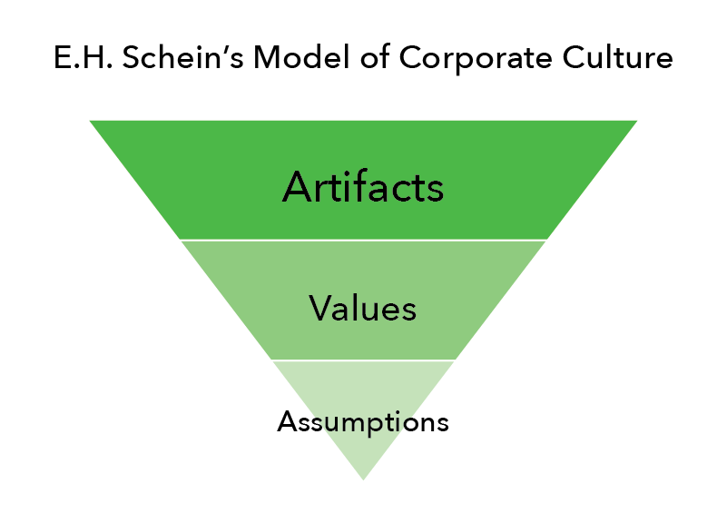
Levels of Corporate Culture
E.H. Schein- theorist who studies corporate culture- wrote book titled Organizational Culture and Leadership- three levels of corporate culture
At core- basic assumptions about human behavior
Surrounding core- values drawn from assumptions- standards, rules
Surface level- ”artifacts”- outcome of assumptions and values (actions, policies, physical environment, office jokes, etc.

Slide 12
Practice Question 1
What is meant by “Assumptions” in the levels of corporate cultures?
Beliefs regarding basic traits of employees.
Beliefs regarding work ethic of employees.
Beliefs regarding the honesty of employees.
Beliefs regarding appropriate work/life balance of employees.

Slide 13
Key Dimensions of Organizational Culture

Slide 14
Learning Outcomes: Key Dimensions of Organizational Culture
9.2: Identify key dimensions of organizational culture
9.2.1: Discuss seven dimensions of culture in the Organizational Culture Profile

Slide 15
Exploring Key Dimensions of Organizational Culture
Detail-oriented- meticulous attention to details
Ritz Carlton hotels
Innovative- individuals who want opportunities to invent new products
GORE-TEX or Google
Aggressive- value of competition
Microsoft
Outcome-oriented- all about results
Best Buy
Stable- knowing who is charge, who to report to, and what to accomplish
Kraft Foods
People-oriented- expect the company to care about you- value of fairness
Starbucks
Team-oriented- employees who like to collaborate & cooperate with team
Southwest Airlines

Slide 16
Influences on Organizational Culture

Slide 17
Learning Outcomes: Influences on Organizational Culture
9.3: Identify the main influences on organizational culture, and explain how culture is maintained
9.3.1: Discuss the sources of culture in an organization
9.3.2: Explain the methods for maintaining a culture
9.3.3: List the visible signs of culture

Slide 18
Influences on Organizational Culture Sources of Culture
Founders
Have a vision for their new company which helps form corporate culture
Some founders have strong personalities and values that company reflects goals upon
Examples: Walt Disney, Ben and Jerry’s Ice Cream
Industry
Industries that are built around regulations and policies that can’t be changed and industries that are creative, innovative, and fun

Slide 19
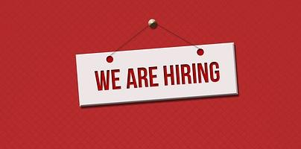
Methods for Maintaining Corporate Culture
Recruiting- finding employees who will fit into corporate culture
Hiring- assessing candidate’s assumptions and values
Onboarding- new employee orientation process- teach company policies
Training- formal and informal (technology or changes, depending on job)

Slide 20
Practice Question 2
Which of the following are NOT a method for maintaining corporate culture:
Onboarding.
Hiring.
Training.
Incenting.

Slide 21
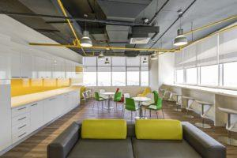
Visible Signs of Culture
When you walk into a business setting, you should be able to see visible signs of business’s organizational culture
Few things to watch out for:
How employees dress
Snack areas/candy jars
Plaques and awards
Mission statement
Events and rituals
Physical layout and décor

Slide 22
Cultural Change

Slide 23
Learning Outcomes: Cultural Change
9.4: Describe the key techniques for initiating and fostering cultural change
9.4.1: Describe key techniques for initiating cultural change (sense of urgency, role modeling, changing leaders)
9.4.2: Describe key techniques for fostering cultural change (training, reward systems, and new stories and symbols)

Slide 24
Initiating and Managing Cultural Change
Initiating
Create sense of urgency
Role modeling
Changing leaders
Managing
Excellent communication
Changing leaders who present barriers to change
Training programs
Changing reward systems and corporate symbols
Changing look and feel of the workplace

Slide 25
Class Activity: Initiating and Managing Cultural Change
Break into small groups. Review the corporate culture attributes of Google and Apple from slides 7-9.
Which of these corporate cultures would you prefer to be a part of?
If you were the CEO of a startup, and wanted to develop a corporate culture similar to your choice, what steps would you follow to do so?

Slide 26
Employee Diversity

Slide 27
Learning Outcomes: Employee Diversity
9.5: Identify the advantages and challenges of employee diversity within organizations
9.5.1: Explain the concept of diversity within organizations
9.5.2: Explain the advantages of employee diversity within organizations
9.5.3: Explain the challenges of employee diversity within organizations

Slide 28
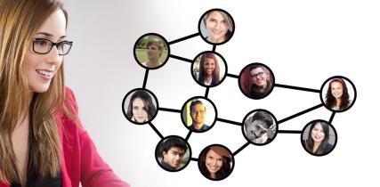
Employee Diversity: What Is It?
Diversity is now required by law and is a recommended strategy
Long-term strategy- broader meaning which adds personality, cognitive style, education, background, and more
Diversity in workplace isn’t easy to achieve
Explosive growth in global trade means large companies grew in diversity

Slide 29
Advantages and Challenges of Employee Diversity
Advantages
Challenges
Builds resilience
Permits system to evolve and learn from experience
Enhances creativity
Enhances image
Improves outreach
Improves morale
Differences in culture
Work styles can vary from culture to culture
Management: top leadership technically white and male and lower level is usually female and nonwhite

Slide 30
Quick Review
Can you define culture for a business?
How can culture be a competitive advantage for a business?
What are the levels of culture?
Can you effectively discuss the seven dimensions of culture in the Organizational Culture Profile?
What are some key techniques for initiating cultural change? For fostering cultural change?
What is the concept of diversity within organizations?
What are the advantages of employee diversity within organizations?
Can you explain the challenges of employee diversity within organizations?

