Slide 1
7
Application: International Trade

Slide 2
What determines whether a country imports or exports a good?

Slide 3
Who gains and who loses from free trade among countries?

Slide 4
What are the arguments that people use to advocate trade restrictions?

Slide 5
THE DETERMINANTS OF TRADE
Equilibrium Without Trade
  Assume:
    A country is isolated from rest of the world and produces steel.
    The market for steel consists of the buyers and sellers in the country.
    No one in the country is allowed to import or export steel.

Slide 6

Figure 1The Equilibrium without International Trade
Price
of Steel
Domestic
supply
Consumer
surplus
Equilibrium
price
Producer
surplus
Domestic
demand
0
Equilibrium
Quantity
quantity
of Steel
Copyright © 2004 South-Western

Slide 7
The Equilibrium Without International Trade
Equilibrium Without Trade
  Results:
    Domestic price adjusts to balance demand and supply.
    The sum of consumer and producer surplus measures the total benefits that buyers and sellers receive.

Slide 8
The World Price and Comparative Advantage
If the country decides to engage in international trade, will it be an importer or exporter of steel?

Slide 9
The World Price and Comparative Advantage
The effects of free trade can be shown by comparing the domestic price of a good without trade and the world price of the good. The world price refers to the price that prevails in the world market for that good.

Slide 10
The World Price and Comparative Advantage
If a country has a comparative advantage, then the domestic price will be below the world price, and the country will be an exporter of the good.

Slide 11
The World Price and Comparative Advantage
If the country does not have a comparative advantage, then the domestic price will be higher than the world price, and the country will be an importer of the good.

Slide 12
Figure 2 International Trade in an Exporting Country
Price
of Steel
Price
Domestic
after
supply
trade
World
price
Price
before
trade
Domestic
Exports
demand
0
Domestic
Domestic
Quantity
quantity
quantity
of Steel
demanded
supplied
Copyright © 2004 South-Western

Slide 13
Figure 3 How Free Trade Affects Welfare in an Exporting Country
Price
of Steel
Domestic
Price
supply
after
A
Exports
trade
World
B
D
price
Price
before
C
trade
Domestic
demand
0
Quantity
of Steel
Copyright © 2004 South-Western

Slide 14
Figure 3 How Free Trade Affects Welfare in an Exporting Country
Price
of Steel
Consumer surplus
before trade
Domestic
Price
supply
after
A
Exports
trade
World
B
D
price
Price
before
C
trade
Producer surplus
before trade
Domestic
demand
0
Quantity
of Steel
Copyright © 2004 South-Western

Slide 15
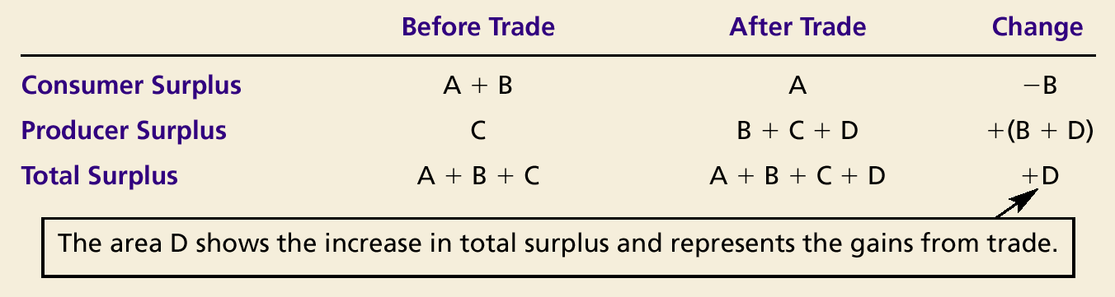
How Free Trade Affects Welfare in an Exporting Country

Slide 16
THE WINNERS AND LOSERS FROM TRADE
The analysis of an exporting country yields two conclusions:
  Domestic producers of the good are better off, and domestic consumers of the good are worse off.
  Trade raises the economic well-being of the nation as a whole.

Slide 17
The Gains and Losses of an Importing Country
International Trade in an Importing Country
  If the world price of steel is lower than the domestic price, the country will be an importer of steel when trade is permitted.
  Domestic consumers will want to buy steel at the lower world price.
  Domestic producers of steel will have to lower their output because the domestic price moves to the world price.

Slide 18
Figure 4 International Trade in an Importing Country
Price
of Steel
Domestic
supply
Price
before
trade
Price
World
after
price
trade
Domestic
Imports
demand
0
Domestic
Domestic
Quantity
quantity
quantity
of Steel
supplied
demanded
Copyright © 2004 South-Western

Slide 19
Figure 5 How Free Trade Affects Welfare in an Importing Country
Price
of Steel
Domestic
supply
A
Price
before trade
B
D
Price
World
after trade
C
price
Imports
Domestic
demand
0
Quantity
of Steel
Copyright © 2004 South-Western

Slide 20
Figure 5 How Free Trade Affects Welfare in an Importing Country
Price
of Steel
Consumer surplus
before trade
Domestic
supply
A
Price
before trade
B
Price
World
after trade
C
price
Producer surplus
before trade
Domestic
demand
0
Quantity
of Steel
Copyright © 2004 South-Western

Slide 21
Figure 5 How Free Trade Affects Welfare in an Importing Country
Price
of Steel
Consumer surplus
after trade
Domestic
supply
A
Price
before trade
B
D
Price
World
after trade
C
price
Imports
Producer surplus
after trade
Domestic
demand
0
Quantity
of Steel
Copyright © 2004 South-Western

Slide 22
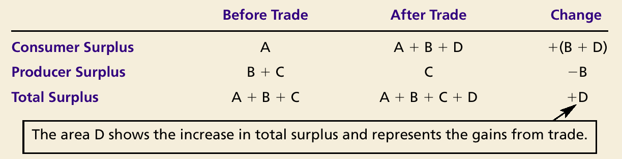
How Free Trade Affects Welfare in an Importing Country

Slide 23
THE WINNERS AND LOSERS FROM TRADE
How Free Trade Affects Welfare in an Importing Country
  The analysis of an importing country yields two conclusions:
    Domestic producers of the good are worse off, and domestic consumers of the good are better off.
    Trade raises the economic well-being of the nation as a whole because the gains of consumers exceed the losses of producers.

Slide 24
THE WINNERS AND LOSERS FROM TRADE
The gains of the winners exceed the losses of the losers.
The net change in total
surplus is positive.

Slide 25
The Effects of a Tariff
A tariff is a tax on goods produced abroad and sold domestically.
Tariffs raise the price of imported goods above the world price by the amount of the tariff.

Slide 26
Figure 6 The Effects of a Tariff
Price
of Steel
Domestic
supply
Equilibrium
without trade
Price
with tariff
Tariff
Price
World
without tariff
Imports
price
with tariff
Domestic
demand
0
Q
S
Q
S
Q
D
Q
D
Quantity
of Steel
Imports
without tariff
Copyright © 2004 South-Western

Slide 27
Figure 6 The Effects of a Tariff
Price
of Steel
Consumer surplus
before tariff
Domestic
supply
Producer surplus
before tariff
Equilibrium
without trade
Price
World
without tariff
price
Domestic
demand
0
Q
S
Q
D
Quantity
of Steel
Imports
without tariff
Copyright © 2004 South-Western

Slide 28
Figure 6 The Effects of a Tariff
Price
of Steel
Consumer surplus
with tariff
Domestic
supply
A
Equilibrium
without trade
B
Price
with tariff
Tariff
Price
World
without tariff
Imports
price
with tariff
Domestic
demand
0
Q
S
Q
S
Q
D
Q
D
Quantity
of Steel
Imports
without tariff
Copyright © 2004 South-Western

Slide 29
Figure 6 The Effects of a Tariff
Price
of Steel
Domestic
supply
Producer surplus
after tariff
Equilibrium
without trade
Price
with tariff
C
Tariff
Price
World
without tariff
G
Imports
price
with tariff
Domestic
demand
0
Q
S
Q
S
Q
D
Q
D
Quantity
of Steel
Imports
without tariff
Copyright © 2004 South-Western

Slide 30
Figure 6 The Effects of a Tariff
Price
of Steel
Domestic
supply
Tariff Revenue
Price
with tariff
Tariff
Price
E
World
without tariff
Imports
price
with tariff
Domestic
demand
0
Q
S
Q
S
Q
D
Q
D
Quantity
of Steel
Imports
without tariff
Copyright © 2004 South-Western

Slide 31
Figure 6 The Effects of a Tariff
Price
of Steel
Domestic
supply
A
Deadweight Loss
B
Price
with tariff
C
Tariff
Price
D
E
F
World
without tariff
G
Imports
price
with tariff
Domestic
demand
0
Q
S
Q
S
Q
D
Q
D
Quantity
of Steel
Imports
without tariff
Copyright © 2004 South-Western

Slide 32
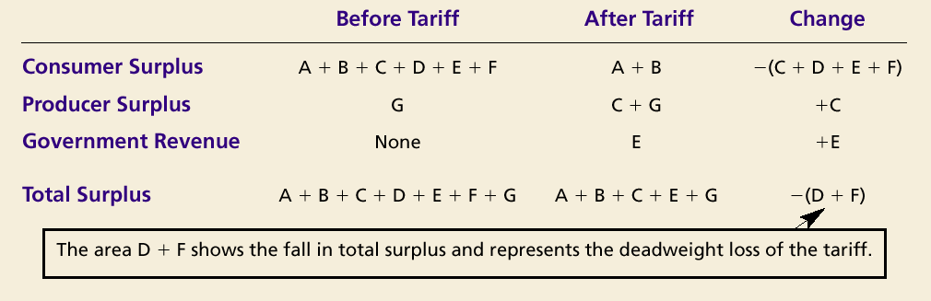
The Effects of a Tariff

Slide 33
The Effects of a Tariff
A tariff reduces the quantity of imports and moves the domestic market closer to its equilibrium without trade.
With a tariff, total surplus in the market decreases by an amount referred to as a deadweight loss.

Slide 34
The Effects of an Import Quota
An import quota is a limit on the quantity of a good that can be produced abroad and sold domestically.

Slide 35
Figure 7 The Effects of an Import Quota
Price
of Steel
Domestic
supply
Equilibrium
without trade
Quota
Domestic
supply
+
Isolandian
Import supply
price with
Equilibrium
quota
with quota
Price
World
World
without
=
price
price
quota
Imports
Domestic
with quota
demand
0
Q
S
Q
S
Q
D
Q
D
Quantity
of Steel
Imports
without quota
Copyright © 2004 South-Western

Slide 36
The Effects of an Import Quota
Because the quota raises the domestic price above the world price, domestic buyers of the good are worse off, and domestic sellers of the good are better off.
License holders are better off because they make a profit from buying at the world price and selling at the higher domestic price.

Slide 37
Figure 7 The Effects of an Import Quota
Price
of Steel
Domestic
supply
Equilibrium
without trade
Quota
Domestic
A
supply
+
Isolandian
Import supply
price with
B
quota
Equilibrium
with quota
C
D
E'
F
Price
World
E"
World
without
=
price
G
price
quota
Imports
Domestic
with quota
demand
0
Q
S
Q
S
Q
D
Q
D
Quantity
of Steel
Imports
without quota
Copyright © 2004 South-Western

Slide 38
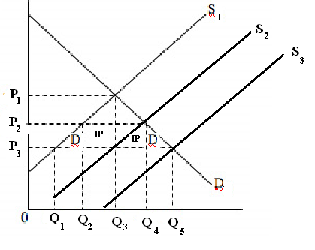
Quota – limit on quantity of imports
Steel Market
No trade – market is at equilibrium at P1 & Q3
If US opens up trade but puts a quota in place makes the US produce at Q2 and efficiency loss areas “D.” Import producer gets extra profits “IP” and the US imports Q2 to Q4.
Eliminate quota price falls to P3. US produces at Q1 and imports Q5 – Q1.
P1 – price in US no trade
P2 – Price in US, trade plus
quota
P3 – World price

Slide 39
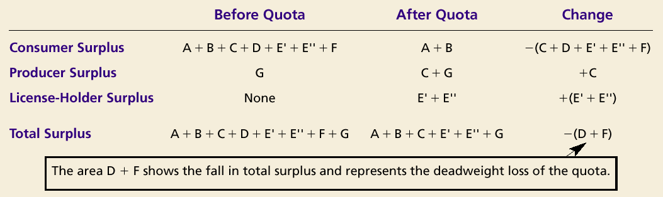
The Effects of an Import Quota

Slide 40
The Effects of an Import Quota
With a quota, total surplus in the market decreases by an amount referred to as a deadweight loss.
The quota can potentially cause an even larger deadweight loss, if a mechanism such as lobbying is employed to allocate the import licenses.

Slide 41
The Lessons for Trade Policy
If government sells import licenses for full value, revenue equals that of an equivalent tariff and the results of tariffs and quotas are identical.

Slide 42
The Lessons for Trade Policy
Both tariffs and import quotas . . .
  raise domestic prices.
  reduce the welfare of domestic consumers.
  increase the welfare of domestic producers.
  cause deadweight losses.

Slide 43
The Lessons for Trade Policy
Other Benefits of International Trade
  Increased variety of goods
  Lower costs through economies of scale
  Increased competition
  Enhanced flow of ideas

Slide 44
THE ARGUMENTS FOR RESTRICTING TRADE
Jobs
National Security
Infant Industry
Unfair Competition
Protection-as-a-Bargaining Chip

Slide 45
CASE STUDY: Trade Agreements and the World Trade Organization
Unilateral: when a country removes its trade restrictions on its own.
Multilateral: a country reduces its trade restrictions while other countries do the same.

Slide 46
CASE STUDY: Trade Agreements and the World Trade Organization
NAFTA
  The North American Free Trade Agreement (NAFTA) is an example of a multilateral trade agreement.
  In 1993, NAFTA lowered the trade barriers among the United States, Mexico, and Canada.

Slide 47
CASE STUDY: Trade Agreements and the World Trade Organization
GATT
  The General Agreement on Tariffs and Trade (GATT) refers to a continuing series of negotiations among many of the world’s countries with a goal of promoting free trade.
  GATT has successfully reduced the average tariff among member countries from about 40 percent after WWII to about 5 percent today.

Slide 48
Summary
The effects of free trade can be determined by comparing the domestic price without trade to the world price.
  A low domestic price indicates that the country has a comparative advantage in producing the good and that the country will become an exporter.
  A high domestic price indicates that the rest of the world has a comparative advantage in producing the good and that the country will become an importer.

Slide 49
Summary
When a country allows trade and becomes an exporter of a good, producers of the good are better off, and consumers of the good are worse off.
When a country allows trade and becomes an importer of a good, consumers of the good are better off, and producers are worse off.

Slide 50
Summary
A tariff—a tax on imports—moves a market closer to the equilibrium than would exist without trade, and therefore reduces the gains from trade.
Import quotas will have effects similar to those of tariffs.

Slide 51
Summary
There are various arguments for restricting trade: protecting jobs, defending national security, helping infant industries, preventing unfair competition, and responding to foreign trade restrictions.
Economists, however, believe that free trade is usually the better policy.

