Slide 1
Principles of Management
Module 5: Decision Making

Slide 2
Module Learning Outcomes
Explain the process and techniques of individual and group decision-making
5.1: Describe the barriers to individual decision-making and common styles of decision-making
5.2: Explain the concept of “rational decision making” and contrast it with prospect theory, bounded rationality, heuristics, and robust decisions
5.3: Explain evidence-based decision making and its tools
5.4: Describe the components and use of a decision tree
5.5: Explain common techniques used to manage group decision making

Slide 3
Barriers to Individual Decision Making and Styles of Decision Making

Slide 4
Learning Outcomes: Barriers to Individual Decision Making and Styles of Decision Making
5.1: Describe the barriers to individual decision-making and common styles of decision-making
5.1.1: Describe the barriers to decision making
5.1.2: Identify common styles of decision making

Slide 5
The Decision Making Process: Information-Related Barriers
When information is either incorrect or incomplete
Uncertainty is introduced and any decision made can be misguided
When too much information is available
Difficult to grasp big picture and recognize important information
Creates an inability to process everything to decision maker’s satisfaction

Slide 6
The Decision Making Process: Circumstance and Time Related Barriers
Stress from personal life
May be less objective or disciplined in following decision-making process
Provides an opportunity to intentionally protect against those tendencies
Time
When decision makers feel rushed, their judgement often suffers
It is important to commit to taking enough time for decisions.

Slide 7
The Decision Making Process: Cognitive Biases
Confirmation Bias: information that we believe will confirm our own judgement
Framing Bias: influenced by the way that a situation or problem is presented
Hindsight Bias: believe falsely we would have accurately predicted the outcome of an event after it is actually known
Anchoring: focus on initial information and then failing to adjust to later information
Halo Effect: initial attitude that we have toward certain individuals/ organizations
Overconfidence Bias: individual decision maker trusts own judgement and allows it to override judgement of others
Status-Quo Bias: prefer to avoid change and maintain status-quo
Pro-Innovation Bias: giving preference to any new and innovative ideas simply because it presents something new

Slide 8
Rational Decision Making vs. Other Types of Decision Making

Slide 9
Learning Outcomes: Rational Decision Making vs. Other Types of Decision Making
5.2: Explain the concept of “rational decision making” and contrast it with prospect theory, bounded rationality, heuristics, and robust decisions
5.2.1: Summarize the steps in the rational decision-making process
5.2.2: Differentiate between prospect theory, bounded rationality, heuristics, and robust decisions

Slide 10
Common Styles of Decision Making
Satisficing
a combination of the words “satisfy” and “suffice”
means settling for a less-than-perfect solution when working with limited information
Optimizing
involves collecting as much data as possible and trying to find the optimal choice
Intuitive
subconscious mind is automatic, rapidly consolidating data and producing a decision almost immediately
Rational
conscious mind requires more effort using logic and reason

Slide 11
Combinatorial vs. Positional Decision Making
Combinatorial decision-making approach
has a final outcome in mind, making a series of moves that try to link the initial position with the final outcome in a firm, narrow, and more certain way.
Positional decision-making approach
is “looser”
sets up strong positions on the board and preparing to react to the opponent.
using this strategy increases flexibility, creating options as opposed to forcing a single sequence.

Slide 12
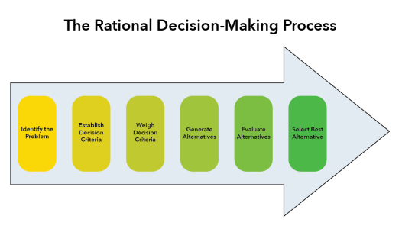
Rational Decision Making
Step 1: Identify Problem
Step 2: Establish Decision Criteria
Step 3: Weigh Decision Criteria
Step 4: Generate Alternatives
Step 5: Evaluate Alternatives
Step 6: Select the Best Alternative

Slide 13
Data, Logic, and Facts
Rational decision making is defined not only by adherence to a careful process, but also by a logical, data-driven manner of following the steps of that process.
In the evaluation stage, the process usually requires numeric values.
If they are not fully weighted, the final analysis will lean toward whatever is easiest to measure.
In a company, the final decision usually belongs to an executive, who takes the analysis as a guide but makes his own decision.

Slide 14
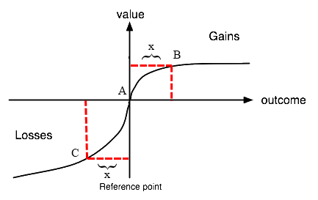
Rational Decision Making (cont.)
Prospect Theory
from field of behavioral economics
is a complex analysis of how individuals make decisions when there is risk involved
is a description of how people made actual decisions in experiments.
It doesn’t say whether this is right or wrong. It is in the hands of decision makers to determine whether these tendencies are justifiable or if they should be overridden by a rational approach.

Slide 15
Bounded Reality
A recognition that human knowledge and capabilities are limited and imperfect
Decision makers
do not have access to all possible information relevant to the decision, and the information they do have is often flawed and imperfect.
have limited analytical and computational abilities.
are not capable of judging their information and alternatives perfectly. inevitably make misjudgments in the evaluation process.
have unlimited time to make decisions.
real-life situations provide time constraints in which decisions must be made.

Slide 16
Heuristics and Robust Decisions
Heuristics:
One of the approaches that might stem from a recognition of bounded rationality is the use of heuristics.
These are analytical and decision-making tools that help simplify the analysis process by relying on tried and tested rules of thumb.
A heuristic simplifies a complex situation and allows the decision maker to focus only on the most important pieces of information.
Robust Decisions:
revolve around the inability to predict the future with certainty. Rather than rely on an imperfect analysis to determine the “best” decision, a robust decision provides a plan that will work in light of numerous uncertainties.

Slide 17
Class Discussion: Why Decision Making Theories?
Why is it important to learn the theories behind decision making? Why does it matter to you as a future leader?

Slide 18
Evidence-Based Decision Making

Slide 19
Learning Outcomes: Evidence-Based Decision Making
5.3: Explain evidence-based decision making and its tools
5.3.1: Explain evidence-based decision making
5.3.2: Explain the uses of descriptive and predictive analytics

Slide 20
Evidence Based Decision Making
An evidence-based approach asks a key question: Has such a course of action been proven to be effective for others in similar situations?
Even if the data itself is reliable, how that data is used remains a key consideration.
Proof of Success: relying on actual experimentation to demonstrate likelihood of success

Slide 21
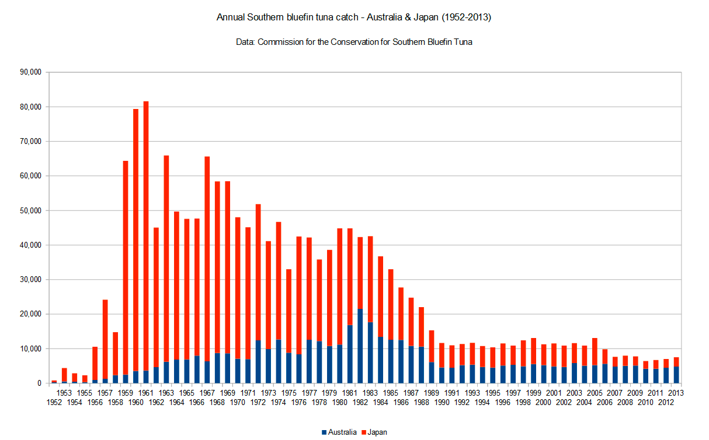
Descriptive and Predictive Analysis
Descriptive
Goal is to understand and describe what has taken place as revealed by data sets
Attempts to explain what data reveals about events that have occurred
Daunting task to accomplish
Predictive
Projecting future trends
Subjected to discipline of evidence-based principles

Slide 22
Practice Question 1
In 2015, Walmart’s revenue fell for the first time in Walmart’s 45-year run as a public company. Shoppers were fed up. They complained of dirty bathrooms, empty shelves, endless checkout lines, and impossible-to-find employees. Only 16 percent of stores were meeting the company’s customer service goals. Walmart decided to conduct an experiment. with heresy! They would raised wages, increased training, and provided employees with give more consistent regular schedules. Early tests showed a strong positive response from customers. By early 2016, the proportion of stores hitting their targeted customer-service ratings had rebounded to 75 percent. Sales were rising again! Walmart executives switched from the norm—cutting costs—to
evidence-based decision making
Rational decision making
Heuristics

Slide 23
Using a Decision Tree

Slide 24
Learning Outcomes: Using a Decision Tree
5.4: Describe the components and use of a decision tree
5.4.1: Describe the components and use of a decision tree

Slide 25
The Decision Tree
Useful tools for situations where financial data and probability of outcomes are relatively reliable
Tree starts with decision node, which decision should be made
A branch is created for each choice and along branch there are decision pathways
Uncertainty node is sometimes added, but eventually each pathway reaches final outcome
Each division involves costs, probability of each outcome, and calculations about return value

Slide 26
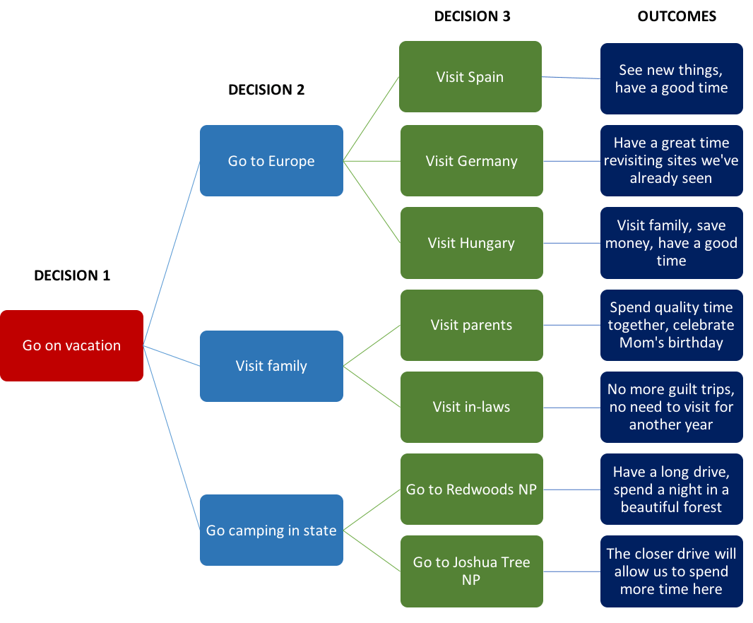
Figure: Using a Decision Tree

Slide 27
Practice Question 2
Happy Socks sells high-quality socks online. Potential customers go through a three-step process online to complete a sale. First, they find Happy Socks, usually through advertising—a Google ad, for example. Customers decide to click on the ad or not. Second, they search for socks they may like and decide to put something in their “cart” or not. Finally, they decide to complete the transaction or not. Happy Socks can invest more in advertising, or in its online store, or in speeding up its checkout process. If Happy Socks wanted to use a decision tree to help them decide where to invest, each of these steps in the customer’s journey would be?
an outcomes
a pathway
a decision mode

Slide 28
Managing Group Decision Making

Slide 29
Learning Outcomes: Managing Group Decision Making
5.5: Explain common techniques used to manage group decision making
5.5.1: Identify the advantages of group decision making
5.5.2: Identify the disadvantages of group decision making
5.5.3: Describe techniques managers can use to guide and reach consensus in groups

Slide 30
Understanding Managing Group Decision Making
Advantages
Sum of knowledge, skills, and creativity in group setting will always be greater than that of individuals
Increased understanding of the issue and decision amongst team members
Disadvantages
Slower process and more expensive
Tendency for group members to support a proposed group position
Decisions may move toward extremes

Slide 31
Ways to Facilitate Group Decision Making
Brainstorming: builds group’s cohesiveness due to encouragement to contribute
Group techniques:
Write ideas on how to solve problem
Each member presents ideas
Group engages in discussion
Members rank-order ideas
Alleviates fear of criticism
Devil’s advocacy or Delphi technique

Slide 32
Group Decision Making Wrap Up
Decisions decided through consensus
Balance strengths and weaknesses
Must keep discussion on topic
Effective group leader will find system that works best for each particular group and setting
Must be prepared to diffuse any issues and bring group back on track

Slide 33
Class Activity: Group Decision Making
An effective group leader will find the system that works best for each particular group and setting. If at any point interpersonal conflict or tension arises, the group leader must be prepared with a plan to diffuse the situation and bring the group back to productive cooperation.
Break into groups and create a simulation of one of the group decision-making techniques. Create a problem to be solved with as much detail as time permits. Each group must select a different technique. Exchange the simulations created between groups and have each group appoint a facilitator to run the simulation. Take notes of the number of ideas generated and the quality of those ideas, and present a retrospective to the class of your experience.

Slide 34
Present: Group Decision Making

Slide 35
Quick Review
Describe the barriers to decision making
Summarize the steps in the rational decision-making process
Differentiate between prospect theory, bounded rationality, heuristics, and robust decisions
Explain evidence-based decision making
Explain the uses of descriptive and predictive analysis
Describe the components and use of a decision tree
Identify the advantages/disadvantages of group decision making
Describe the techniques used to guide and reach consensus

