Slide 1
Principles of Management
Module 3: Planning and Mission

Slide 2
Module Learning Outcomes
Explain how managers align the planning process with company mission, vision, and values
3.1: Distinguish between mission, vision, and values
3.2: Explain the pros and cons of planning
3.3: Explain the stages of the planning cycle
3.4: List and describe the types of plans and common planning tools

Slide 3
Mission, Vision, and Values

Slide 4
Learning Outcomes: Mission, Vision, and Values
3.1: Distinguish between mission, vision, and values
3.1.1: Distinguish between mission and vision in business
3.1.2: Explain how a values statement can support the goals of an organization

Slide 5
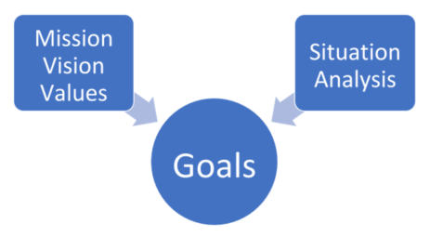
Understanding Mission
Mission Statement
describes what organization needs to do to achieve vision
will be more specific than vision statement
conveys to stakeholders why the organization exists
explains how it creates value for the market or the larger community

Slide 6
Understanding Vision
Vision Statement
is a statement of organization’s overarching aspirations of what it hopes to achieve
should inspire people
motivate people to want to be part of and contribute to the organization.
should be clear and concise, usually not longer than a short paragraph

Slide 7
Understanding Values
Values Statement
defines what organization believes in
describes how people should behave
must be reinforced at all levels of organization
called the “code of ethics”
provides a standard for employees to judge violations.

Slide 8
Practice Question 1
In his groundbreaking book, “The Lean Startup”, Eric Ries discusses the concept of “true north” as it relates to planning. The true north concept is an attempt to define an organization’s ultimate destination.
True north would be an example of which of these:
Mission
Vision
Values
Notes:
Correct answer is Vision.

Slide 9
Class Activity: Mission, Vision, and Values
Compare and contrast the definitions of mission, vision, and values statements. List similarities and differences of the three statements.
In addition, find examples from the same industry, such as sports clothing, music, or another type product, using the definitions in the text. What do the businesses have in common with their statements? How do they differ?

Slide 10
Present: Mission, Vision, and Values

Slide 11
Pros and Cons of Planning

Slide 12
Learning Outcomes: Pros and Cons of Planning
3.2: Explain the pros and cons of planning
3.2.1: Explain benefits of planning
3.2.2: Explain the drawbacks of planning

Slide 13
Understanding Pros and Cons of Planning
Pros of Planning
Cons of Planning
Provides a guide for action
Improves resource utilization
Provides motivation and commitment
Sets performance standards
Allows flexibility
Prevents action
Leads to complacency
Prevents flexibility
Inhibits creativity

Slide 14
Class Discussion: Planning
If having a good plan can lead managers to believe they know where the organization is going and how it will get there, then how may this mindset cause them to fail to monitor the progress of the plan or to detect changes in the environment?

Slide 15
The Planning Cycle

Slide 16
Learning Outcomes: The Planning Cycle
3.3: Explain the stages of the planning cycle
3.3.1: Explain the stages of the planning cycle
3.3.2: Explain why the planning cycle is an essential part of running a business

Slide 17
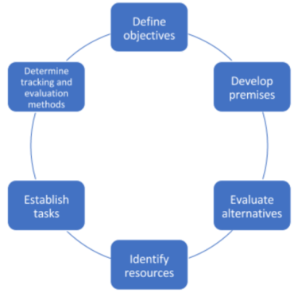
Six Stages of the Planning Cycle
Define objectives
Develop premises
Evaluate alternatives
Identify resources
Plan and implement tasks
Determine tracking and evaluation methods

Slide 18
Essential Aspects of the Planning Cycle
Maintaining organizational focus
Defining specific goals to consider the vision, mission, and values of the organization
Encouraging diverse participation
Provides opportunity for input
Establish planning committees that intentionally include people from diverse backgrounds
Empowering and motivating employees
Empowers people to contribute
Motivates them to support outcomes

Slide 19
Class Activity: What is an Iterative Process?
Organizations have goals they want to achieve, so they must consider the best way of reaching their goals and must decide the specific steps to be taken. However, this is not a linear, step-by-step process. It is an iterative process with each step reconsidered as more information is gathered. As organizations go through the planning, they may realize that a different approach is better and go back to start again.
What does the phrase “iterative process” mean? In your own words, explain how this phrase connects to the six stages of the planning cycle.

Slide 20
Present: What is an Iterative Process?

Slide 21
Types of Plans and Common Planning Tools

Slide 22
Learning Outcomes: Types of Plans and Common Planning Tools
3.4: List and describe the types of plans and common planning tools
3.4.1: Differentiate between the uses of long-term plans, short-term plans, and operational plans
3.4.2: Differentiate between standing plans and single-use plans
3.4.3: Explain how policies, procedures, and regulations impact operational plans
3.4.4: Explain the role budgets in the planning process
3.4.5: Differentiate between forecasting, scenario planning, and contingency planning
3.4.6: Explain the use of "management by objectives" (MBO), SMART goals, and benchmarking in planning

Slide 23
Types of Plans
Long term
Crucial to ultimate success
Top management responsible for these plans
Short term
Allocate resources for a year or less
must be monitored and updated
Standing Plans
Policies, procedures, and regulations
Single-use
One-time project or event (budgets, project schedules)

Slide 24
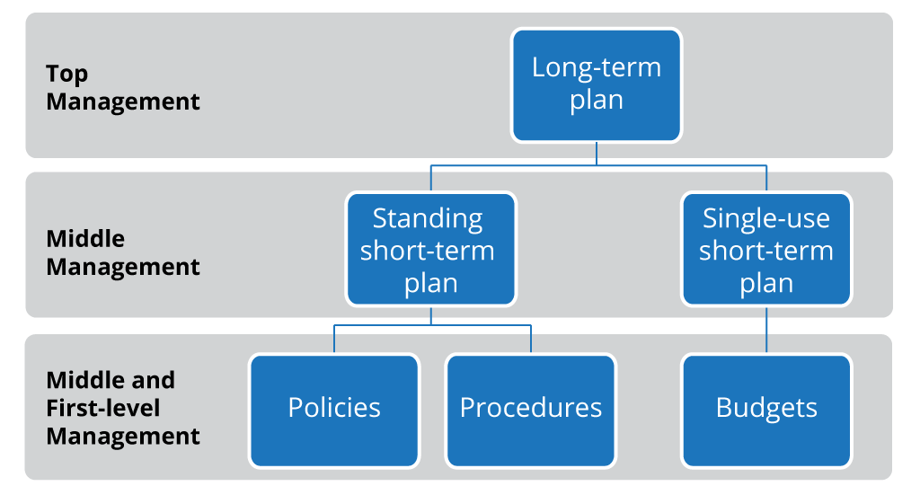
Policies, Procedures, and Regulations
Policies: broad guidelines for smooth operation- hiring and firing, promotions, etc.
Procedures: steps to be followed in established operations- reflect company policies and support long-term goals
Regulations: what is allowed and what is strictly prohibited= state and federal governments issue regulations often

Slide 25
Long-term and short-term goals
Watch the short animated video for a brief overview of the importance of long-term and short-term planning.
Long Term and Short Term Planning Animated

Slide 26
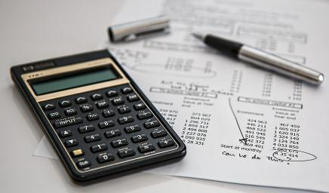
Role of Budgets in Planning Process
Single-use and short-term
Different budget types
Financial: balance sheets/expense statements
Operating: project revenue against expenditures
Nonmonetary: allocate resources such as labor and workspace
Fixed: do not change: sales revenue
Flexible: vary with level of activity

Slide 27
Role of Budgets in Planning Process (cont)
Important planning tool: going “over budget” is sign of poor planning.
In some cases, to routinely come in under budget is also viewed negatively, because with more accurate budgeting those committed resources could have been allocated to other projects.
Often, projects compete for limited resources so the best budget is the one that most closely projects actual expenses and revenue.

Slide 28
Forecasting, Scenario Planning, and Contingency Planning
Forecasting
Makes a prediction about future
Scientific forecasting is using mathematical models, historical data, and statistical analysis
Long-range forecasting requires both quantitative numerical data and qualitative data based on experts
Contingency plans
Describes what will happen in a possible—but not expected--situation
Used to handle emergency situations

Slide 29
Management By Objective and SMART Goals
Management By Objective (MBO)
Jointly set goals and objectives, plan tasks for employees, agree on standards for evaluating performance, meet to review progress often
SMART Goals
Provides incentives to employees, empowering them to set own objectives, honestly communication with workers
Specific, Measurable, Achievable, Relevant, Time-bound
Benchmarking: looing for performance levels outside organization
Industry, geography, organization, processes, innovation

Slide 30
Benchmarking
looks for performance levels outside your organization, and sometimes across departments
Industry
consider your competitors
Geography
Consider the regional economy
Organization
Consider the economic climate
Processes
May also be called “strategic benchmarking”
Innovation
Considers processes used by partners or competitors

Slide 31
Practice Question 2
Which of these benchmarking metrics would be most valuable to an organization:
Your competitors can produce their competing products for 25% less than your manufacturing costs.
Public corporations in your state are seeing growth rates of 15% year over year.
Analysts are forecasting a 10% degradation of consumer purchasing next year.
A review of annual reports reveals that the market leader has added a CRO (Chief Revenue Officer) to their stable of executives.
Industry consultants brief you that two new startups have entered the market and have streamlined their testing processes to half the normal time required.

Slide 32
Quick Review
Distinguish between a mission, a vision, and values
Explain the benefits and drawbacks of planning
Explain the stages of the planning cycle
List and describe the types of plans and common planning tools
Define MBOs, SMART GOALs, and Benchmarking

