Slide 1
11
Firms in Competitive Markets

Slide 2
WHAT IS A COMPETITIVE MARKET?
A perfectly competitive market has the following characteristics:
There are many buyers and sellers in the market.
The goods offered by the various sellers are largely the same, standardized products.
Firms can freely enter or exit the market, easy entry into and easy exit from market.
Price takers
No non-price competition (advertising)
Example: Agriculture

Slide 3
WHAT IS A COMPETITIVE MARKET?
As a result of its characteristics, the perfectly competitive market has the following outcomes:
The actions of any single buyer or seller in the market have a negligible impact on the market price.
Each buyer and seller takes the market price as given.

Slide 4
WHAT IS A COMPETITIVE MARKET?
A competitive market has many buyers and sellers trading identical products so that each buyer and seller is a price taker.
Buyers and sellers must accept the price determined by the market.

Slide 5
The Revenue of a Competitive Firm
Total revenue for a firm is the selling price times the quantity sold.
TR = (P × Q)
Total revenue is proportional to the amount of output.

Slide 6
The Revenue of a Competitive Firm
Average revenue tells us how much revenue a firm receives for the typical unit sold.
Average revenue is total revenue divided by the quantity sold.

Slide 7
The Revenue of a Competitive Firm
In perfect competition, average revenue equals the price of the good.

Slide 8
The Revenue of a Competitive Firm
Marginal revenue is the change in total revenue from an additional unit sold.
MR =ΔTR/ ΔQ
For competitive firms, marginal revenue equals the price of the good.

Slide 9
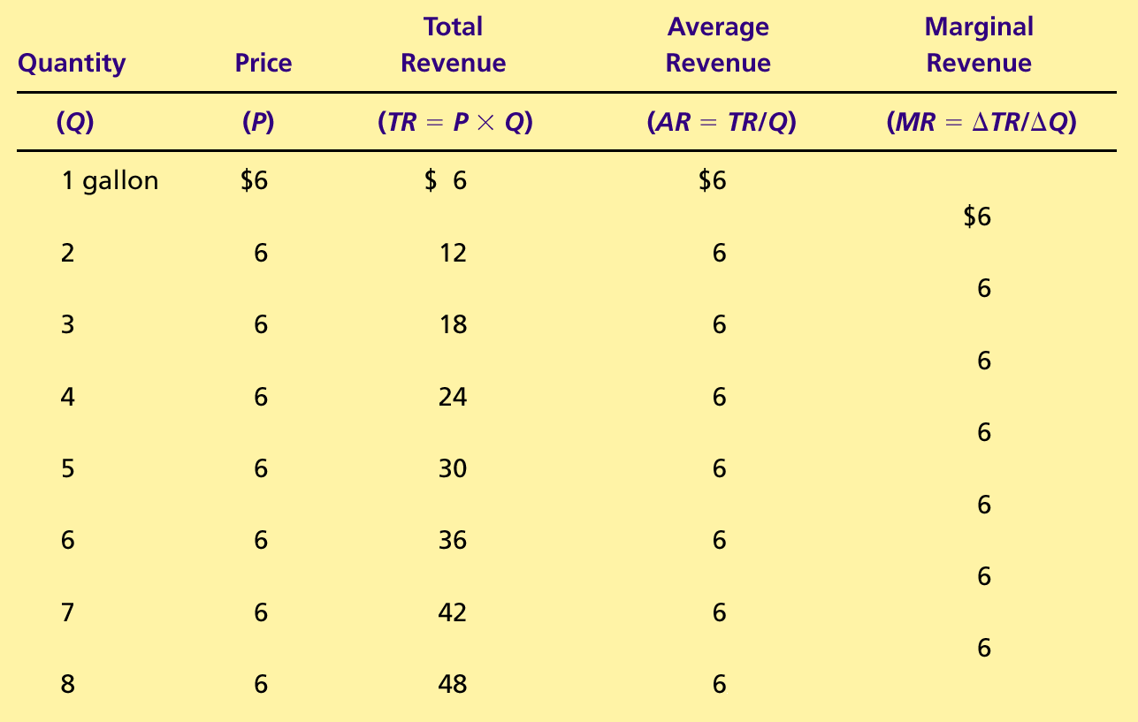
Table 1 Total, Average, and Marginal Revenue for a Competitive Firm
Copyright©2004 South-Western

Slide 10
PROFIT MAXIMIZATION AND THE COMPETITIVE FIRM’S SUPPLY CURVE
The goal of a competitive firm is to maximize profit.
This means that the firm will want to produce the quantity that maximizes the difference between total revenue and total cost.

Slide 11
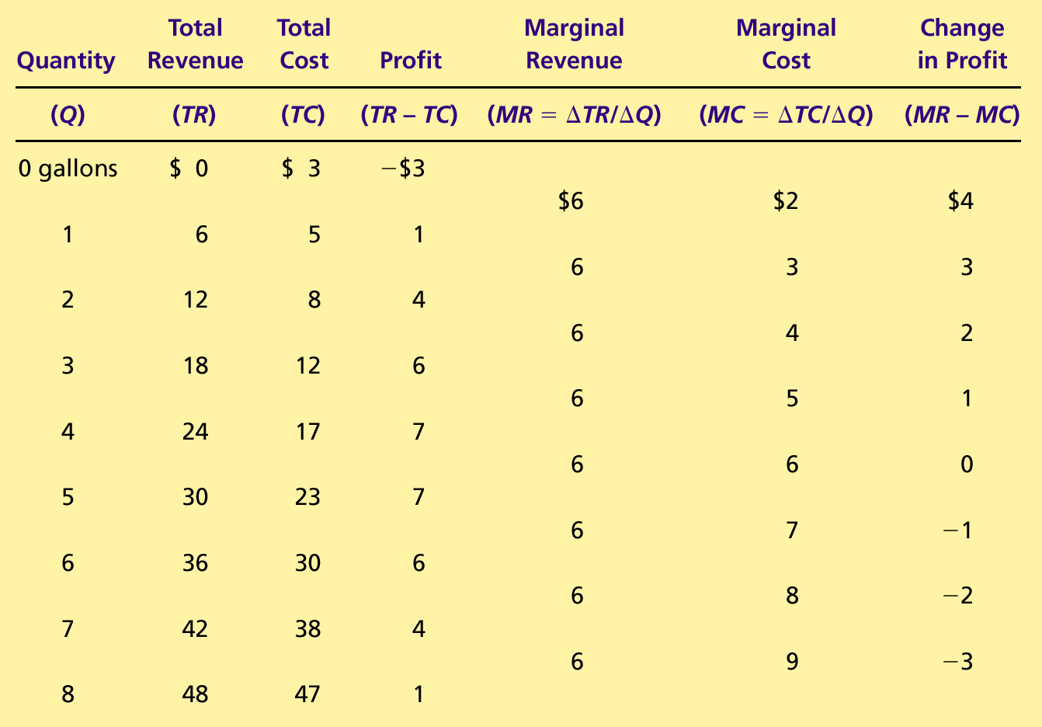
Table 2 Profit Maximization: A Numerical Example
Copyright©2004 South-Western

Slide 12
Figure 1 Profit Maximization for a Competitive Firm
Costs
and
The firm maximizes
Revenue
profit by producing
the quantity at which
marginal cost equals
MC
marginal revenue.
MC
2
ATC
P
=
MR
=
MR
P
=
AR
=
MR
=D
1
2
AVC
MC
1
0
Q
1
Q
MAX
Q
2
Quantity
Copyright © 2004 South-Western

Slide 13
PROFIT MAXIMIZATION AND THE COMPETITIVE FIRM’S SUPPLY CURVE
Profit maximization occurs at the quantity where marginal revenue equals marginal cost.

Slide 14
PROFIT MAXIMIZATION AND THE COMPETITIVE FIRM’S SUPPLY CURVE
When MR > MC increase Q
When MR < MC decrease Q
When MR = MC Profit is maximized.

Slide 15
Figure 2 Marginal Cost as the Competitive Firm’s Supply Curve
Price
This section of the
firm’s MC curve is
also the firm’s supply
curve.
MC
P
2
ATC
P
1
AVC
0
Q
1
Q
2
Quantity
Copyright © 2004 South-Western

Slide 16
The Firm’s Short-Run Decision to Shut Down
A shutdown refers to a short-run decision not to produce anything during a specific period of time because of current market conditions.
Exit refers to a long-run decision to leave the market.

Slide 17
The Firm’s Short-Run Decision to Shut Down
The firm considers its sunk costs when deciding to exit, but ignores them when deciding whether to shut down.
Sunk costs are costs that have already been committed and cannot be recovered.

Slide 18
The Firm’s Short-Run Decision to Shut Down
The firm shuts down if the revenue it gets from producing is less than the variable cost of production.
Shut down if TR < VC
Shut down if TR/Q < VC/Q
Shut down if P < AVC

Slide 19
Figure 3 The Competitive Firm’s Short Run Supply Curve
Costs
Firm
’
s short-run
If P > ATC, the firm will continue to produce at a profit.
supply curve
MC
ATC
If P > AVC, firm will continue to produce in the short run.
AVC
Firm
shuts
down if
P
<
AVC
0
Quantity
Copyright © 2004 South-Western

Slide 20
The Firm’s Short-Run Decision to Shut Down
The portion of the marginal-cost curve that lies above average variable cost is the competitive firm’s short-run supply curve.

Slide 21
The Firm’s Long-Run Decision to Exit or Enter a Market
In the long run, the firm exits if the revenue it would get from producing is less than its total cost.
Exit if TR < TC
Exit if TR/Q < TC/Q
Exit if P < ATC

Slide 22
The Firm’s Long-Run Decision to Exit or Enter a Market
A firm will enter the industry if such an action would be profitable.
Enter if TR > TC
Enter if TR/Q > TC/Q
Enter if P > ATC

Slide 23
Figure 4 The Competitive Firm’s Long-Run Supply Curve
Costs
Firm
’
s long-run
supply curve
MC = long-run S
Firm
enters if
P > ATC
ATC
Firm
exits if
P < ATC
0
Quantity
Copyright © 2004 South-Western

Slide 24
THE SUPPLY CURVE IN A COMPETITIVE MARKET
The competitive firm’s long-run supply curve is the portion of its marginal-cost curve that lies above average total cost.

Slide 25
Figure 4 The Competitive Firm’s Long-Run Supply Curve
Costs
MC
Firm
’
s long-run
supply curve
ATC
0
Quantity
Copyright © 2004 South-Western

Slide 26
THE SUPPLY CURVE IN A COMPETITIVE MARKET
Short-Run Supply Curve
The portion of its marginal cost curve that lies above average variable cost.
Long-Run Supply Curve
The marginal cost curve above the minimum point of its average total cost curve.

Slide 27
Figure 5 Profit as the Area between Price and Average Total Cost
(a) A Firm with Profits
Firms Enter
Price
MC
ATC
Profit
P
ATC
P
=
AR
=
MR
0
Q
Quantity
(profit-maximizing quantity)
Copyright © 2004 South-Western

Slide 28
Figure 5 Profit as the Area between Price and Average Total Cost
(b) A Firm with Losses
Firms exit
Price
MC
ATC
ATC
P
P
=
AR
=
MR
Loss
0
Q
Quantity
(loss-minimizing quantity)
Copyright © 2004 South-Western

Slide 29
THE SUPPLY CURVE IN A COMPETITIVE MARKET
Market supply equals the sum of the quantities supplied by the individual firms in the market.

Slide 30
The Short Run: Market Supply with a Fixed Number of Firms
For any given price, each firm supplies a quantity of output so that its marginal cost equals price.
The market supply curve reflects the individual firms’ marginal cost curves.

Slide 31
Figure 6 Market Supply with a Fixed Number of Firms
(a) Individual Firm Supply
(b) Market Supply
Price
Price
MC
Supply
$2.00
$2.00
1.00
1.00
0
100
200
Quantity (firm)
0
100,000
200,000
Quantity (market)
Copyright © 2004 South-Western

Slide 32
The Long Run: Market Supply with Entry and Exit
Firms will enter or exit the market until profit is driven to zero.
In the long run, price equals the minimum of average total cost.
The long-run market supply curve is horizontal at this price.

Slide 33
Figure 7 Market Supply with Entry and Exit
(a) Firm
’
s Zero-Profit Condition
(b) Market Supply
Price
Price
MC
ATC
P
= minimum
Supply
ATC
0
Quantity (firm)
0
Quantity (market)
Copyright © 2004 South-Western

Slide 34
The Long Run: Market Supply with Entry and Exit
At the end of the process of entry and exit, firms that remain must be making zero economic profit.
The process of entry and exit ends only when price and average total cost are driven to equality.
Long-run equilibrium must have firms operating at their efficient scale.

Slide 35
Why Do Competitive Firms Stay in Business If They Make Zero Profit?
Profit equals total revenue minus total cost.
Total cost includes all the opportunity costs of the firm.
In the zero-profit equilibrium, the firm’s revenue compensates the owners for the time and money they expend to keep the business going.

Slide 36
A Shift in Demand in the Short Run and Long Run
An increase in demand raises price and quantity in the short run.
Firms earn profits because price now exceeds average total cost.

Slide 37
Figure 8 An Increase in Demand in the Short Run and Long Run
(a) Initial Condition
Firm
Market
Price
Price
MC
ATC
Short-run supply,
S
1
A
P
1
P
1
Long-run
supply
Demand,
D
1
0
Quantity (firm)
0
Q
1
Quantity (market)

Slide 38
Figure 8 An Increase in Demand in the Short Run and Long Run
(b) Short-Run Response
Firm
Market
Price
Price
Profit
MC
ATC
S
1
P
P
B
2
2
A
P
1
P
1
Long-run
supply
D
2
D
1
0
Quantity (firm)
0
Q
1
Q
2
Quantity (market)
Copyright © 2004 South-Western

Slide 39
Figure 8 An Increase in Demand in the Short Run and Long Run
(c) Long-Run Response
Firm
Market
Price
Price
MC
ATC
S
1
P
B
S
2
2
A
C
P
1
P
1
Long-run
supply
D
2
D
1
0
Quantity (firm)
0
Q
1
Q
2
Q
3
Quantity (market)
Copyright © 2004 South-Western

Slide 40
Why the Long-Run Supply Curve Might Slope Upward
Some resources used in production may be available only in limited quantities.
Firms may have different costs.
Marginal Firm
The marginal firm is the firm that would exit the market if the price were any lower.

Slide 41
Summary
Because a competitive firm is a price taker, its revenue is proportional to the amount of output it produces.
The price of the good equals both the firm’s average revenue and its marginal revenue.

Slide 42
Summary
To maximize profit, a firm chooses the quantity of output such that marginal revenue equals marginal cost.
This is also the quantity at which price equals marginal cost.
Therefore, the firm’s marginal cost curve is its supply curve.

Slide 43
Summary
In the short run, when a firm cannot recover its fixed costs, the firm will choose to shut down temporarily if the price of the good is less than average variable cost.
In the long run, when the firm can recover both fixed and variable costs, it will choose to exit if the price is less than average total cost.

Slide 44
Summary
In a market with free entry and exit, profits are driven to zero in the long run and all firms produce at the efficient scale.
Changes in demand have different effects over different time horizons.
In the long run, the number of firms adjusts to drive the market back to the zero-profit equilibrium.

