Slide 1
Principles of Management
Module 1: Introduction to Management

Slide 2
Module Learning Outcomes
Describe the primary functions of management and the roles of managers.
1.1: Describe what management is
1.2: Explain the primary functions of management
1.3: Describe the primary types of managers and the roles they play
1.4: Explain the advantages that arise from managing people well

Slide 3
Management

Slide 4
Learning Outcomes: Management
1.1: Describe what management is
1.1.1: Describe what management is

Slide 5
Why does learning about management matter?
Who makes the difficult decisions that result in the success or failure of the organization?
How do organizations survive in world where conditions are constantly changing?
Do you think making good business choices is an art or a science?

Slide 6
What is Management?
The Definition of Management
Process of planning, organizing, leading, and controlling people in organization- effectively use resources to meet goals
The Two Aspects of Management
People
The people with the responsibility and authority to determine the overall direction of the organization
Process
Decide what goals should be and defines them for the organization

Slide 7
Practice Question 1
In most cases, the management function includes which of the following?
applying and distributing organizational resources effectively
acquiring new resources when necessary
analyzing and adapting to the ever-changing environment in which the organization operates
complying with legal, ethical, and social responsibilities of the community
developing relationships with and among people to execute the strategies and plans
all of the above

Slide 8
Primary Functions of Management

Slide 9
Learning Outcomes: Primary Functions of Management
1.2.1: Explain the primary functions of management
1.2.1: Explain the primary functions of management
1.2.2: Differentiate between the planning, organizing, leading, and controlling functions of management

Slide 10
Introduction to Functions of Management
Processes
ongoing activities ongoing and interrelated
Ongoing
activities not done in a linear, step-by-step fashion
will continue while others begin
Interrelated
results of tasks influence each other
must be done efficiently
Important to note that processes do not always go in order!

Slide 11
First Factor of Management: Planning
Defining goals and tackling them
Defines future of organization- long-term plans
Develops strategic plans
Long-term and effects entire organization
Bridges gap between what organization is and what it wants to be
Tactical plans
Translate strategic plans into specific actions- who, what, where, etc.

Slide 12
Second Factor of Management: Organizing
Decides how to best implement the plans
Decides how an organization is structured
Assigns authority and responsibility
Works to acquire resources
Decides coordination

Slide 13
Third Factor of Management: Leading
Uses knowledge, character, and charisma- inspire achievement of goals
Leads by communication, building commitment, creating shared values, and encouraging high performance
Uses the power of granting rewards and punishments

Slide 14
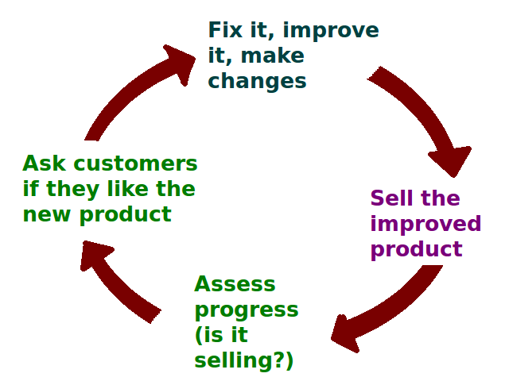
Fourth Factor of Management: Controlling
Unexpected issues will arise
Controlling
process of monitoring activities, measuring performance, comparing results, making corrections
Observing and responding to what happens
The feedback loop
most important aspect of controlling is that managers must be keep informed.

Slide 15
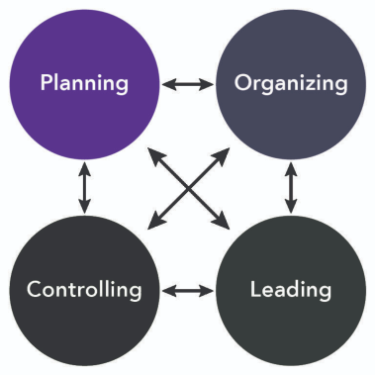
Who Directs Each Function of Management?
Leaders often step up in times of crisis that needs immediate action.
All managers perform each at different times and the position depends on how much.
Different activities may happening at once in an organization.

Slide 16
Class Discussion: Functions of Management
Now that we’ve discussed the four functions of management, let’s take a minute to reflect on why it can be hard to motivate employees when big changes come into play.
What are some factors that cause employees to become resistant to change?

Slide 17
Types of Managers and Their Roles

Slide 18
Learning Outcomes: Types of Managers and Their Roles
1.3: Describe the primary types of managers and the roles they play
1.3.1: Differentiate between the functions of top managers, middle managers,first-line managers, and team leaders
1.3.2: Differentiate between leadership, informational, and decision-making roles

Slide 19
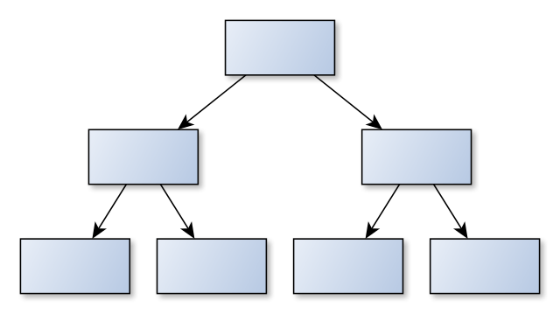
Vertical Management
Various levels of management within organization
Different levels = different aspects of business
Thinking
Communicating
Highly structured
Workers in labor-intensive industries
Disadvantage- limits information from lower levels to upper

Slide 20
Top-Level
What do these acronyms represent on a management team?
CEO, COO, CMO, CTO, CFO, CCO
Vice Presidents or division heads sometimes part of top management team
Responsible for long-term success
Set goals and pay careful attention to external environment
Economy, law proposals, consumer/public relations
Make financial investments

Slide 21
Middle Managers
Department heads, directors, chief supervisors
Links between top and first-line managers
Receives broad strategic plans with specific objectives
Encourages, supports, and fosters employees
Provides leadership

Slide 22
First-Line Managers
Entry level- “on the line”
close contact with workers
Responsible for organizational objectives and plans
Assistant managers, shift managers, foremen, section chiefs, office managers
Focuses on internal issues- must communicate

Slide 23
Team Leaders
Reports to first-line or middle manager
Develops timelines, specific work assignments, provides training to team, communicates clear instructions
Makes sure team is operating efficiently
Positions may be eliminated when new team must be formed

Slide 24
Types of Management Roles
Leadership and Interpersonal Roles
Top Managers
Middle managers
focus more on interpersonal skills
Decisional Roles
All managers required to make decisions

Slide 25
Leadership and Interpersonal Roles
Top Managers
Voice of organization
Hard to separate personal aspects from corporate positions
Middle Managers
Determines what information can be shared
Weighs informational value to decide what to send to top management
First-Line Managers
Evaluates work and helping employees contribute

Slide 26
Decisional Roles
Entrepreneur- top-level managers
Economic opportunities, lead change initiative
Disturbance handler- top and middle managers
React to problems in organization (internal/external)- decide what actions should be taken
Resource allocator
Depending on whether decisions affect whole company or not
Negotiator- top and middle-level managers
Top- negotiations about whole company (contracts or agreements)
Middle- negotiate salary and hiring

Slide 27
Class Discussion: Managers and Leadership
Which type of manager spends more time in leadership activities?

Slide 28
The Advantages of Managing People Well

Slide 29
Learning Outcomes: The Advantages of Managing People Well
1.4: Explain the advantages that arise from managing people well
1.4.1: Explain the advantages that arise from managing people well

Slide 30
Class Discussion: The Advantages of Managing People Well
“People are definitely a company’s greatest asset. It doesn’t make any difference whether the company’s product is cars or cosmetics. A company is only as good as the people it keeps.” – Mary Kay Ash
How can managers leverage their employees to achieve a true competitive advantage?

Slide 31
What Makes a Good Manager?
What makes a good manager?
Effectiveness
Efficiency
Sustainable practices
Competitive advantage
business outperforms rivals due to employees
Depends on a stable and reliable workforce

Slide 32
Quick Review
Describe what management is in your own words.
Explain the primary functions of management
Differentiate between the planning, organizing, leading, and controlling functions of management
Differentiate between the functions of top managers, middle managers, first-line managers, and team leaders
Differentiate between leadership, informational, and decision-making roles
Explain the advantages that arise from managing people well

