Slide 1
Literature of the harlem renaissance

Slide 2
The Emancipation Proclamation marked the end of slavery in the United States, but also signaled the beginning of a long period of social debate about how to heal the wounds left by the Civil War
Reconstruction - deliberate attempt to enfranchise blacks, especially in the realm of government.
Reconstruction lasted just over a decade (1865–1877), and at its end American society was in disarray with regard to race relations.
In the wake of the Civil War, the focus was on social programs and public policy more than on literature, and most scholars and general readers agree that the half-century following the Emancipation Proclamation did not produce the greatest works in African American literary history in terms of artistic accomplishment and creativity.
Black writers were beginning to gain a foothold in the white literary establishment

Slide 3
Double Consciousness Du Bois
“It is a peculiar sensation, this double-consciousness, this sense of always looking at one’s self through the eyes of others, of measuring one’s soul by the tape of a world that looks on in amused contempt and pity. One ever feels his two-ness, an American, a Negro; two souls, two thoughts, two unreconciled strivings; two warring ideals in one dark body, whose dogged strength alone keeps it from being torn asunder. The history of the American Negro is the history o9f this strife- this longing to attain self-conscious manhood, to merge his double self into a better and truer self. In this merging he wishes neither of the older selves to be lost. He does not wish to Africanize America, for America has too much to teach the world and Africa. He wouldn’t bleach his Negro blood in a flood of white Americanism, for he knows that Negro blood has a message for the world. He simply wishes to make it possible for a man to be both a Negro and an American without being cursed and spit upon by his fellows, without having the doors of opportunity closed roughly in his face”

Slide 4
the “New Negro” Renaissance
The period known as the Harlem Renaissance mostly associated with the 1920s, though its beginnings can be traced to the years just prior, and some of its spirit continued to exist in the years just after, until the Great Depression brought about a new set of issues that further changed the nature of African American literature.
During the 1920s, an unprecedented amount of black writing was published and accepted by the white literary establishment, promising not only a better future for race relations, but, equally importantly, a new sense of black race pride
a new optimism replaced the mood of cultural uncertainty that characterized black America in the late nineteenth and early twentieth centuries,

Slide 5
For the first time in the African American literary tradition, there was a wide range of subject matter, a willingness to experiment with form, and the emergence of a vast array of diverse voices that did not always sing in harmony.
black artists shook off the devastation of the past in order to produce a body of literature that was free, celebratory, and forward-thinking

Slide 6
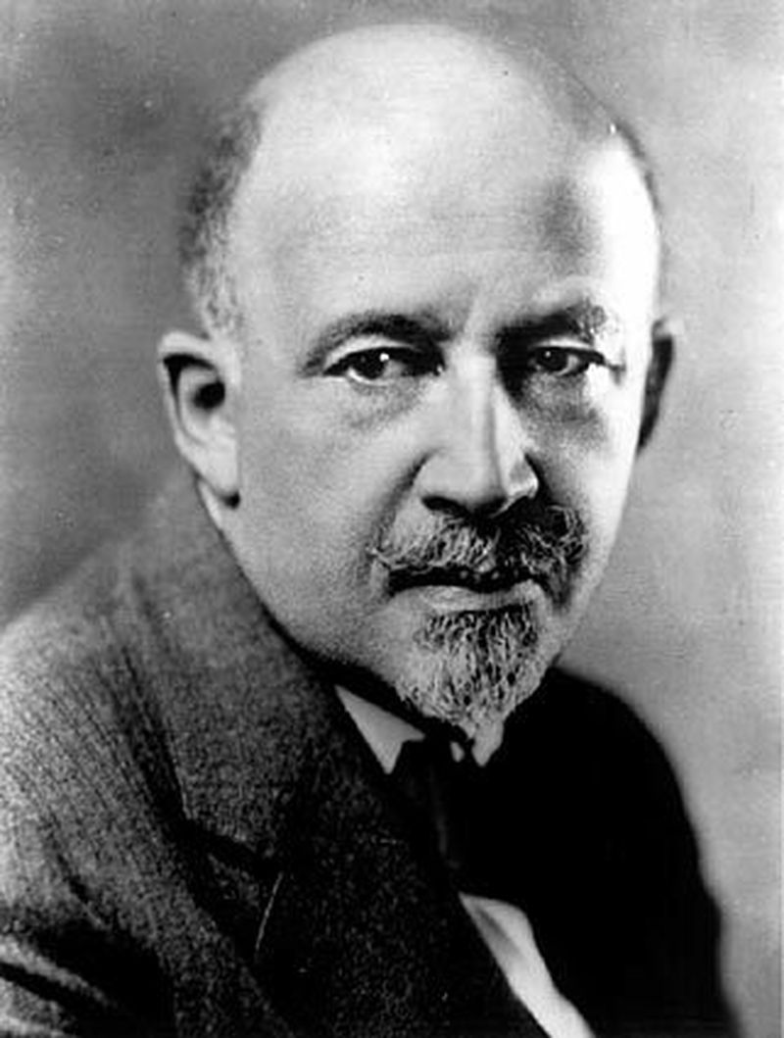
Du Bois went on to be a leading critical voice within the Renaissance as well as a practitioner: in addition to essays, he contributed a novel, and was also an editor
One of the central points of debate amongst the practitioners and critics of the period was the question of whether African American literature was meant to speak for the experiences of the whole race, the “talented tenth” who were interested in art and education, the common folk, or individuals.

Slide 7
New negro? Racial self-doubt…
Hughes describes an artist at the end of “The Negro Artist and the Racial Mountain:” free, comfortable, uninhibited, and, to some extent, willing to move through life untroubled by the racism of the past or even the present.

Slide 8
“Sweat” Study Questions
1.Explain the meaning of the title "Sweat
2. Where does this story take place and how does Hurston clue you in as to the socio economic status, beliefs, and culture of those in the community?
3.How is Delia's body represented in the text?
4. Delia often expresses herself through African-American folk proverbs or religious statements. Choose two of these expressions/allusions and explain how they foreshadow events in the story.
5. The townspeople all know that Sykes mistreats Delia. What unified action do they take to express their displeasure? Is this an effective action? Why or why not? What else could the townspeople have done?
6. How do the following contribute to the story as symbols: snakes, the bull whip, the sun, China Berry Tree, baskets of laundry?
7. How does Christianity function in the story?
8.After Sykes has been bitten by the snake, Delia hears him call her name. Why doesn’t she respond to his calls for help? Since she does not respond, is Delia partly responsible for Sykes’s death? Why or why not?

