Slide 1
THE IMPORTANCE OF MODERN LANGUAGES IN THE INTERNATIONALISATION
The Center of Modern Languages in UCA

Slide 2
It is a unit of the University of Cadiz, responsible for language training and language certification, which offers its services to both the university community and its social environment.
CSLM

Slide 3
Our main lines of action:
Teaching Spanish as a Foreign Language (ELE).
International programmes and custom-made courses.
Foreign language courses and Spanish Sign Language (LSE).
Practical training courses for teachers of Spanish. Master’s Degree.
Language certification.
Translation service.

Slide 4
SPANISH AS A FOREIGN LANGUAGE

Slide 5
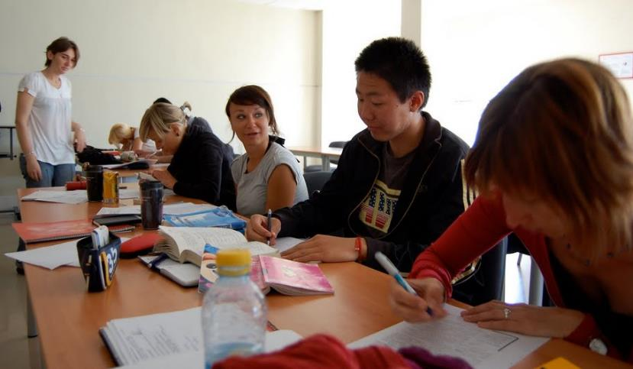
GENERAL SPANISH COURSES
Adapted to the CEFRL
90 or 180 total teaching hours
Created to be combined with other university subjects
Popular with the Erasmus students
ECTS credits recognised
Reduced fees applied

Slide 6
International programmes
Tailor-made academic programme
Wide catalogue of subjects
Extra curricular programme
Immersion with Spanish families
Volunteering service
Intership, partnership
Exchanges with Spanish students
ECTS credits recognised

Slide 7
International Summer Programmes

Slide 8
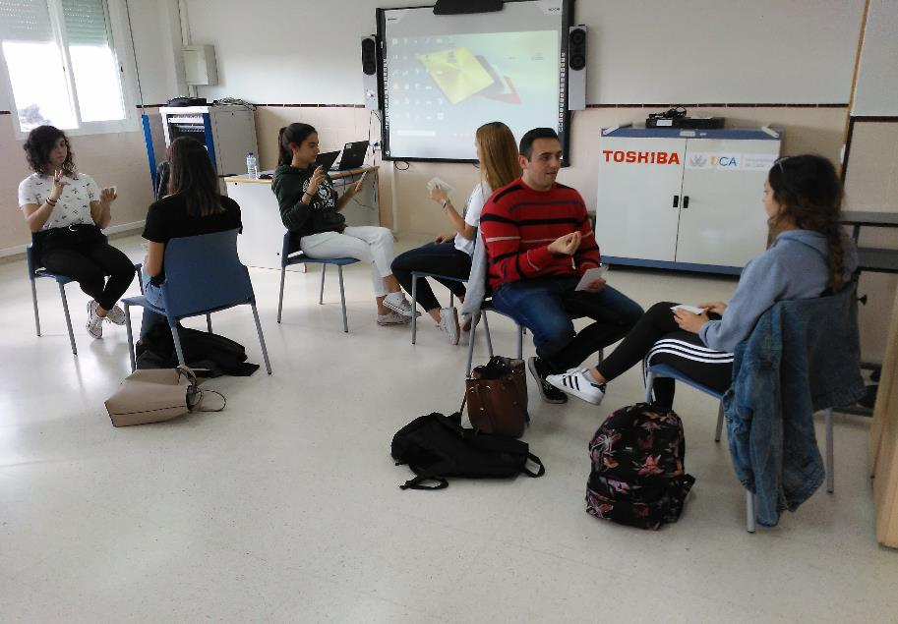
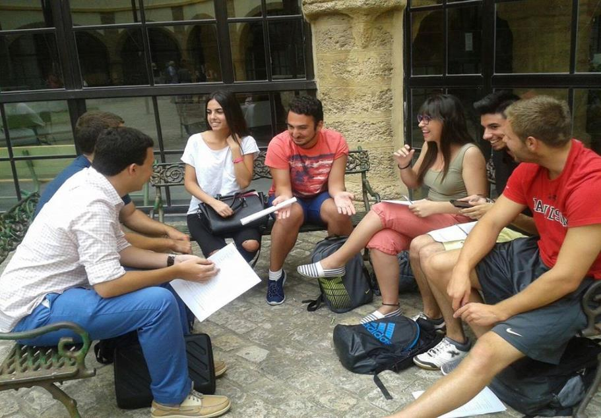
FOREING LANGUAGES
English
French
German
Italian
Moroccan arabic
Portuguese
Russian. In collaboration with Pushkin Institute.
Spanish Sign Language

Slide 9
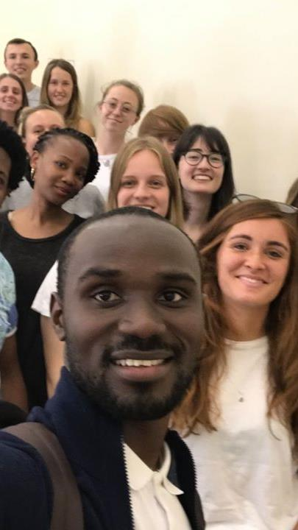
Practical training courses for teachers of Spanish
The methodology of language teaching is one of the disciplines of applied linguistics that is advancing faster, and knowing its latest developments is essential to become a specialist in the teaching of Spanish as a foreign language.
The CSLM offers practical courses several times along the year and a Master’s Degree in Professional Teaching of Spanish as a Foreign Language.

Slide 10
official lANGUAGE certification:
ACLES certification tests
APTIS language tests
DELF/DALF accreditation tests
Instituto Cervantes exams (DELE, SIELE & CCSE)

Slide 11
TRANSLATION SERVICE
Created in 2007 in response to the growing internal demand of the different Departments, Units and Faculties of the University for a high quality and professional language service.
It contributes to the internationalization of the University of Cadiz.
With the support of a human team of highly qualified and experienced translators in various fields of specialization.

Slide 12
What makes the difference?
A team of professionals committed to satisfying all the needs and interests of the students.
A work in the classroom based on the communicative methodology and focused on helping students succeed in developing all language skill areas.
A wide range of subjects offered and an official certification from UCA so that students can transfer their ECTS credits.
An academic programme tailored to fully meet the needs of visiting institutions.
A listening to the students and their coordinators.
A team of professional and specialised native language teachers.

Slide 13
the lANGUAGE centre in figures (2019):
ENROLMENTS: INTERNATIONAL PROGRAMMES:
Official Certification | 1.882
Foreign languages | 1.469
Spanish | 1.602
TOTAL | 4.953
No. PROGRAMMES | COUNTRY | No. STUDENTS
26 | USA | 380
2 | CHINA | 39
4 | RUSSIA | 29
1 | NORWAY | 7
2 | ITALY | 27
35 | 5 | 482

Slide 14
Thank you for your attention.
Annabel García
lenguas.modernas@uca.es
This project has been funded with support from the European Commission. This document reflects the views only of the authors, and the Commission cannot be held responsible for any use that may be made of the information contained therein.

