Slide 1
Toni Morrison
1970-2000 The Rise of Women Writers

Slide 2
1970-2000 The Rise of Women Writers
a major theme in African American literature beginning in the early 1970s was the turn toward history
a fresh look at history and at the deep ancestral connections that became a primary literary focus in the 1970s and 1980s (The Roots, Generations)
the urgent preoccupation with history in the writings of black women in the 1970s and 1980s registered alarm at the potential loss of a history that had never been accurately recorded

Slide 3
Toni Morrison is by almost any measure the most important American novelist of the late twentieth century
Song of Solomon (1977) and Beloved (1987) are at the center of her magisterial oeuvre, and both underscore the prominence of family history and history more generally in African American fiction of this era
Morrison began as an editor at Random House, helping to promote the careers of important members of her cohort such as Gayl Jones and Toni Cade Bambara.
She also curated and co-edited The Black Book (1974), an illustrated history of the African American experience that foretells her emphasis on folk history in her fiction

Slide 4

The themes of Morrison’s writing recur: violence and love are always intertwined in her work, human sacrifice is both a necessary and random component of societies, material values are the primary threat to higher spiritual values, and growth is impossible without pain and effort

Slide 5
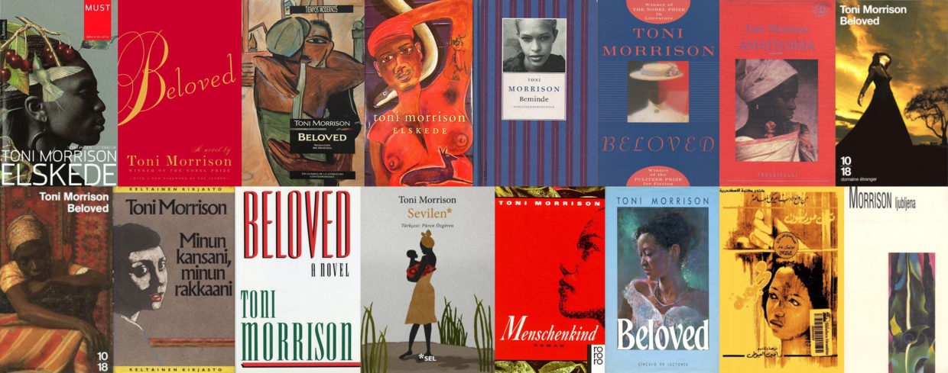
Toni Morrison
Her focus is largely (but not exclusively) on the experiences of black women. The truly heroic characters in her work are unlikely mentors and spiritual guides, frequently outcasts rather than pillars of their community. The majority of her novels are historical.

Slide 6
Beloved
1. Describe the relationships that slave mothers have with their children in the novel. How are these relationships affected by slavery? How are they affected by freedom?
2. What are some examples of healing in Beloved? How are people healed physically? Spiritually?
3. Discuss the use of nature imagery in the novel and how it corresponds to the characters'moods or situations
4. Discuss the different ways in which white people treat African Americans.
5. How does Sethe justify her murder of Beloved? How are her actions viewed by townspeople? By Paul D?

Slide 7
Beloved
Identify the speakers and and the circumstances of the following quotations
‘Velvet is like the world was just born. Clean and new and so smooth’.
“I took and put my babies where they’d be safe”.
“You got two feet, Sethe, not four.”
“What I have to do is get in my bed and lay down. I want to fix on something harmless in this world”.
“Her face is my own and I want to be there in the place where her face is and to be looking at it too”.

Slide 8
American Slave Narratives: An Online Anthology. xroads.virginia.
edu/~HYPER/wpa/wpahome.html.

