Slide 1
The Color Purple
By Alice Walker

Slide 2
WALKER is best known for her 1982 novel The Color Purple.
In it she focuses on Celie, a young black woman in the Jim Crow South.

Slide 3
Celie is poor and uneducated.
She is unattractive and is sexually molested at a young age by a man she believes to be her father
She is trapped in a loveless marriage and a life of unending, brutally hard work. She is cruelly separated from her only living relation, her beloved sister Nettie
Celie manages to create both meaning and community in her own small way. She surrounds herself with a variety of figures who teach her what it means to be strong

Slide 4
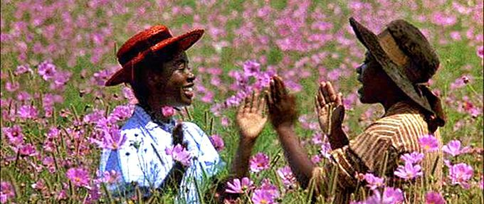
The novels tells of Celie’s struggle to give up the fixed ideas that limit her horizons.
She must learn that she has the right to her own propert, her own sexuality, her own family, and her o own identity

Slide 5
what must happen is not merely a destruction of patriarchal values, but a complete reorganization of roles based on personality and skill rather than gender.
Walker re-examines family history in the novel
The novel is told in a series of ninety letters, Celie to God, from her sister Nettie back to Celie, and from Celie to Nettie. Celie takes literally her stepfather’s injunction, “You better never tell nobody butGod,” a clear attempt to conceal his sexual abuse of Celie

Slide 6
Themes
Gender
Walker’s main concern has been the representation of black women, seeking to give voice to the voiceless, to those who suffer the double oppression of race and gender. Celie is, in many ways, Walker’s archetypal heroine: Her path from oppression to anger to acceptance and wholeness comprises the narrative of The Color Purple.
She has been criticized for what many consider to be her unfair portrayal of black men

Slide 7
Celie is more comfortable with women than with
men. “I don’t even look at mens. I look at women, tho, cause I’m not scared of them”
The men of The Color Purple seem determined to make the women under them pay for the wrongs of society by enforcing strict gender divisions, often through violence.
However, the major male characters eventually learn to give up their desires to control the women in their lives and accept their strength and equality

Slide 8
Religion
God is an important character in the book: The vast majority of the letters included are addressed to him. But Celie loses her faith and starts believing that God is a white man
Instead Shug proposes an ideal of religion based on the idea that God exists through and inside of people and things, rather than as an abstract, judgmental creator: “I believe God is everything, say Shug”

Slide 9
Race
Black culture is presented largely as a closed system, only touching on white culture when absolutely necessary, usually as an unreasonable and unreasoning source of violent authority.
As with divisions between the genders, divisions between races, Walker implies, can only be healed when both parties can consider each other as equals.

Slide 10
Study questions
1. Explain the relationship between the color of purple and the feeling of beauty.
2. Examine the effect of two "arranged" marriages--Celie's to Albert, and Albert's to Annie Julia--
and the consequences of each of them.
3. How are Celie’s letters to God similar to the African-American slave narratives collected in the 1930s? How are they different?

