Slide 1
Summer school
INNOVATION IN HERITAGE TOURISM
HERITAGE TOURISM
Lecturer: Prof. Dr Sanja Pekovic
Mr Jovana Janinovic
Kotor, 20/10/2022
Project no. 609675-EPP-1-2019-1-ME-EPPKA2-CBHE-SP

Slide 2
OUTLINE
Introduction to innovation
Innovation in tourism
NextGen Traveller
Social innovation in heritage field
Innovations in heritage tourism
7 sources of innovation
Project no. 609675-EPP-1-2019-1-ME-EPPKA2-CBHE-SP

Slide 4
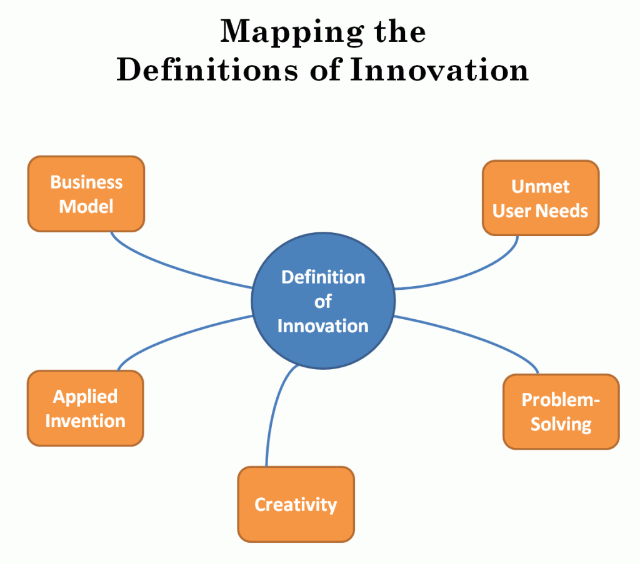
INNOVATION
“Innovation is the process of creating value by applying novel solutions to meaningful problems.” (Joe Dwyer, 2021)
Innovation is conceived as a means of changing an organization, either as a response to changes in the external environment or as a pre‐emptive action to influence the environment. Hence, innovation is here broadly defined to encompass a range of types, including new product or service, new process technology, new organization structure or administrative systems, or new plans or program pertaining to organization members. (Damanpour, 1996)

Slide 5
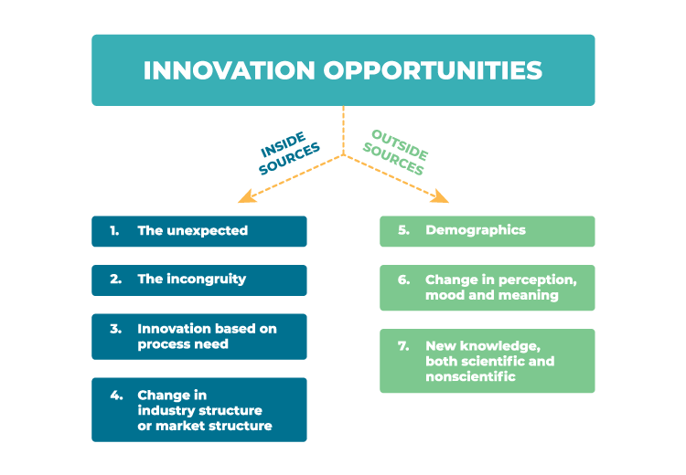
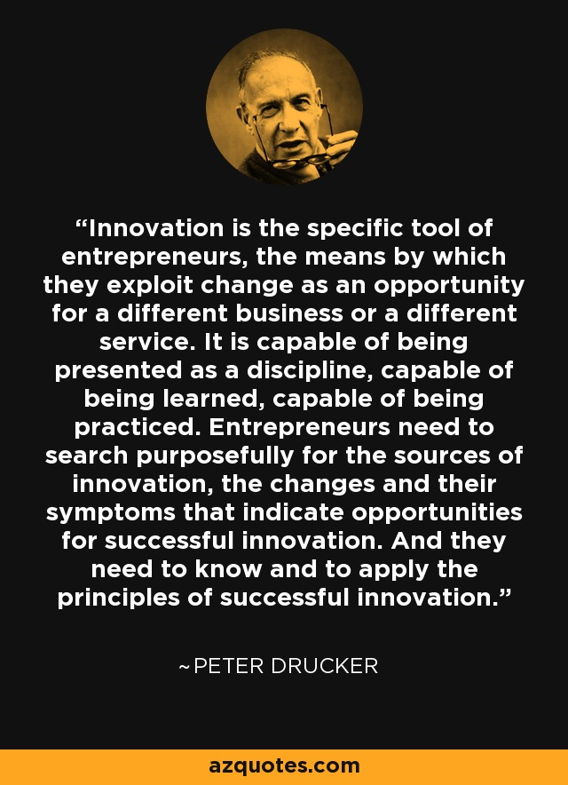
7 SOURCES OF INNOVATION
Peter Drucker, Innovation and Entrepreneurship, 1985

Slide 6
EXERCISE
THINK OF THE GREATEST INNOVATION IN THE HISTORY OF HUMANKIND?
Project no. 609675-EPP-1-2019-1-ME-EPPKA2-CBHE-SP

Slide 7
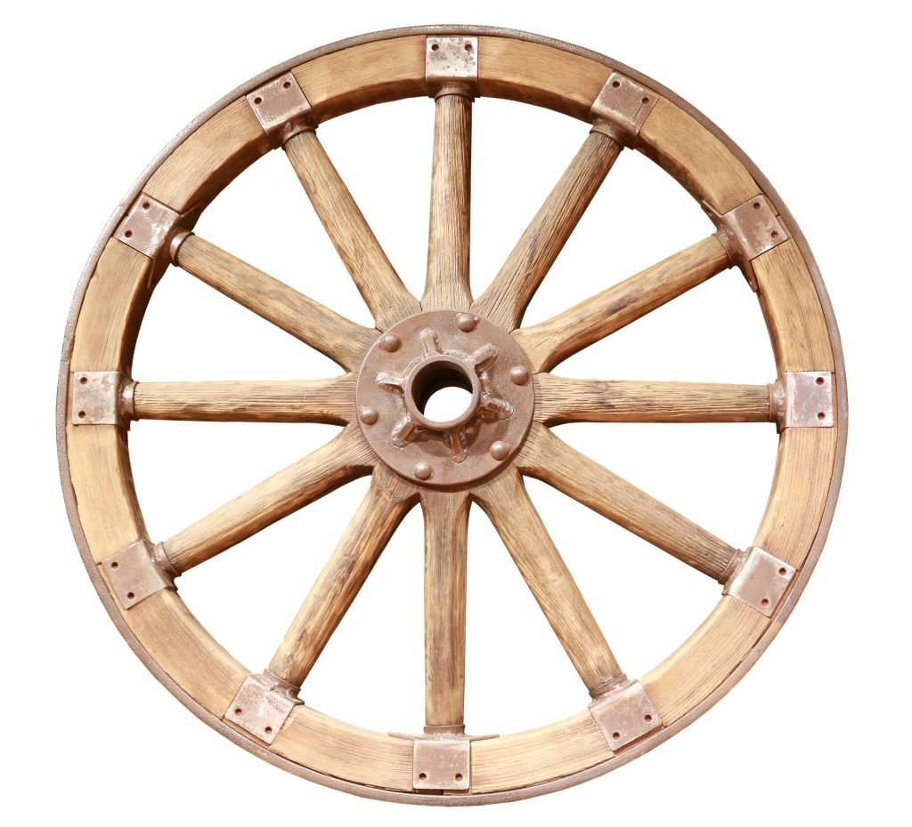
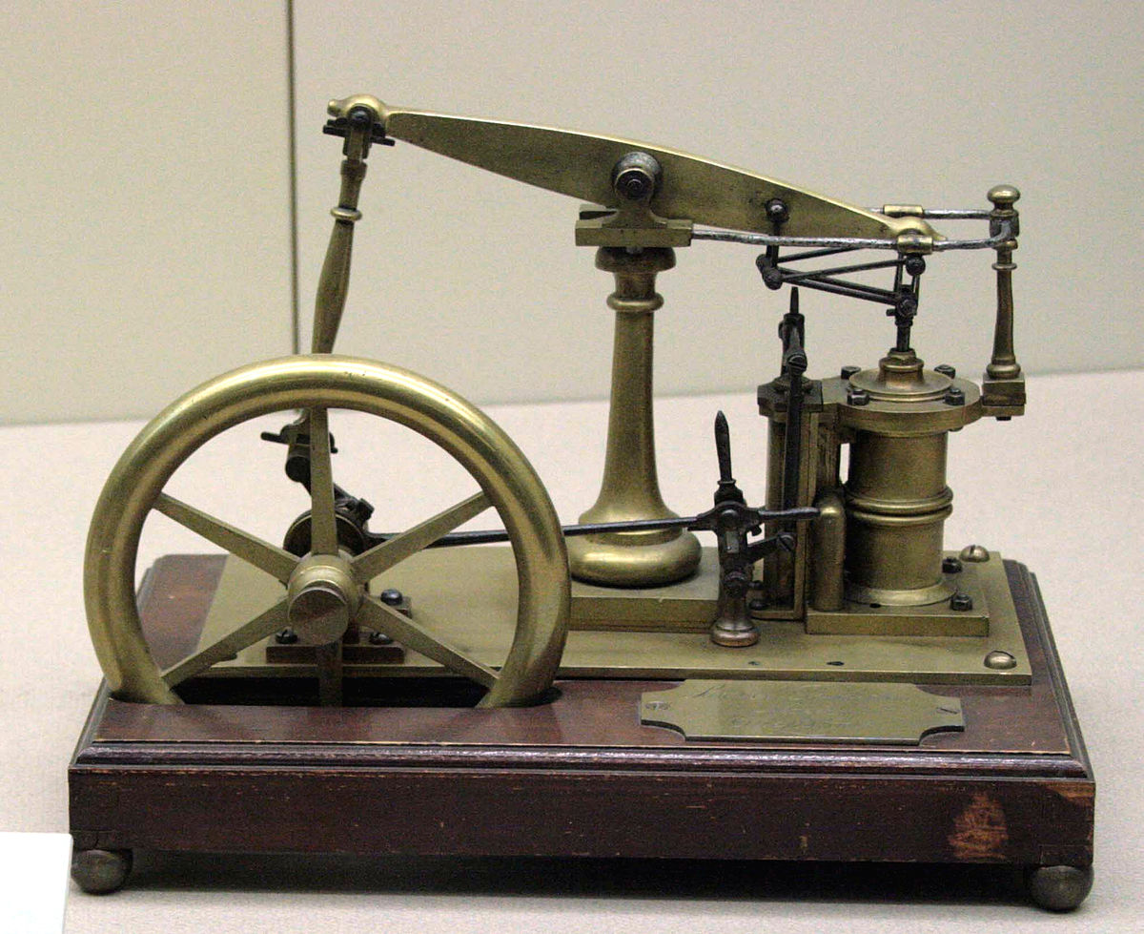
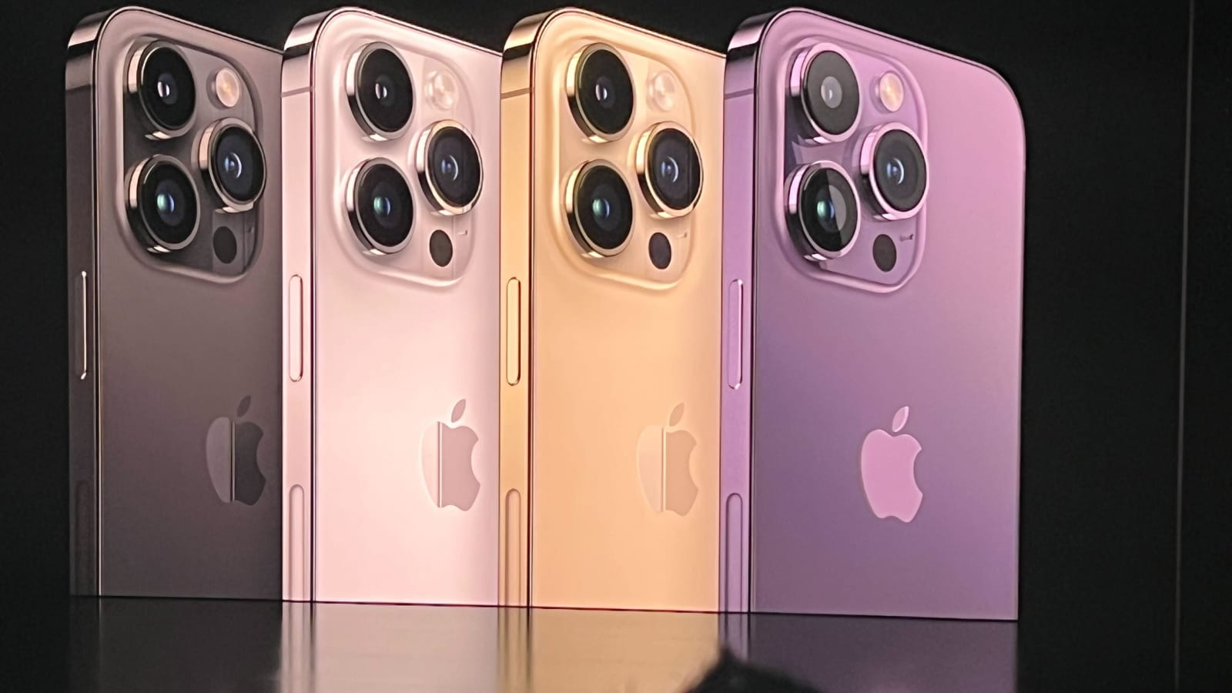
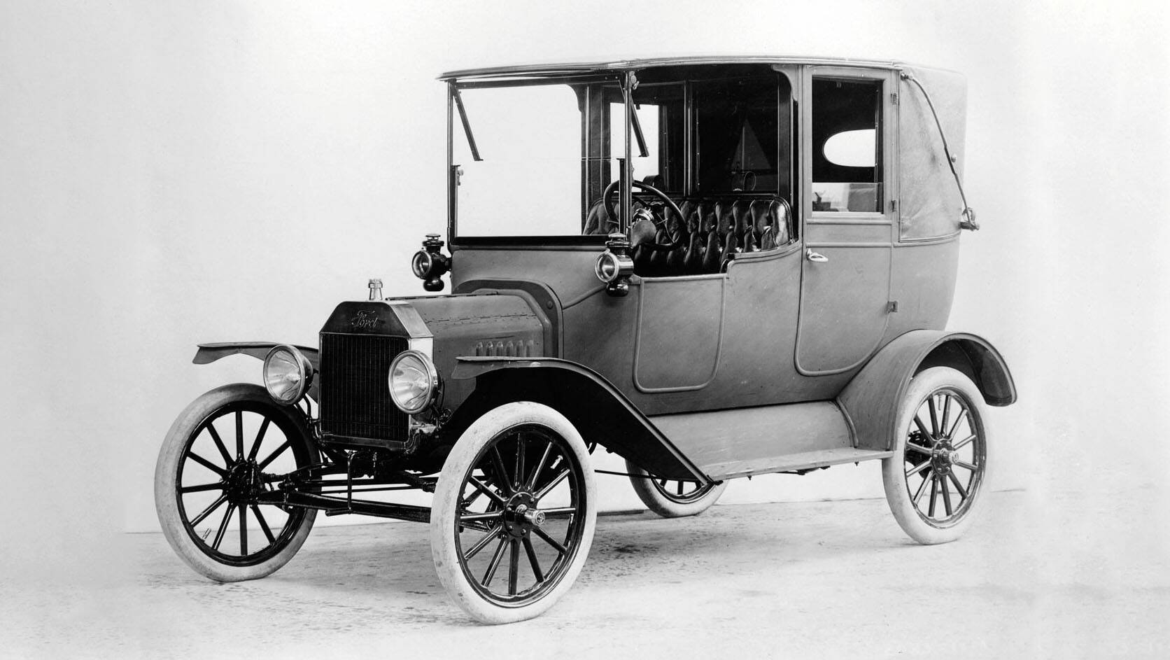

Slide 9
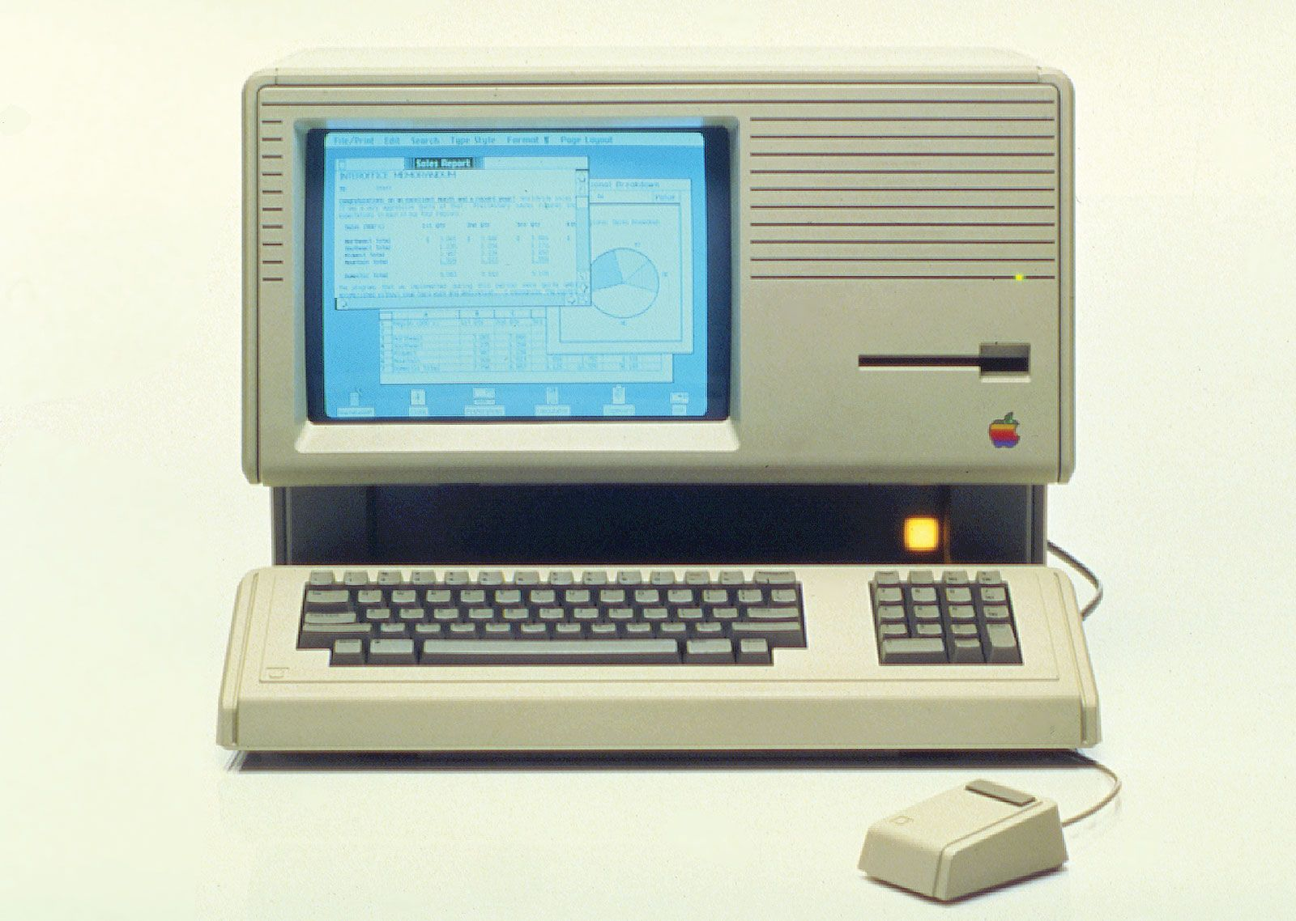
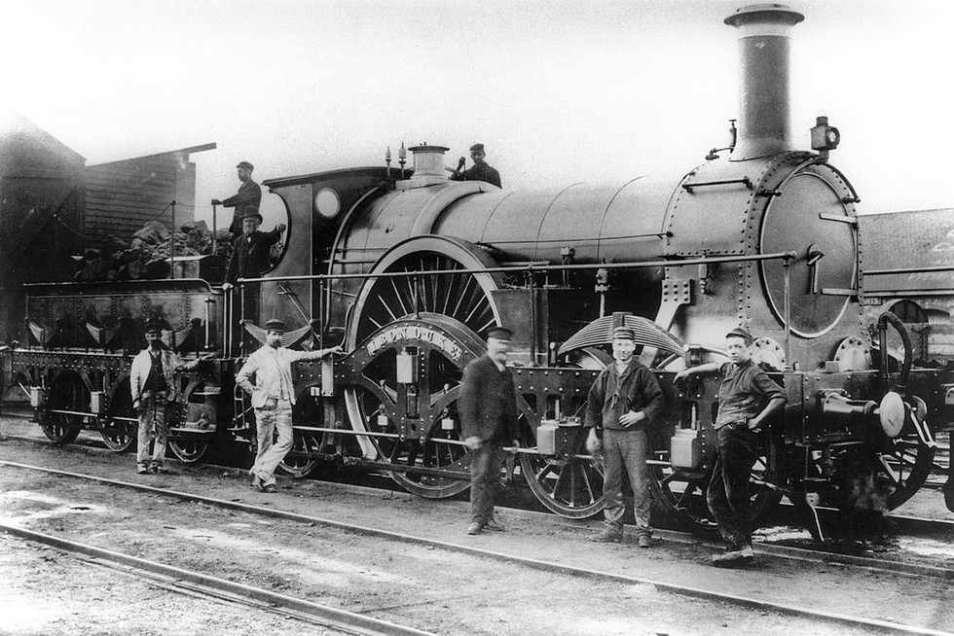
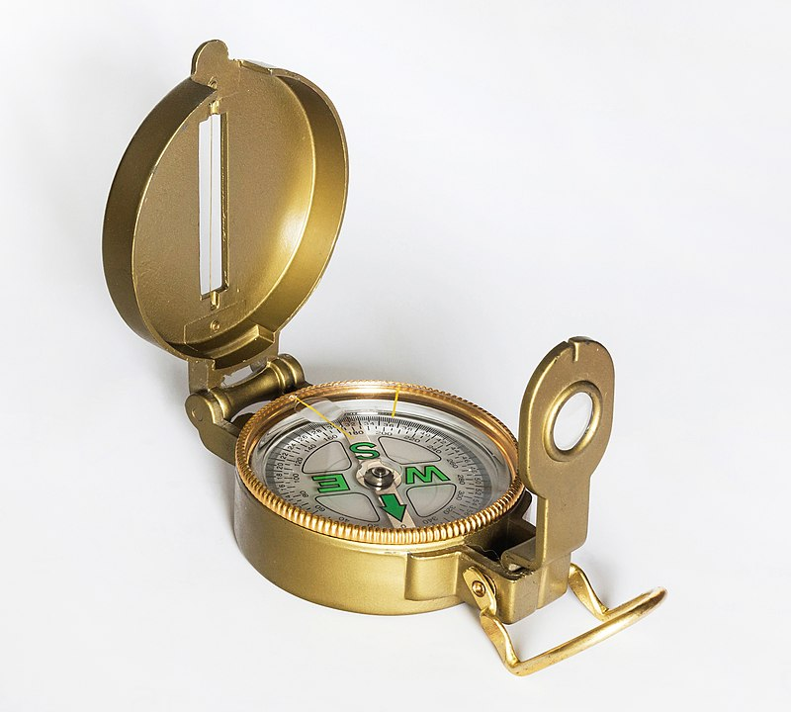

Slide 10
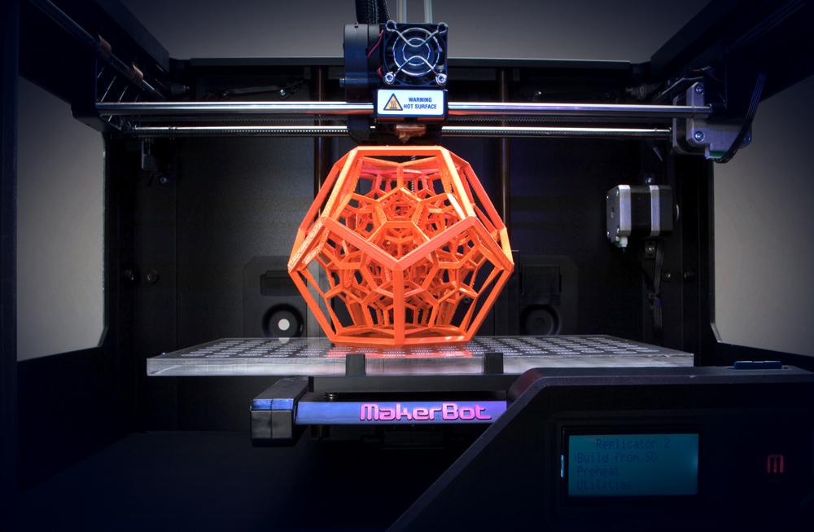
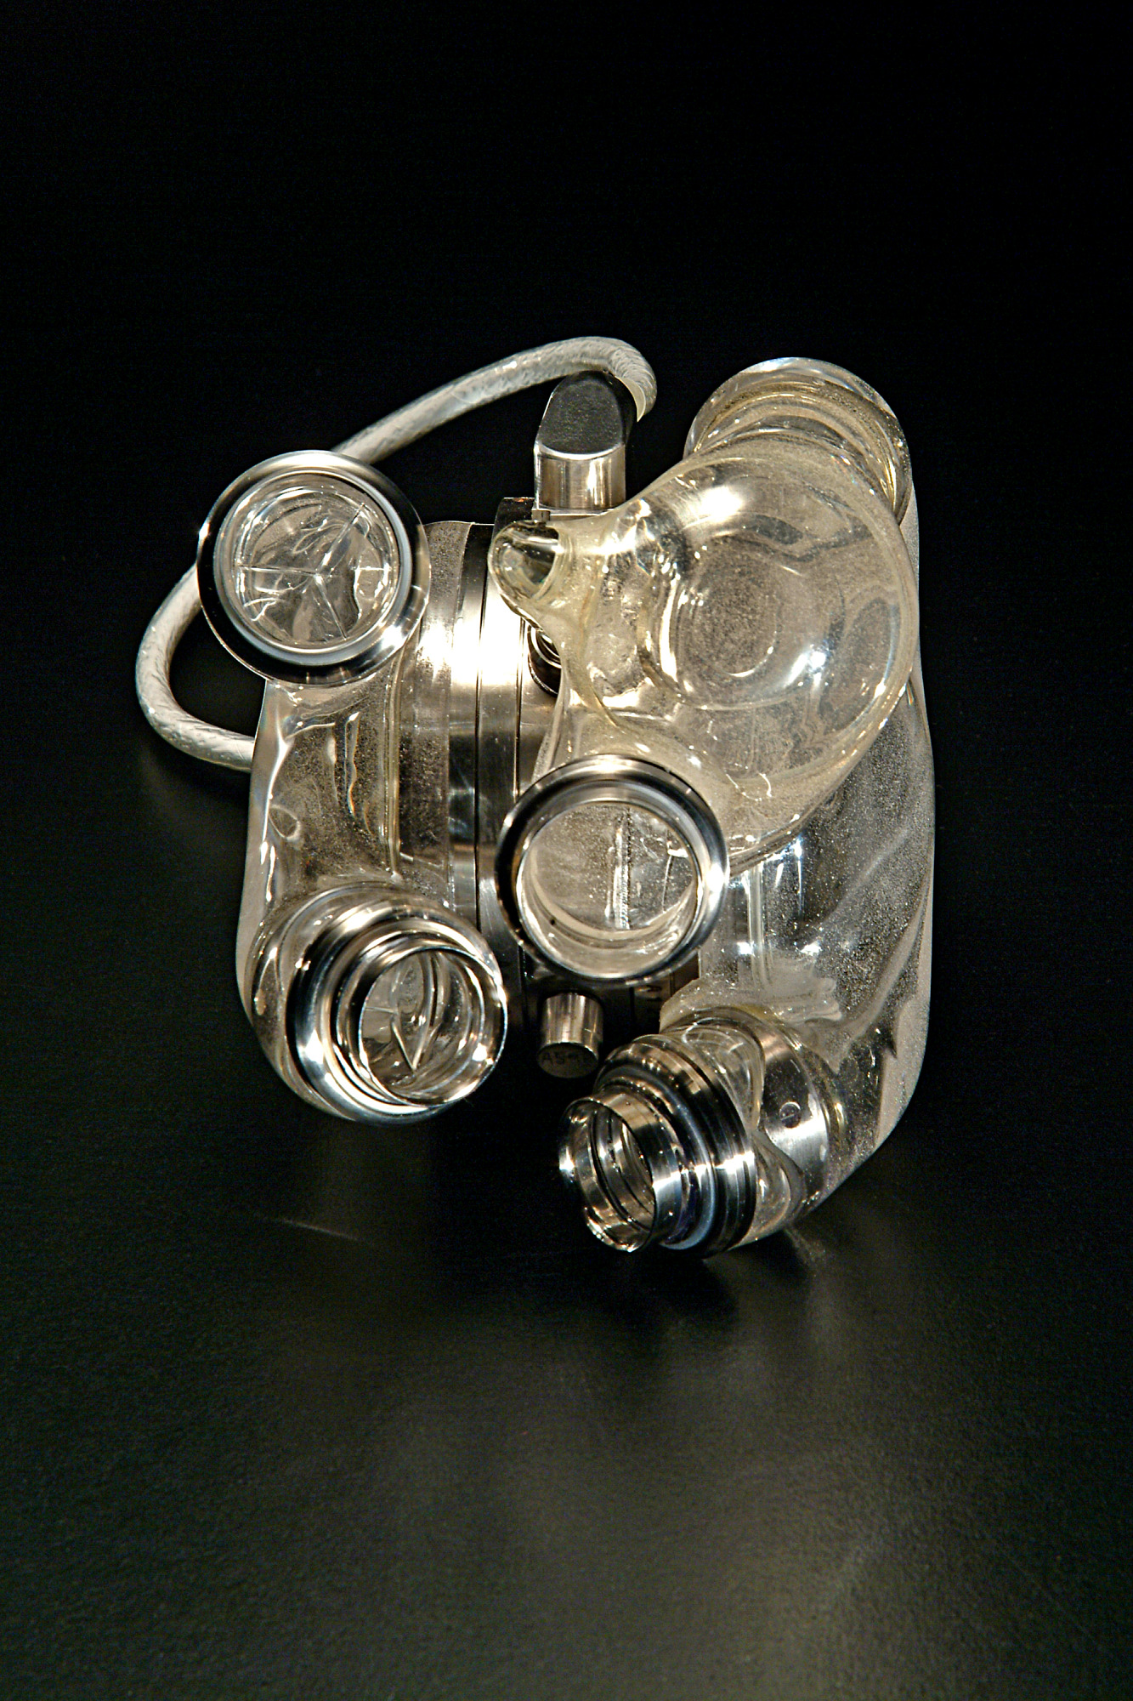
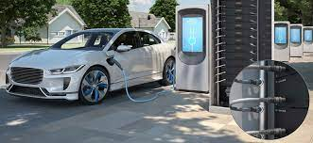
MOST IMPORTANT INNOVATION OF THE XXI CENTURY?

Slide 11
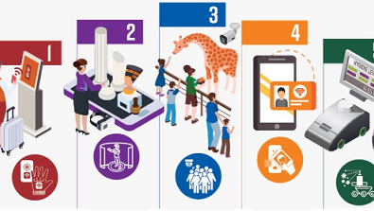
INNOVATION IN TOURISM

Slide 13
NEXT GEN TRAVELLER

Slide 14
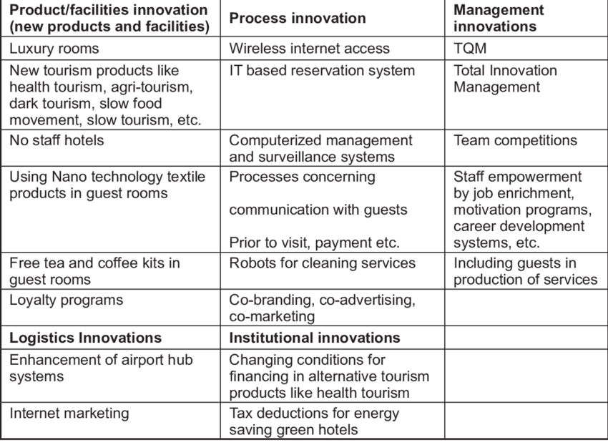
HERITAGE CLASSIFICATION
EXAMPLES OF DIFFERENT TOURISM INNOVATION TYPES
Source: Pirnar, Bulut and Deniz Eris (2012)
Source: UNESCO
Project no. 609675-EPP-1-2019-1-ME-EPPKA2-CBHE-SP

Slide 15
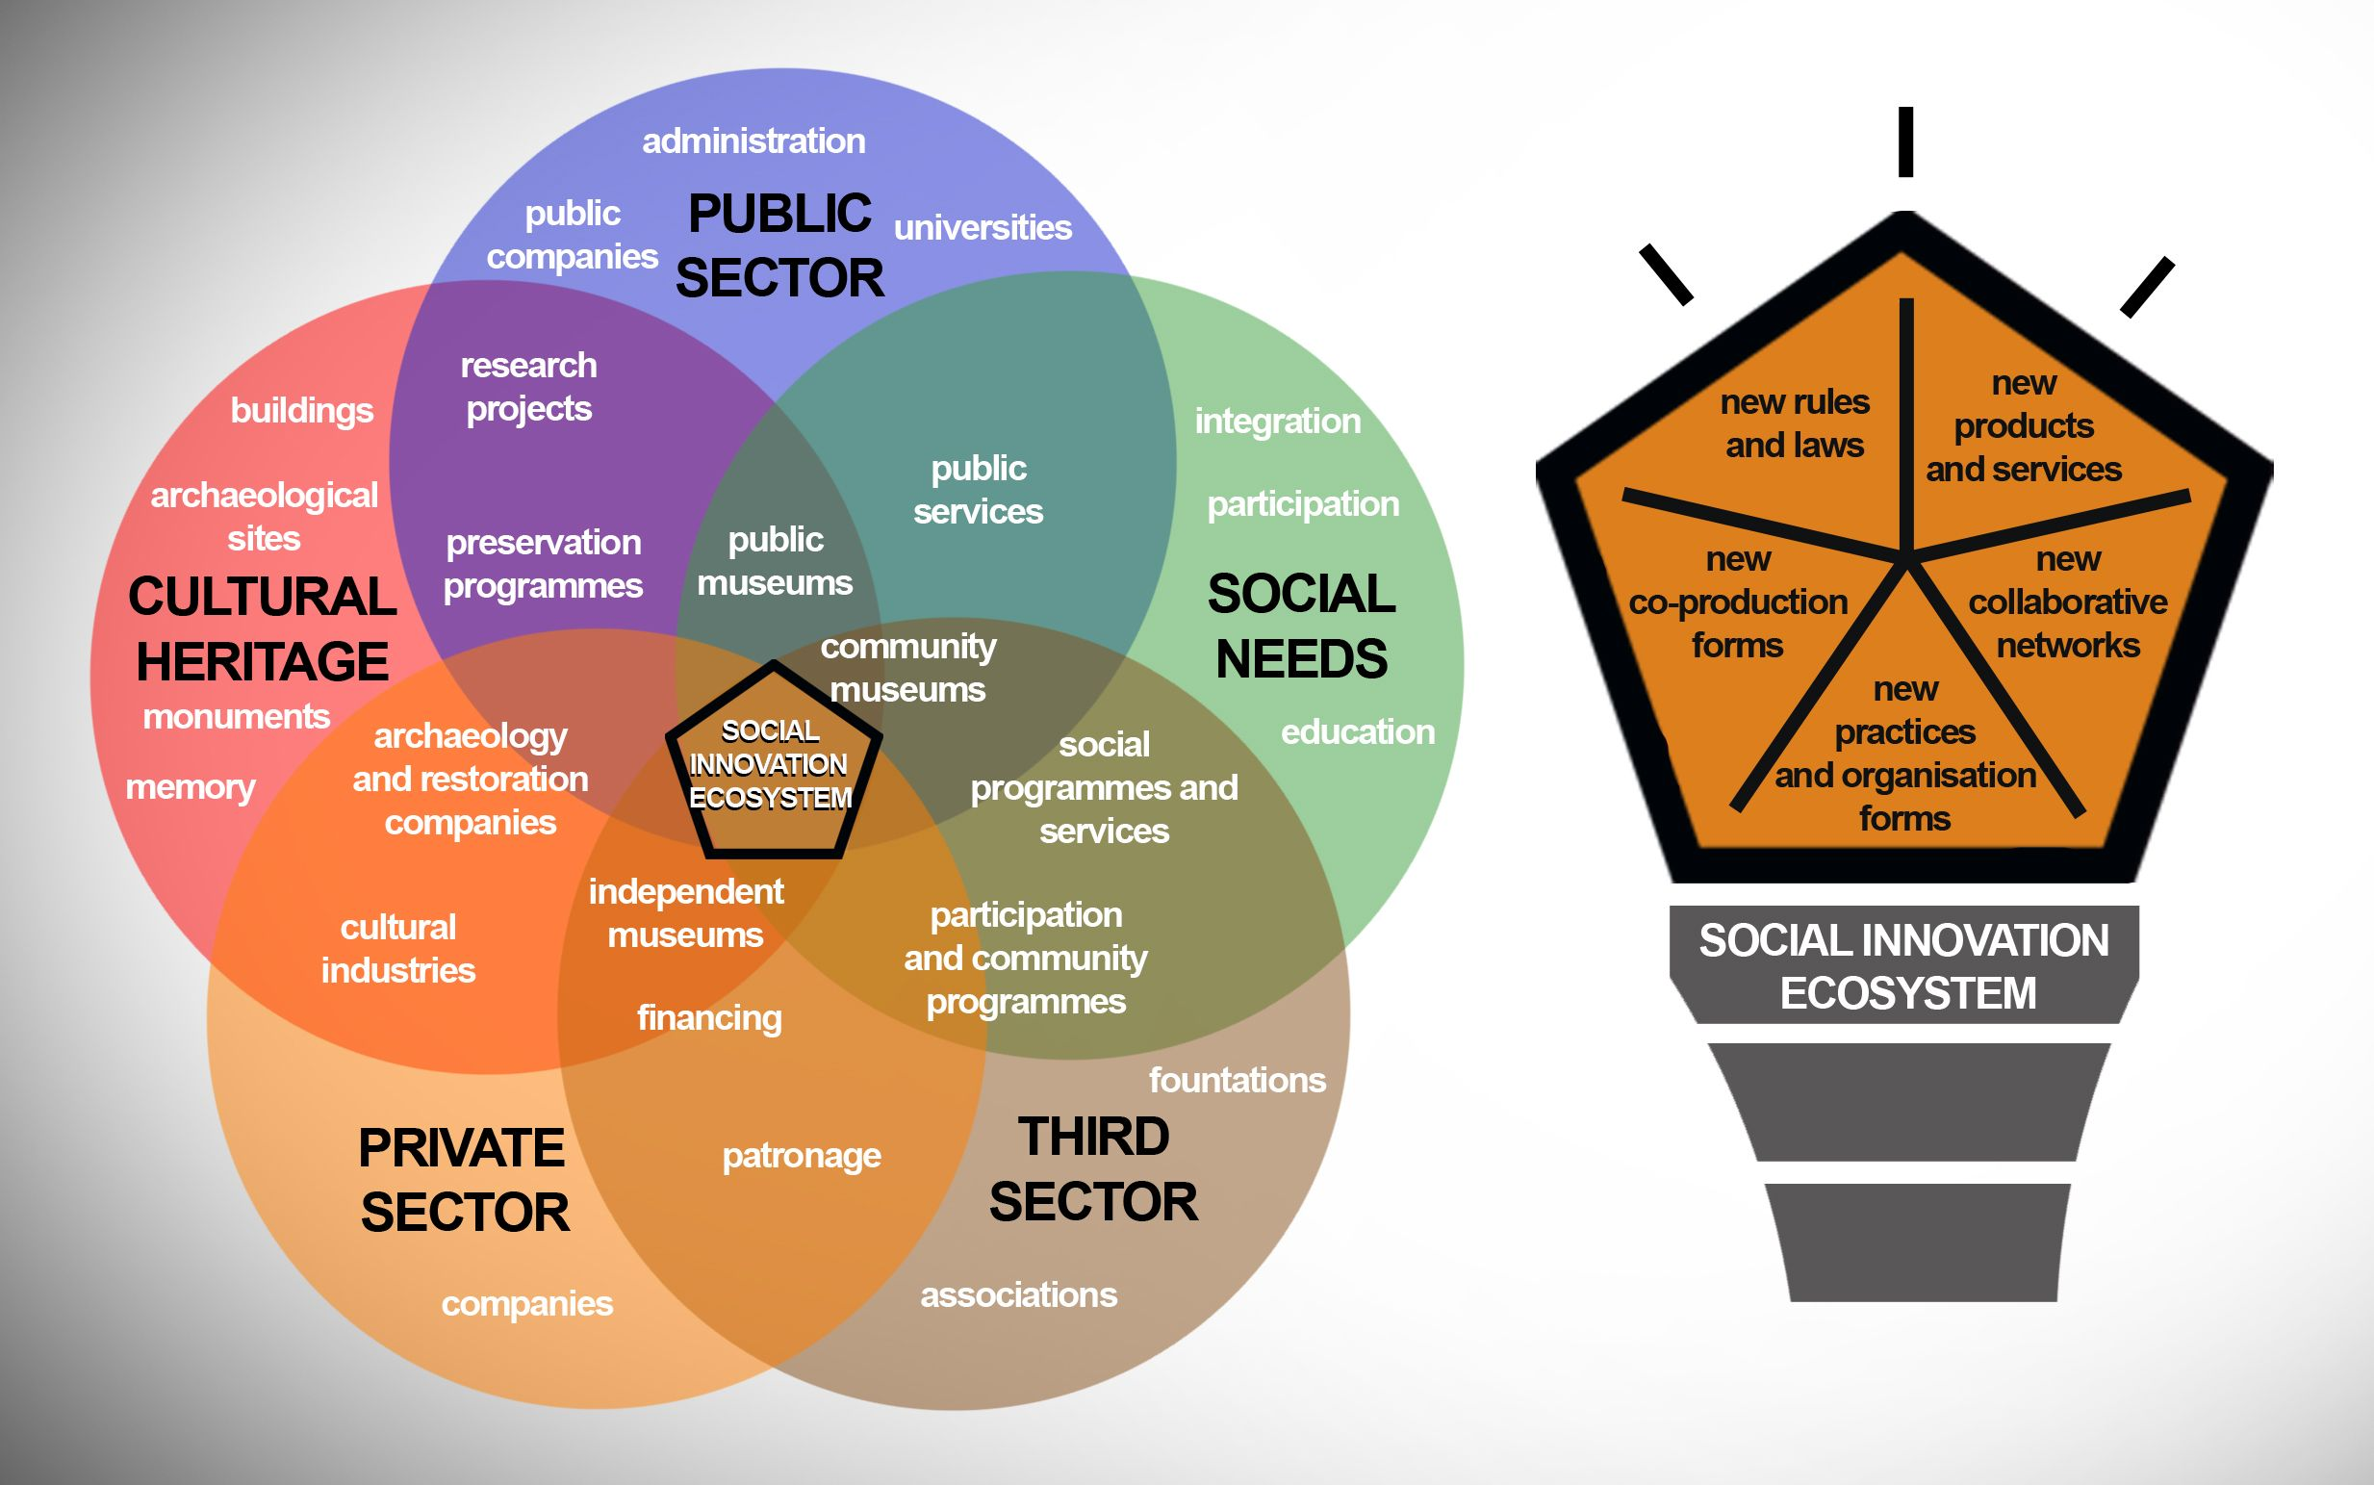
SOCIAL INNOVATION IN HERITAGE FIELD
Project no. 609675-EPP-1-2019-1-ME-EPPKA2-CBHE-SP

Slide 16
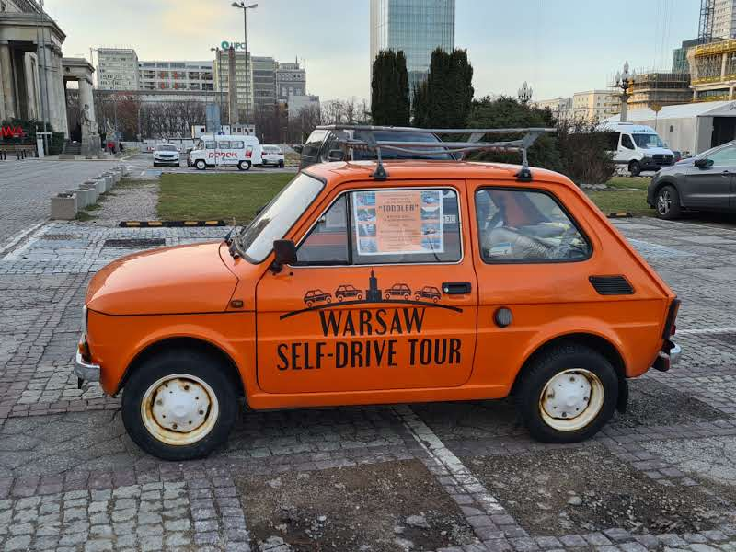
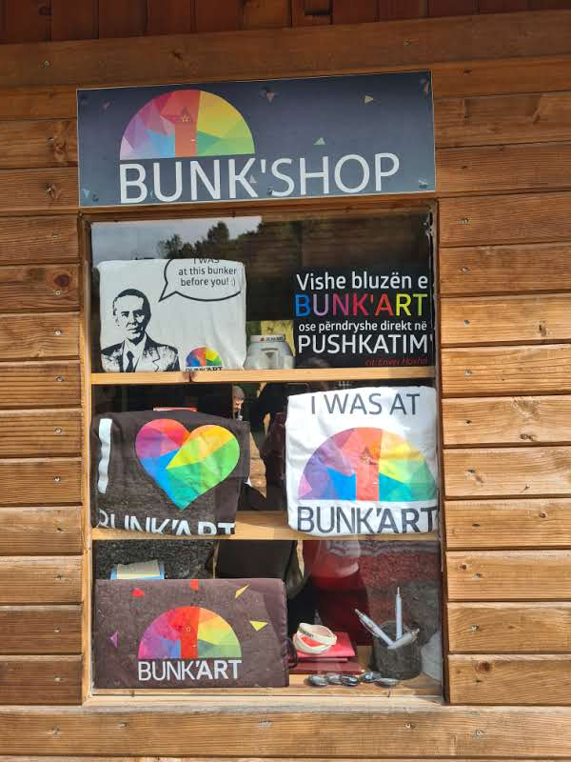
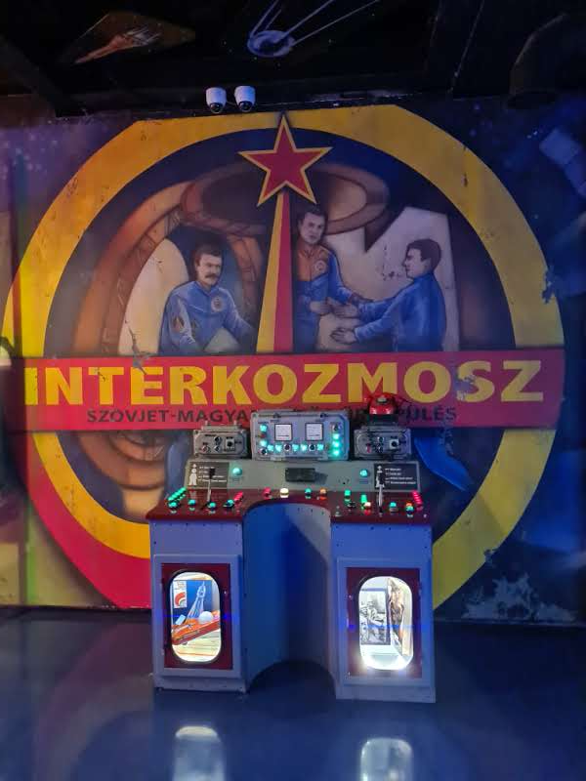
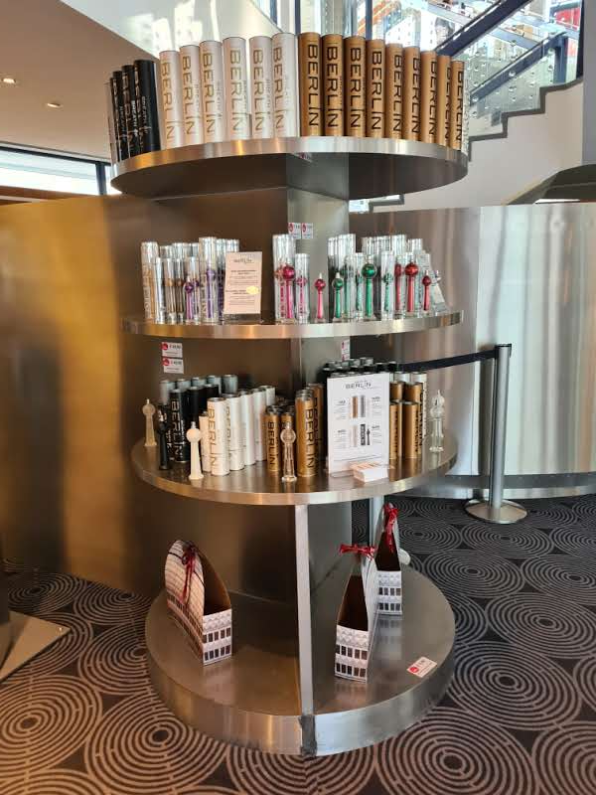
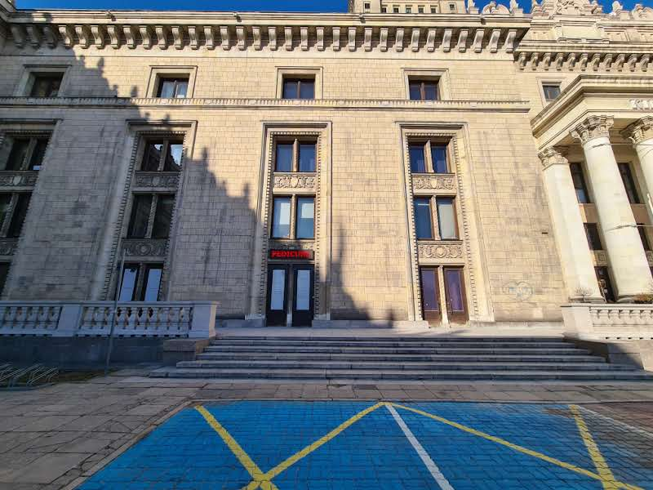
INNOVATIONS IN HERITAGE TOURISM
Project no. 609675-EPP-1-2019-1-ME-EPPKA2-CBHE-SP

Slide 17
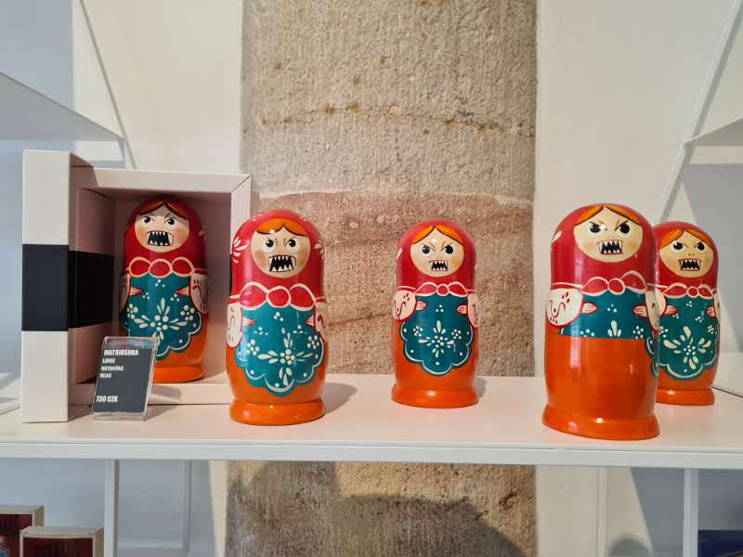
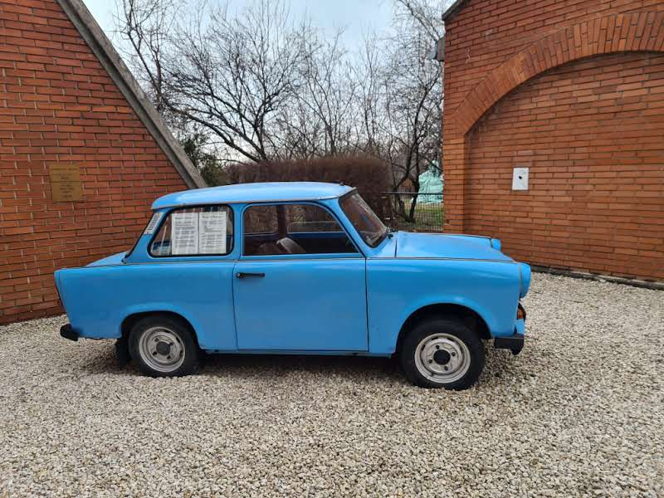
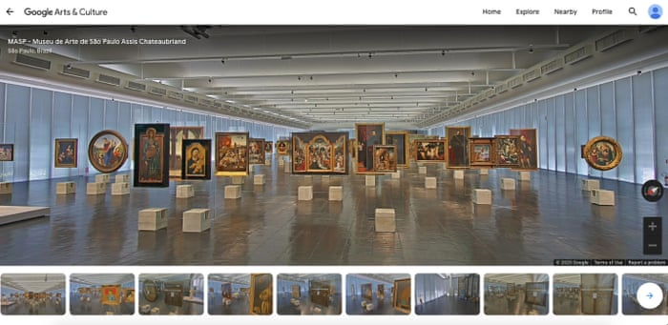
INNOVATIONS IN HERITAGE TOURISM
Project no. 609675-EPP-1-2019-1-ME-EPPKA2-CBHE-SP

Slide 18
Thank you for your attention!
Project no. 609675-EPP-1-2019-1-ME-EPPKA2-CBHE-SP

