Slide 1
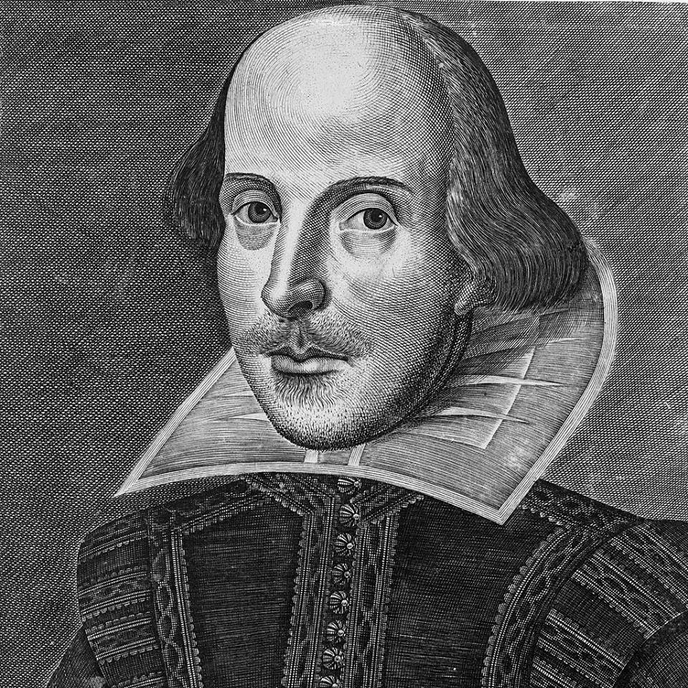
William Shakespeare’s sonnets

Slide 2
“the key with which Shakespeare unlocked his heart” (W.Wordsworth)
when were the sonnets written?
what is the division of the sonnets
Sonnets were written in the period between 1592 and 1601; the collection was published in 1609
Sonnets 1-126 are devoted to “the Youth” while sonnets 127-154 are devoted to “the Dark Lady”
This division is conventional enough, in many cases one cannot say to whom the text is addressed: to the young man or to the lady
In some sonnets the lyrical hero addresses the Muse, Time, Love, his own soul and other.

Slide 3
Readers’ unsatisfied curiosity
The dedication “to W.H.” by the publisher Thomas Thorpe
William Herbert, earl Pembroke
Henry Wriothesley
Publisher William Hall who turned attention of Thorpe to the sonnets
***

Slide 4
Shakespeare’s poetic monologues
the demarcation between the two parts of the Collection is symbolic enough
sonnets can be treated as a poetic diary of Shakespeare’s
“fair” – “dark” as spiritual and bodily in a human being

Slide 5
Sonnet 116
Let me not to the marriage of true minds
Admit impediments. Love is not love
Which alters when it alteration finds,
Or bends with the remover to remove:
O no! it is an ever-fixed mark
That looks on tempests and is never shaken;
It is the star to every wandering bark,
Whose worth’s unknown, although his height be taken
Love’s not Time’s fool, though rosy lips and cheeks
Within his bending sickle’s compass come:
Love alters not with his brief hours and weeks,
But bears it out even to the edge of doom.
If this be error and upon me proved,
I never writ, nor no man ever loved.
Impediment - a hindrance or obstruction in doing something
What is Love? What is its principal characteristic?

Slide 6
William Shakespeare’s sonnets, for the first time globally reprinted, A Quartercentenary Anthology 1609-2009 (with the DVD)

Slide 7
Sonnet 129
To perjure – to tell a lie in a law court
To shun – to avoid smth
How is lust represented in this sonnet?
The expense of spirit in a waste of shame
Is lust in action; and till action, lust
Is perjured, murderous, bloody, full of blame,
Savage, extreme, rude, cruel, not to trust,
Enjoy’d no sooner but despised straight,
Past reason hunted, and no sooner had
Past reason hated, as a swallow’d bait
On purpose laid to make the taker mad;
Mad in pursuit and in possession so;
Had, having, and in quest to have, extreme;
A bliss in proof, and proved, a very woe;
Before, a joy proposed; behind, a dream.
All this the world well knows; yet none knows well
To shun the heaven that leads men to this hell.

Slide 8
William Shakespeare’s sonnets, for the first time globally reprinted, A Quartercentenary Anthology 1609-2009 (with the DVD)

Slide 9
Sonnet 144
What battle is represented in this sonnet?
Two loves I have of comfort and despair,
Which like two spirits do suggest me still:
The better angel is a man right fair,
The worser spirit a woman coloured ill.
To win me soon to hell, my female evil,
Tempteth my better angel from my side,
And would corrupt my saint to be a devil,
Wooing his purity with her foul pride.
And whether that my angel be turned fiend,
Suspect I may, yet not directly tell;
But being both from me, both to each friend,
I guess one angel in another's hell:
Yet this shall I ne'er know, but live in doubt,
Till my bad angel fire my good one out.

