Slide 1


IESP PMB meeting – November 12th, 2021
University of Cadiz – UCA_ES
This project has been funded with support from the European Commission. This presentation reflects the views only of the author, and the Commission cannot be held responsible for any use which may be made of the information contained therein.

Slide 2

IESP PMB meeting – November 12th, 2021
Overview of project expenditures – University of Cadiz
Concept | Direct costs (€) | First year (€) | Second year (€) (estimation) | Total | %
Staff costs | 39.974,00 | 21.276,00 | 12.000,00 | 33.276,00 | 83,24%
Travel costs | 1.080,00 | 1.039,62 | 0,00 | 1.039,62 | 7,16%
Costs of stay | 13.440,00 |  | 0,00
Subcontracting | 1.500,00 | 0,00 | 0,00 | 0,00 | 0%
Exceptional costs | 11.520,00 | 1.728,38 | 0,00 | 1.728,38 | 15,04%
Total direct costs | 67.514,00 | 24.044,00 | 12.000,00 | 36.044,00 | 53,39%

Slide 3
IESP PMB meeting – November 12th, 2021
Overview of activities for the third year – University of Cadiz
WP5 - Concept
2nd Year Quality Report | December 2021-January 2022
Impact Analysis | To be delivered by the end of the third year Proposed beginning: June-July 2022
External Quality Control & Evaluation | To be delivered by the end of the third year Contracting? – UM
Other WPs
Dissemination | All year round
Participation in pilot summer school | Summer, 2022
Dissemination & exploitation events | Multiplier events International staff week?

Slide 4
IESP PMB meeting – November 12th, 2021
Proposal of activity: International Staff Week
Possible dates: Summer (in parallel to the Summer School) or September.
Objectives:
  Strength relations among IO staff of project partners
  Networking to find new cooperation projects and ideas
  Possibility of inviting strategic partners to Montenegrin HEIs
  Fostering the international projection of Montenegrin HEIs
Format:
  Conferences
  Workshops
  Networking spaces
  Different venues (to visit the different campus)
  Duration: One week?

Slide 5
IESP PMB meeting – November 12th, 2021
Proposal of activity: International Staff Week
Organizing committee:
  Montenegrin HEIs
  European partners
Financing:
  IESP for the organizers: travel, stay costs, staff costs, exceptional costs
  Erasmus+ KA107 projects of Erasmus+ partners: to support the attendance of IO staff

Slide 6
IESP PMB meeting – November 12th, 2021
University of Cadiz previous experiences
Main results:
  Seven International Staff Weeks with this new format
  Average number of attendants: 70-100
  Increase of international projection
  Increase of international partnerships
  New projects and ideas
  Creation of new networks in specific areas
  New double degrees and PhD co-supervised agreements

Slide 7
IESP PMB meeting – November 12th, 2021
University of Cadiz previous experiences

Slide 8
IESP PMB meeting – November 12th, 2021

Slide 9
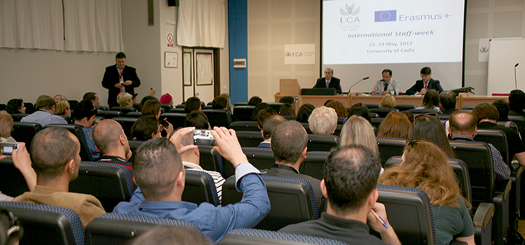
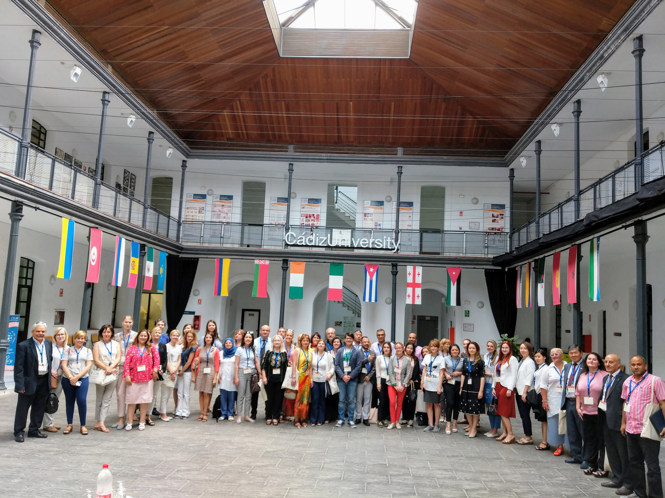
IESP PMB meeting – November 12th, 2021
Vth Staff Week - 2018
IVth Staff Week - 2017

