Slide 1
Principles of Management
Module 6: Organizational Structures

Slide 2
Module Learning Outcomes
Identify common organizational structures and the advantages and disadvantages of each.
6.1: Explain the purpose of organization
6.2: Describe common organizational structures and their advantages and disadvantages
6.3: Identify important factors for consideration in organizational design
6.4: Describe current trends in organization and job design

Slide 3
The Purpose of Organization

Slide 4
Learning Outcomes: The Purpose of Organization
6.1: Explain the purpose of organization
6.1.1: Explain the efficiencies created by specialization and the division of labor
6.1.2: Describe characteristics of organizational structures
6.1.3: List Edgar Schein's four common elements of an organization

Slide 5
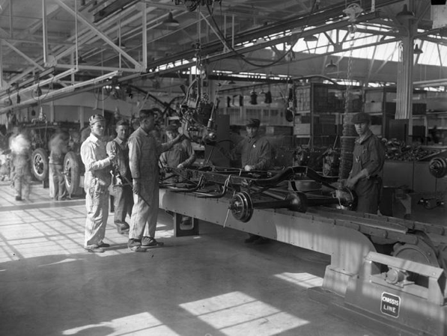
Common Elements
Common Purpose. Unifies employees and helps them understand organization’s direction
Coordinated Effort. Maximizes resources with the common purpose in mind- managers need to leverage employee skills and experiences
Specialization and the Division of Labor

Slide 6
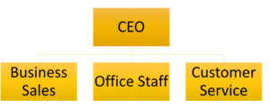
Common Elements Continued
Hierarchy of Authority: Determines formal, position-based reporting lines and expresses who reports to whom
CEO, business sales, office staff, customer service
Centralization and Decentralization: Degree to that decision making is concentrated to the top of the organization (key decisions made by executive team)
Formalization: Extent to which jobs within an organization are standardized

Slide 7
Common Organizational Structures

Slide 8
Learning Outcomes: Common Organizational Structures
6.2: Describe common organizational structures and their advantages and disadvantages
6.2.1: Differentiate between the four basic types of departmentalization (function, product, customer, and geography) Types of Departmentalization
6.2.2: Distinguish matrix organizations from traditional departments
6.2.3: Differentiate between team-based structures, networks, and modular organizations

Slide 9
Departmentalization
Functional Structure
Groups employees based on their expertise (e.g., operations and finance)
Generally used to allow for a higher degree of specialization
Product Structure
Groups employees based on product lines (e.g., aviation and transportation)
Generally used in organizations with multiple products
Customer Structure
Groups employees based on which customers they do their work for (e.g., outpatient and urgent care)
Generally used in organizations that have products or services unique to specific market segments
Geography Structure
Groups employees based on their physical location
Generally used in large organizations that span multiple regions

Slide 10
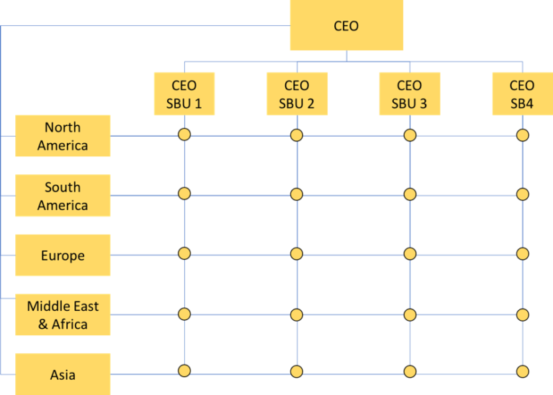
Matrix Organizations
Organized by two dimensions (e.g., product and geography)
Each employee will have two “bosses”
Combines the localization benefits of the geography structure with those of the functional structure.
Advantage: Provides both flexibility and more balanced decision making
Disadvantage: Complexity which can lead to confusion

Slide 11
Practice Question 1
Nike has a complex organization structure. It is broken down to divisions for Manufacturing, Sourcing, IT, Procurement, and Operations/Technology. There are also divisions that specialize in Running, Men’s Training, Women’s Fitness, Soccer, Basketball, and Digital Sports.
Nike’s organization could be classified as this type of structure:
Functional
Product
Geography
Matrix

Slide 12
Team-based Structures, Networks, and Modular Organizations
Team-based Structure. Focused on a few objectives and usually disbanded at project’s end
Team. Made up of people with complementary skills who are working toward a common purpose- created by grouping employees in a way that generates a variety of expertise
Network Structure. Little bureaucracy and features decentralized decision making- holacracy which attempts to achieve control and coordination by distributing power
Modular Organizations. Business that has areas that can be easily separated from company without jeopardizing it

Slide 13
Factors Impacting Organizational Design

Slide 14
Learning Outcomes: Factors Impacting Organizational Design
6.3: Identify important factors for consideration in organizational design
6.3.1: Identify aspects of the external environment that influence the design of an organization's structure
6.3.2: Identify aspects of the internal environment that influence the design of an organization's structure
6.3.3: Explain how business growth cycle affects organizational choices

Slide 15
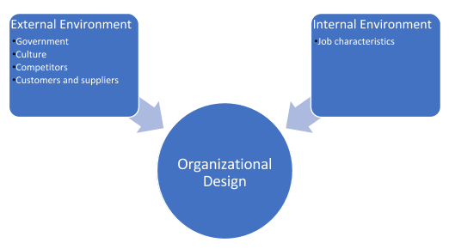
External and Internal Environment
External
Greater external forces, greater complexity of external environment
Internal
Skill variety: degree to which job requires use of high-level skills
Task identity: degree to which person is in charge of completing work
Task significance: degree to which person’s job affects customers
Autonomy: degree to which person has freedom to perform their tasks
Feedback: degree to which people learn how effective they are being

Slide 16
Growth Cycle
Creativity. Marked by early growth of company due to emphasis on product creation
Direction. Installs functional organizational structure with formal communication
Delegation. Marked by application of decentralized organizational structure
Coordination. Merging of local units into product groups and establish formal planning procedures
Collaboration. Takes collaboration with key leaders, managers, and employees to create better structure

Slide 17
Class Activity: Organization Design
Design an organizational structure for the following hypothetical businesses:
A mature manufacturing company with a narrow product line and customers world-wide.
A startup software company.
An apparel company with five brand businesses distributed internationally,
A media company composed of several acquisitions with business focused on TV, film, internet and a streaming service.

Slide 18
Current Trends in Organization and Job Design

Slide 19
Learning Outcomes: Current Trends in Organization and Job Design
6.4: Describe current trends in organization and job design
6.4.1: Explain the advantages of flatter organizational structures
6.4.2: Explain the benefits of employee empowerment
6.4.3: Explain the trend toward flexible work schedules

Slide 20
Understanding Current Trends in Organization and Job Design
Flatter Organizational Structures: focuses on horizontal growth, digging deeper, expanding knowledge, and getting better at core competencies
Employee Empowerment: trust employee’s ability and give them the authority to make decisions
Flexible work arrangements- reduced workload, compressed work weeks, and remote work

Slide 21
Practice Question 2
Studies have shown the recent trend of self-organizing teams, flexible work hours, employee empowerment, and flatter organizations fosters which of the following benefits?
Enhanced employee job satisfaction.
Increased employee engagement.
Improved customer service.
Increased productivity.

Slide 22
Quick Review
Can you correctly explain the efficiencies created by specialization and division of labor?
Are you now able to describe characteristics of organizational structures?
Please list Edgar Schein’s four common elements of an organization
Can you differentiate between four basic types of departmentalization?
Are you able to differentiate between team-based structures?
Please distinguish matrix organizations from traditional departments

Slide 23
More Quick Review
Can you correctly identify aspects of the external/internal environment that influence the design of an organization’s structure?
Please explain how business growth cycle affects organization
Can you explain the advantages of flatter organizational structures?
Please explain the benefits of employee empowerment
Are you able to explain the trend toward flexible work schedules?

