Slide 1

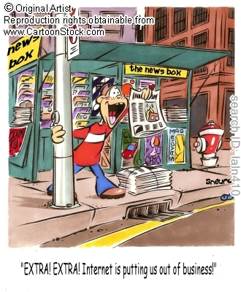
The Market Forces of Supply and Demand

Slide 2
Markets and Competition
Market – a group of buyers and sellers of a particular good or service
Competitive market – a market in which there are many buyers and many sellers so that each has a negligible impact on the market price

Slide 3
Competition: Perfect and Otherwise
Characteristics of a perfectly competitive market
  The goods being offered for sale are all the same
  The buyers and sellers are so numerous that none can influence the market price
  Because buyers and sellers must accept the market price as given, they are often called “price takers.”
Not all goods are sold in a perfectly competitive market
  A market with only one seller is called a monopoly market
    seller controls price
  A market with only a few sellers is called an oligopoly
    Not always aggressive competition
  A market with a large number of sellers, each selling a product that is slightly different from its competitor’s products, is called monopolistic competition
We will start by studying perfect competition

Slide 4
Demand
Demand comes from the behavior of buyers.
The demand curve: the relationship between price and quantity demanded
Quantity demanded – the amount of a good that buyers are willing and able to purchase
One important determinant of quantity demanded is the price of the product
Quantity demanded is negatively related to price. This implies that the demand curve is downward sloping
Law of demand – the claim that, other things equal, the quantity demanded of a good falls when the price of the good rises.

Slide 5
Demand Schedule
A table that shows the relationship between the price of a good and the quantity demanded
Example:
Helen’s demand for lattes.
Notice that Helen’s preferences obey the
Law of Demand.
Price of lattes | Quantity of lattes demanded
$0.00 | 16
1.00 | 14
2.00 | 12
3.00 | 10
4.00 | 8
5.00 | 6
6.00 | 4

Slide 6
Demand Curve
0
Price of Lattes
A graph of the relationship between the price of a good and the quantity demanded
Price is generally drawn on the vertical axis
Quantity demanded is represented on the horizontal axis
Quantity of Lattes

Slide 7
Helen’s Demand Schedule & Curve
0
Price of Lattes
Price of lattes | Quantity of lattes demanded
$0.00 | 16
1.00 | 14
2.00 | 12
3.00 | 10
4.00 | 8
5.00 | 6
6.00 | 4
Quantity of Lattes

Slide 8
Why the demand curve slopes downward?
What causes the inverse relationship between price and quantity demanded? Move along the line/curve
Law of Diminishing Marginal Utility
Income Effect – a lower price has the effect of increasing money income => buy more of other things
Substitution Effect–a lower price causes people to switch to the purchase of the “better deal”
Common sense – buy more if price is lower

Slide 9
Utility
Utility measures the want-satisfying power of a good or service. Subjective notion
Marginal utility is the additional or incremental satisfaction (utility) a consumer receives from acquiring one additional unit of a product.
Total utility: the total amount of satisfaction or pleasure a person derives from consuming some quantity.
Disutility results when total satisfaction decreases with the consumption of an additional unit.
  A person can eat only so many hot dogs before they get sick.
  A potato chip company had an ad that said "I bet you can't eat one." The idea was that utility went up and you had to eat more than one chip.
  A util is a fictitious measure of satisfaction. Two utils have twice the satisfaction of one util.

Slide 10
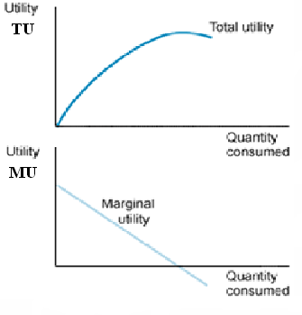
Law of Diminishing Marginal Utility
A law of economics stating that as a person increases consumption of a product - while keeping consumption of other products constant - there is a decline in the marginal utility that person derives from consuming each additional unit of that product.
The more a good, a consumer already has, the lower the extra (marginal) utility (satisfaction) provided by each extra unit
A util = a unit of satisfaction
When total utility is at its peak, marginal utility becomes zero. MU reflects the change in total utility so it is negative when total utility declines

Slide 11
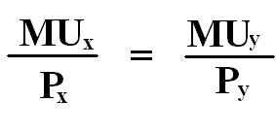


Law of Diminishing Marginal Utility
Consumers want:
  1)To maximize their total utility
  2) The most for their money, most “bang for their bucks”
3)
4)
In other words, whatever combination of two goods that meets this condition with the available income will maximize the consumer’s total utility.

Slide 12
Marginal Utility and Utility-Maximizing Combination
Units of J | MUj | Units of K | Muk
1 | 56 | 1 | 32
2 | 48 | 2 | 28
3 | 32 | 3 | 24
4 | 24 | 4 | 20
5 | 20 | 5 | 12
6 | 16 | 6 | 10
7 | 12 | 7 | 8
Given: Consumer income = $52, Price of J = $8, Price of K = $4
The consumer will maximize her utility by purchasing
3 units of J and 6 units of K
6 units of J and 3 units of K
4 units of J and 5 units of K
5 units of J and 5 units of K
2 units of J and 7 units of K

Slide 13


Marginal Utility and Utility-Maximizing Combination
Units of J | MUj | Units of K | Muk
1 | 56 | 1 | 32
2 | 48 | 2 | 28
3 | 32 | 3 | 24
4 | 24 | 4 | 20
5 | 20 | 5 | 12
6 | 16 | 6 | 10
7 | 12 | 7 | 8
Given: Consumer income = $52, Price of J = $8, Price of K = $4
The consumer will maximize her utility by purchasing
3 units of J and 6 units of K
6 units of J and 3 units of K
4 units of J and 5 units of K
5 units of J and 5 units of K
2 units of J and 7 units of K
Answer: C 4 units of J and 5 units of K
4J @ 8 = $32 + 5K @ $4 = $20 = $52

Slide 14
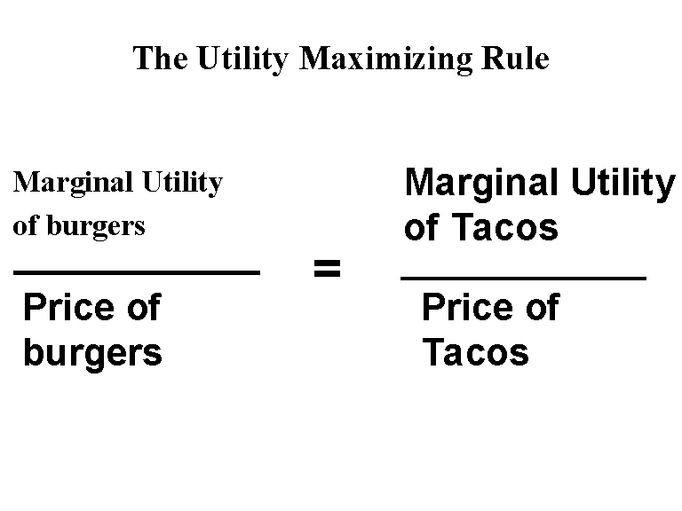
Utility Maximizing Rule

Slide 15
Market Demand Versus Individual Demand
The market demand is the sum of all of the individual demands for a particular good or service
The demand curves are summed horizontally – meaning that the quantities demanded are added up for each level of price
The market demand curve shows how the total quantity demanded of a good varies with the price of the good, holding constant all other factors that affect how much consumers want to buy

Slide 16
Market Demand versus Individual Demand
0
Suppose Helen and Ken are the only two buyers in the Latte market. (Q^{d} = quantity demanded)
Price
Helen’s Q^{d}
Ken’s Q^{d}
Market Q^{d}
$0.00
16
+
8
=
24
1.00
14
+
7
=
21
2.00
12
+
6
=
18
3.00
10
+
5
=
15
4.00
8
+
4
=
12
5.00
6
+
3
=
9
6.00
4
+
2
=
6

Slide 17
The Market Demand Curve for Lattes
0
P | Q^{d} (Market)
$0.00 | 24
1.00 | 21
2.00 | 18
3.00 | 15
4.00 | 12
5.00 | 9
6.00 | 6
P
Q

Slide 18
Shifts in the Demand Curve
The demand curve shows how much consumers want to buy at any price, holding constant the many other factors that influence buying decisions
If any of these other factors change, the demand curve will shift
  An increase in demand can be represented by a shift of the demand curve to the right
  A decrease in demand can be represented by a shift of the demand curve to the left

Slide 19
Shifts in the Demand Curve
Income
  The relationship between income and quantity demanded depends on what type of good the product is
  Normal good – a good for which, other things equal, an increase in income leads to a increase in demand
    Demand for a normal good is positively related to income.
  Inferior good – a good for which, other things equal, an increase in income leads to a decrease in demand
    Demand for an inferior good is negatively related to income.

Slide 20
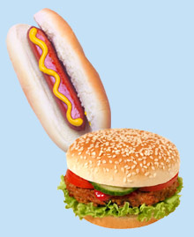
Shifts in the Demand Curve
Prices of related goods
  Substitutes – two goods for which an increase in the price of one good leads to an increase in the demand for the other
    Example: hot dogs and hamburgers.
    An increase in the price of hot dogs
    increases demand for hamburgers,
    shifting hamburger demand curve to the right.
    Other examples: Coke and Pepsi,
    laptops and desktop computers,
    compact discs and music downloads
  Complements – two goods for which an increase in the price of one good leads to a decrease in the demand for the other
    Example: computers and software.
    If price of computers rises, people buy fewer computers, and therefore less software.
    Software demand curve shifts left.
    Other examples: college tuition and textbooks,
    bagels and cream cheese, eggs and bacon

Slide 21
Shifts in the Demand Curve
Tastes
  Example:
  The Atkins diet became popular in the ’90s,
  caused an increase in demand for eggs,
  shifted the egg demand curve to the right.
Expectations – future income or future prices
  Examples:
  If people expect their incomes to rise,
  their demand for meals at expensive restaurants may increase now.
  If the economy turns bad and people worry about their future job security, demand for new autos may fall now.
Number of buyers
  An increase in the number of buyers causes
  an increase in quantity demanded at each price, which shifts the demand curve to the right.

Slide 22
Demand Curve Shifters: # of buyers
0
P
Suppose the number of buyers increases.
Then, at each price, quantity demanded will increase
(by 5 in this example).
Q
Notes:
Beginning economics students often have trouble understanding the difference between a movement along the curve and a shift in the curve. Here, the animation has been carefully designed to help students see that a shift in the curve results from an increase in quantity at each price.
(A more realistic scenario would involve a non-parallel shift, where the horizontal distance of the shift would be greater for lower prices than higher ones. However, to remain consistent with the textbook, and to keep things simple, this slide shows a parallel shift.)

Slide 23
Summary: Variables That Affect Demand
0
Variable A change in this variable…
Price …causes a movement
along the D curve
No. of buyers …shifts the D curve
Income …shifts the D curve
Price of
related goods …shifts the D curve
Tastes …shifts the D curve
Expectations …shifts the D curve
Notes:
Students should notice that the only determinant of quantity demanded that causes a movement along the curve is price. Also notice: price is one of the variables measured along the axes of the graph.
Here’s a handy “rule of thumb” to help students remember whether the curve shifts: If the variable causing demand to change is measured on one of the axes, you move along the curve. If the variable that’s causing demand to change is NOT measured on either axis, then the curve shifts.
This rule of thumb works with all curves in economics that involve an X-Y relationship. (I.e., it works for the supply curve, the marginal cost curve, the IS and LM curves, among many others, but it doesn’t apply to curves drawn on time series graphs.)

Slide 24

A C T I V E L E A R N I N G 1:
Demand curve
Draw a demand curve for music downloads. What happens to it in each of the following scenarios? Why?
A. The price of iPods falls
B. The price of music downloads falls
C. The price of compact discs falls
24
Notes:
In each case, there are only three possible answers:
- the curve shifts to the right
- the curve shifts to the left
- the curve does not shift (though there may be a movement along the curve)

Slide 25
A C T I V E L E A R N I N G 1:
A. price of iPods falls
Music downloads and iPods are complements.
A fall in price of iPods shifts the demand curve for music downloads
to the right.
Price of music down-loads
P₁
D₁
D₂
Q₁
Q₂
Quantity of
music downloads
25
Notes:
Point out to your students that there are no numbers or units on either axis, and we are using “P₁” and “Q₁” to represent the initial price and quantity, rather than specific numerical values. Tell them that this is common, because in much economic analysis, the goal is only to see the direction of changes, not specific amounts. (Besides, if we put numbers on this graph, they’d just have been made up, so why bother?)
Also point out the following:
Notice that the price of music downloads is the same, but the quantity demanded is now higher. In fact, this is the nature of a shift in a curve: at any given price, the quantity is different than before.

Slide 26
A C T I V E L E A R N I N G 1:
B. price of music downloads falls
Price of music down-loads
The D curve
does not shift.
Move down along curve to a point with lower P, higher Q.
P₁
P₂
D₁
Q₁
Q₂
Quantity of
music downloads
26

Slide 27
A C T I V E L E A R N I N G 1:
C. price of CDs falls
Price of music down-loads
CDs and
music downloads are substitutes.
A fall in price of CDs shifts demand for music downloads
to the left.
P₁
D₂
D₁
Q₂
Q₁
Quantity of
music downloads
27

Slide 28
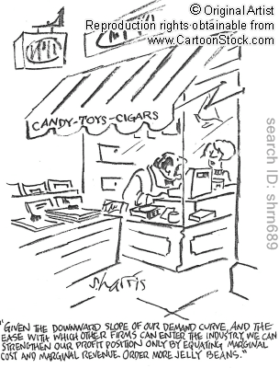
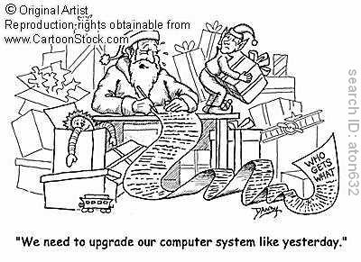
Cartoons

Slide 29
Supply
Supply comes from the behavior of sellers.
The Supply Curve: The Relationship between Price and Quantity Supplied
Quantity Supplied – the amount of a good that sellers are willing and able to sell
  Quantity supplied is positively related to price
  Law of supply – the claim that, other things equal, the quantity supplied of a good rises when the price of the good rises

Slide 30
Supply Schedule
Supply schedule – a table that shows the relationship between the price of a good and the quantity supplied
Example:
Starbucks’ supply of lattes.
Notice that Starbucks’ supply schedule obeys the
Law of Supply.
Price of lattes | Quantity of lattes supplied
$0.00 | 0
1.00 | 3
2.00 | 6
3.00 | 9
4.00 | 12
5.00 | 15
6.00 | 18

Slide 31
Supply Curve
0
P
Supply curve – a graph of the relationship between the price of a good and the quantity supplied
Q

Slide 32
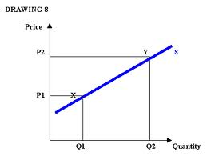
Supply Curve
Change in price causes a change in quantity
At X the price is P1 and quantity is Q1.
An increase in price increases the quantity supplied
Moving to point Y where price is P2 and quantity is Q2.

Slide 33
Starbucks’ Supply Schedule & Curve
0
Price of lattes | Quantity of lattes supplied
$0.00 | 0
1.00 | 3
2.00 | 6
3.00 | 9
4.00 | 12
5.00 | 15
6.00 | 18
P
Q

Slide 34
Market Supply vs. Individual Supply
The market supply curve can be found by summing individual supply curves
Individual supply curves are summed horizontally at every price
The market supply curve shows how the total quantity supplied varies as the price of the good varies

Slide 35
Market Supply versus Individual Supply
0
Suppose Starbucks and Jitters are the only two sellers in this market. (Q^{s} = quantity supplied)
Price
Starbucks
Jitters
Market Q^{s}
$0.00
0
+
0
=
0
1.00
3
+
2
=
5
2.00
6
+
4
=
10
3.00
9
+
6
=
15
4.00
12
+
8
=
20
5.00
15
+
10
=
25
6.00
18
+
12
=
30
Notes:
Again, the assumption of only two sellers is a clear violation of perfect competition. However, it’s much easier for students to learn how the market supply curve relates to individual supplies in the two-firm case.

Slide 36
The Market Supply Curve
0
P | Q^{S} (Market)
$0.00 | 0
1.00 | 5
2.00 | 10
3.00 | 15
4.00 | 20
5.00 | 25
6.00 | 30
P
Q

Slide 37
Shifts in the Supply Curve
The supply curve shows how much producers offer for sale at any given price, holding constant all other factors that may influence producers’ decisions about how much to sell
When any of these factors change, the supply curve will shift
  An increase in supply can be represented by a shift of the supply curve to the right
  A decrease in supply can be represented by a shift of the supply curve to the left

Slide 38

Shifts in the Supply Curve
Input prices/Resource(factor) prices
  Examples of input prices:
  wages, prices of raw materials.
  A fall in input prices makes production
  more profitable at each output price,
  so firms supply a larger quantity at each price,
  and the S curve shifts to the right.
Technology
  Technology determines how much inputs are required to produce a unit of output.
  A cost-saving technological improvement has same effect as a fall in input prices,
  shifts the S curve to the right.

Slide 39
Supply Curve Shifters: input prices
0
P
Suppose the price of milk falls.
At each price, the quantity of
Lattes supplied
will increase
(by 5 in this example).
Q
Notes:
Again, the animation here is carefully designed to help make clear that a shift in the supply curve means that there is a change in the quantity supplied at each possible price. If it seems tedious, you can turn it off. In any case, be assured that, by the end of this chapter, the animation of curve shifts will be streamlined and simplified.

Slide 40
Shifts in the Supply Curve
Expectations
  Suppose a firm expects the price of the good it sells to rise in the future.
  The firm may reduce supply now, to save some of its inventory to sell later at the higher price.
  This would shift the S curve leftward.
Number of sellers
  An increase in the number of sellers increases the quantity supplied at each price, shifts the S curve to the right.

Slide 41

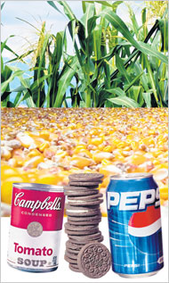
Shifts in the Supply Curve
Taxes/subsidies
  When a tax is added to a good the supply will decrease, when a subsidy is added to a good the supply will increase.
Price of other goods => production substitution
  Example: Corn syrup cheaper than sugar. Coca-Cola replaces sugar with corn syrup and increases the supply.
Notes:
Manufacturers had always been able to buy the sweetener at prices 20 percent to 70 percent less than those of sugar. In a 1983 article in Fortune magazine, one beverage analyst estimated that by switching to high-fructose corn syrup, Coca-Cola gained a cost advantage over Pepsi and its bottlers of $70 million a year. A year later, Pepsi followed in Coke's footsteps and also began using the sweetener. And McDonald's began supersizing its drinks in the late 80's.

Slide 42
Foods with Corn Syrup
Baking and Cooking ingredients Kellogg'sÂ® Corn Flake Crumbs Nabisco Oreo Cookie Crumbs Shake n Bake - Tangy Honey Glaze Shake n Bake - Honey Mustard GlazeStove Top Stuffing – Chicken Stove Top Stuffing – Cornbread Stove Top Stuffing - Homestyle Herb Stove Top Stuffing – Pork Stove Top Stuffing – Turkey Beverages: A&W Root Beer Capri-Sun Iced Tea Capri-Sun Juice Drink - Fruit Punch Capri-Sun Juice Drink – Grape Capri-Sun Juice Drink - LemonadeCapri-Sun Juice Drink - Mountain Cooler Capri-Sun Juice Drink – Orange Capri-Sun Juice Drink - Pacific Cooler Capri-Sun Juice Drink - Red Berry Capri-Sun Juice Drink - Splash Cooler Capri-Sun Juice Drink – Strawberry Capri-Sun Juice Drink - Strawberry/Kiwi Capri-Sun Juice Drink - Surfer Cooler Capri-Sun Juice Drink - Tropical Punch Capri-Sun Juice Drink - Wild Cherry Capri-Sun Refreshers - Orange Dragonfruit Capri-Sun Refreshers - Rasberry Passionfruit Capri-Sun Refreshers - Strawberry/Kiwi Capri-Sun Refreshers - Tropical Fruit Capri-Sun Sport Drink - Berry Ice Capri-Sun Sport Drink - Clear Cherry Chill Capri-Sun Sport Drink - Light Speed Lemon Lime Capri-Sun Sport Drink - Orange Edge Capri-Sun Sport Drink - Thunder Punch Coca-Cola Darigold Chocolate Milk Hanson's All-Natural Soda (all flavors) Hanson's Tonic Water Jones Soda Newman's Own Pink Lemonade Ocean Spray Cranberry Juice Orangenia Pepsi PowerAde Snapple -Cranberry Raspberry Juice Drink Sprite Starbucks' Frappuccino Thomas Kemper Soda's Tropicana OrangeAde Tropicana Smoothies Village Lemonade Breads: Brownberry Breads Pepperidge Farm's line of 100% whole grain breads Sara Lee Heart Healthy Whole Grain Bread. Thomas English Muffins Wonderbread Breakfast Cereals Kellogg's Frosted Rice KrispiesÂ® Kellogg's Tony's Cinnamon Krunchersâ„¢ Kellogg's Corn FlakesÂ® Kellogg's Frosted FlakesÂ®Kellogg's SmorzÂ®Kellogg's Special KÂ® Red Berries Kellogg's All-BranÂ® Bran BudsÂ® Kellogg's All-BranÂ® Extra Fiber Kellogg's All-BranÂ® Original Kellogg's Apple JacksÂ® Kellogg's Cinnamon Crunch Crispixâ„¢Kellogg's Cocoa KrispiesÂ®Kellogg's CompleteÂ® Oat Bran FlakesKellogg's CompleteÂ® Wheat Bran FlakesKellogg's Fruit Harvestâ„¢ Strawberry Blueberry Kellogg's Honey Crunch Corn FlakesÂ®Kellogg's Kellogg's Crunchy Blendsâ„¢ Just RightÂ® Fruit & NutKellogg's Kellogg's Crunchy Blendsâ„¢ Low Fat Granola without Raisins Kellogg's Kellogg's Crunchy Blendsâ„¢ Low Fat Granola With Raisins Kellogg's Mini-WheatsÂ® Frosted Bite Size Kellogg's Mini-WheatsÂ® Frosted Original Kellogg's Mini-WheatsÂ® Strawberry Kellogg's Crunchy Blendsâ„¢ MueslixÂ® with Raisins, Dates & Almonds Kellogg's Product 19Â® Kellogg's Raisin Bran Kellogg's Raisin Bran CrunchÂ® Kellogg's Rice Krispies TreatsÂ® Cereal Kellogg's Rice KrispiesÂ® Kellogg's Smart StartÂ® Antioxidants Kellogg's Smart StartÂ® Soy Protein Kellogg's Special KÂ® Kellogg's Special KÂ® Vanilla Almond Kellogg's Fruit Harvestâ„¢ Peach Strawberry Kellogg's SpongeBob SquarePantsâ„¢ Cereal Kellogg's Corn FlakesÂ® with Real Bananas Kellogg's Spider-manâ„¢ Spidey-Berry Cereal Kellogg's Kellogg's Frosted FlakesÂ® 1/3 Less Sugar Kellogg's Special KÂ® low carb lifestyle Kellogg's Fruit Harvestâ„¢ Banana Berry Kellogg's Disney Pixar Finding Nemoâ„¢ Cereal Kellogg's All-Branâ„¢ Bars Honey Oat Kellogg's All-Branâ„¢ Bars Brown Sugar Cinnamon Kellogg's Disney Pixar The Incrediblesâ„¢ Kellogg's Tiger Power Kellogg's Smart StartÂ® Healthy Heart Kellogg's Disney Lilo & Stitchâ„¢ Kellogg's Special KÂ® Fruit & Yogurt Kellogg's Mini Swirlzâ„¢ Fudge Ripple Kellogg's Toasted Honey Crunchâ„¢ Kellogg's Cran-Vanilla Crunchâ„¢ Post Blueberry Morning Cereal Breakfast Pastries EggoÂ® Pancakes Buttermilk EggoÂ® Waf-Fullsâ„¢ Blueberry EggoÂ® Waf-Fullsâ„¢ Strawberry Candy Bars: Hershey's Watchamacallit Lifesavers - Butter Rum Lifesavers - Chill-o-mints Lifesavers - Cryst-o-mint Lifesavers - Five Flavor Value Pack Lifesavers - Hard Candy Sours Lifesavers – Sours Lifesavers - Tropical Fruits Lifesavers - Wild Berries Lifesavers - Wild CherryOptimum Opti-Pro Meal Lite Bar PowerBar Condiments: Heinz 57 Sauce Heinz Ketchup Hunt's Catsup Miracle Whip Cookies and Cakes: Kellogg's Rice Krispies TreatsÂ® Squares Caramel Chocolatey Chunk Kellogg's Rice Krispies TreatsÂ® Squares OriginalKellogg's Rice Krispies TreatsÂ® Squares Rainbow Kellogg's Cereal & Milk Bars Frosted FlakesÂ® Kellogg's Cereal & Milk Bars Cocoa KrispiesÂ® Kellogg's Pop-TartsÂ® Frosted Hot Fudge Sundae Kellogg's Pop-TartsÂ® Spider-manâ„¢ Spidey-BerryKellogg's Pop-TartsÂ® Apple Cinnamon Kellogg's Pop-TartsÂ® Blueberry Kellogg's Pop-TartsÂ® Brown Sugar Cinnamon Kellogg's Pop-TartsÂ® Chocolate Chip Kellogg's Pop-TartsÂ® Frosted BlueberryKellogg's Pop-TartsÂ® Frosted Brown Sugar Cinnamon Kellogg's Pop-TartsÂ® Frosted Cherry Kellogg's Pop-TartsÂ® Frosted Chocolate Fudge Kellogg's Pop-TartsÂ® Frosted Chocolate Vanilla Crème Kellogg's Pop-TartsÂ® Frosted Grape Kellogg's Pop-TartsÂ® Frosted Raspberry Kellogg's Pop-TartsÂ® Frosted S'Mores Kellogg's Pop-TartsÂ® Frosted Strawberry Kellogg's Pop-TartsÂ® Frosted Wild Berry Kellogg's Pop-TartsÂ® Low Fat Frosted Brown Sugar Cinnamon Kellogg's Pop-TartsÂ® Star Warsâ„¢ Frosted Lava Berry Explosion Kellogg's Pop-TartsÂ® Frosted Caramel Chocolate Kellogg's Pop-TartsÂ® Frosted Cookies & Crème Kellogg's Pop-TartsÂ® Cinnamon Roll Kellogg's Pop-TartsÂ® Low Fat Frosted Chocolate FudgeKellogg's Pop-TartsÂ® Low Fat Frosted Strawberry Kellogg's Pop-TartsÂ® Strawberry Kellogg's Pop-TartsÂ® Yogurt Blasts Blueberry Kellogg's Pop-TartsÂ® Yogurt Blasts Strawberry Kellogg's Pop-TartsÂ® French Toast Kellogg's Pop-TartsÂ® SpongeBob SquarePantsâ„¢ Wild Bubble-BerryKellogg's Pop-TartsÂ® Chocolate Chip Cookie Dough Kellogg's Pop-TartsÂ® The Incredibles Incrediberry Blast Ice Creams Ben & Jerry's - Chubby Hubby (HFCS and Transfat!) - Should we call it Very Chubby Hubby? Ben & Jerry's - Cherry Garcia Ben & Jerry's - Neapolitan Dynamite Ben & Jerry's - Cherry Garcia Body & Soul Ben & Jerry's - Cherry Garcia Low Fat Frozen Yogurt Pints Ben & Jerry's - Cherry Garcia Original Ice Cream Singles Dreyer's - Girl Scouts Samoas Cookie Ice Cream Dreyer's - Almond Praline Grand Ice Cream Dreyer's - Cherry Chocolate Chip Grand Ice Cream Dreyer's - Cherry Vanilla Grand Ice Cream Dreyer's - Cookies 'N Cream Grand Ice Cream Dreyer's - Dulce de Leche Grand Ice Cream Dreyer's - Nestle Toll House Cookie Swirl Grand Ice Cream Dreyer's - Spumoni Grand Ice Cream Dreyer's - Toffee Bar Crunch Grand Ice Cream Dreyer's - Turtle Sundae Grand Ice Cream Dreyer's - Ultimate Caramel Cup Grand Ice Cream Jams, Jellies, and Syrups Eggoâ„¢ Syrup Original Syrup Eggoâ„¢ Syrup Buttery Syrup Eggoâ„¢ Syrup Lite Syrup Hershey's Chocolate Syrup Knott's Boysenberry preserves Smucker's Grape Jelly Meats Oscar Meyer Pickle and Pimento Loaf Pastries Nabisco Nilla Wafer Pie Crust Nabisco Oreo Pie Crust Jello No-Bake - Chips Ahoy Jello No-Bake – Oreo Pepperidge Farm's Puff Pastry sheets Salad Dressings: Emeril's Italian Vinegrette Kraft Salad Dressing - Light done Right Creamy French Kraft Salad Dressing - Thousand Island Fat Free Maple Grove Farms Caesar Fat Free Miracle Whip Salad Dressing Miracle Whip Salad Dressing - Hot n Spicy Miracle Whip Salad Dressing – Light Miracle Whip Salad Dressing - Light Super Easy Squeeze Miracle Whip Salad Dressing - Non-fat Miracle Whip Salad Dressing - Super Easy Squeeze Wishbone Ranch Dressing Wish-Bone Classic Caesar Oscar Mayer Lunchables - TacosSoups Campbells Vegatable soup (in microwaveable bowl) Crackers: Kraft Cheese Nips Nabisco Harvest Crisps - Wheat Thins 5 Grain Nabisco Ritz Bits - Peanut Butter Nabisco Ritz Bits - Graham Cracker S'mores Nabisco Ritz Chips - Cheddar - Oven-Toasted CrunchNabisco Ritz Crackers Nabisco Ritz Crackers - Low Sodium Nabisco Sociables Nabisco Wheat Thins Nabisco Wheat Thins – Baked Nabisco Wheat Thins - Low Sodium Nabisco Wheat Thins - Multi-Grain Nabisco Wheat Thins – Ranch Nabisco Wheat Thins - Reduced Fat Dairy: Breakstones Cottage Cheese & Toppings – Peach Breakstones Cottage Cheese & Toppings - PineappleBreyer's Yogurt -Fruit on the Bottom - Strawberry Lowfat Cool Whip Cool Whip - Extra-Creamy Cool Whip – Lite Knudsen - Cottage Double (Peach) Knudsen - Cottage Double (Pineapple)Knudsen - Cottage Double (Strawberry)Yoplait Yogurts Drink Mixers:Saratoga Salsa Bloody Mare Mix (spelling is correct)El Paso Chili Key Lime Margarita Mix Frozen Foods:Fruits and Vegetables:B&M Original Baked Beans Contadina Tomato Paste Claussen Pickles - Bread and Butter Chips Claussen Pickles - Kosher Dill Burger Slices Claussen Pickles - Sweet GherkinsClaussen Pickle Relish Del Monte canned petite diced tomatoes with italian seasonings Del Monte Fruit Naturals Red Grapefruit Heinz Pickle Relish Mott's Applesauce Mt. Olive Sweet Relish Mt. Olive Bread and Butter Pickles Ocean Spray Jellied Cranberry Sauce

Slide 43
Foods with Corn Syrup
Nabisco Barnum's Animal Crackers Nabsico Chips Ahoy Nabisco Fig Newtons Nabisco Fig Newtons - Fat Free Nabisco Fig Newtons - Whole Grain Nabisco Honey Maid Graham Crackers Nabisco Lorna Dornes Nabisco Nilla Wafers Nabisco Nutter Butter Nabisco Mallomars Nabisco Oreo Cookies Nabisco Snackwells - Creme Sandwich Nabisco Teddy Grahams Nutri-Grain Twistsâ„¢ Apple CobblerNutri-Grain Twistsâ„¢ Cappuccino & CremeNutri-Grain Twistsâ„¢ Strawberry CheesecakeNutri-GrainÂ® Muffin Bars Banana Nutri-GrainÂ® Muffin Bars Cinnamon Raisin Nutri-GrainÂ® Cereal Bars Apple Cinnamon Nutri-GrainÂ® Cereal Bars Blueberry Nutri-GrainÂ® Cereal Bars Cherry Nutri-GrainÂ® Cereal Bars Mixed Berry Nutri-GrainÂ® Cereal Bars Raspberry Nutri-GrainÂ® Cereal Bars Strawberry Nutri-GrainÂ® Chewy Granola Bars Honey Oat & Raisin Nutri-GrainÂ® Chewy Granola Bars Chocolatey Chunk Nutri-GrainÂ® Chewy Granola Bites Chocolatey Chip Nutri-GrainÂ® Minis Yogurt Icing Blueberry Nutri-GrainÂ® Minis Yogurt Icing Strawberry Nutri-GrainÂ® Yogurt Bars Strawberry Yogurt Nutri-GrainÂ® Yogurt Bars Vanilla Yogurt Nutri-GrainÂ® Muffin Bars Blueberry Nutri-GrainÂ® Chewy Granola Bites Caramel Nut Crunch Grandma's Homestyle Peanut Butter Cookies Cough Syrups:Delsym 12 Hour Cough Suppressant for Children, Orange Delsym 12 Hour Cough Suppressant, Orange Delsym Cough Suppressant Children's Dimetapp Decongestant Infant Drops Children's Dimetapp Decongestant Plus Cough Infant Drops Robitussin Infant Cough DM Robitussin Infant Cough & Cold CF Robitussin DM Cough Relief Infant Drops, Fruit Punch Robitussin Pediatric Cough & Cold Formula Robitussin Pediatric Cough Long-Acting Robitussin Pediatric Cough & Cold Long-Acting Robitussin Maximum Strength Cough & Cold Robitussin Head & Chest Congestion PE Robitussin Cough DM Robitussin PE Nasal Decongestant and Expectorant Robitussin Cough, Cold & Flu Nighttime Robitussin Chest Congestion Guaifenesin Syrup, USP Robitussin Cough & Congestion Robitussin Cough Long-Acting Robitussin Honey Cough Natural Cough Drops, Honey Center Vicks NyQuil multi-symptom - originalVicks NyQuil multi-symptom – cherry Vicks NyQuil Cough Vicks Formula 44 Cough Vicks Formula 44 Expectorant Vicks Formula 44 Decongestant Vicks Formula 44 Mult-symptom Pediatric Vicks 44E Cough & Congestion Pediatric Vicks 44M Cough & Cold Vicks Casero Sauces: A1 Steak Sauce Marinade – Cajun A1 Steak Sauce Marinade – Chicago A1 Steak Sauce Marinade – Teriyaki Bull's Eye BBQ Sauce Bull's Eye BBQ Sauce - Honey Smoke Bull's Eye BBQ Sauce - Smokehouse Hickory Bull's Eye BBQ Sauce - Sweet Hickory SmokeBull's Eye BBQ Sauce - Texas Style Mesquite Crazy Jerry's Alotta Bull BBQ Sauce - Torrid Toro (Hot Holy Smoke - Sticky Wings Glaze Holy Smoke - Bar B Q Glaze Jim Beam Steak Sauce Jim Beam Herb & Garlic Gourmet MarinadeJim Beam Lemon & Herb Gourmet Marinade Kraft Barbecue Sauce Penn State Nittany Lions Lime Grilling Sauce Pork Rubbers Original Competition BBQ Sauce Tuttorosso Marinara Tuttorosso Three Cheese Tuttorosso TraditionalTuttorosso Flavored With Meat Tuttorosso Mushroom Tuttorosso Tomato & Basil Tuttorosso Tomato, Olive & Garlic Virginia Gentleman Bourbon BBQ Sauce Snacks: Kraft Philadelphia Cream Cheese Strawberry Cheesecake Bar Kraft Philadelphia Cream Cheese Chocolate covered Strawberry Cheesecake Bar Oscar Mayer Lunchables - All Star Burgers Oscar Mayer Lunchables - All-star Hot Dogs Oscar Mayer Lunchables - Chicken Dunks Oscar Mayer Lunchables - Chicken Strips Oscar Mayer Lunchables - Cracker Stackers Oscar Mayer Lunchables – Nachos Oscar Mayer Lunchables - Peanut Butter Pile-upsOscar Mayer Lunchables – Pizza Oscar Mayer Lunchables - Pizza Dunks Oscar Mayer Lunchables - Pizza Pile-ups Oscar Mayer Lunchables - Pizza Stix Oscar Mayer Lunchables - Pizza Swirls

Slide 44
Summary: Variables That Affect Supply
0
Variable A change in this variable…
Price …causes a movement
along the S curve
Input prices …shifts the S curve
Technology …shifts the S curve
No. of sellers …shifts the S curve
Expectations …shifts the S curve
Notes:
Again, the price is the only determinant of quantity supplied that causes a movement along the curve. A change in any of the other determinants causes the supply curve to shift.

Slide 45

A C T I V E L E A R N I N G 2:
Supply curve
0
Draw a supply curve for tax return preparation software. What happens to it in each of the following scenarios?
  A. Retailers cut the price of the software.
  B. A technological advance allows the software to be produced at lower cost.
  C. Professional tax return preparers raise the price of the services they provide.
45
Notes:
Examples of tax return preparation software include TurboTax by Quicken and TaxCut by H&R Block.

Slide 46
A C T I V E L E A R N I N G 2:
A. fall in price of tax return software
Price of tax return software
The S curve
does not shift.
Move down
along the curve
to a lower P
and lower Q.
S₁
P₁
P₂
Q₂
Q₁
Quantity of tax return software
46

Slide 47
A C T I V E L E A R N I N G 2:
B. fall in cost of producing the software
Price of tax return software
The S curve shifts to the right:
at each price,
Q increases.
S₁
S₂
P₁
Q₁
Q₂
Quantity of tax return software
47

Slide 48
A C T I V E L E A R N I N G 2:
C. professional preparers raise their price
Price of tax return software
S₁
This shifts the demand curve for tax preparation software, not the supply curve.
Quantity of tax return software
48

Slide 49
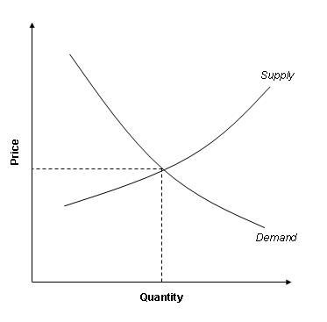
Supply and Demand Together
Equilibrium
  The point where the supply and demand curves intersect is called the market’s equilibrium
  Equilibrium – a situation in which the price has reached the level where quantity supplied equals quantity demanded
  Equilibrium price – the price that balances quantity supplied and quantity demanded
  the equilibrium price is often called the “market-clearing” price because both buyers and sellers are satisfied at this price
  Equilibrium quantity – the quantity supplied and the quantity demanded at the equilibrium price

Slide 50
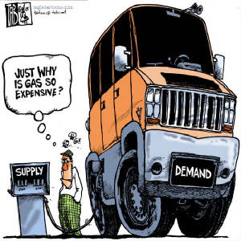

Slide 51
Supply and Demand Together
0
P
Equilibrium:
P has reached
the level where
quantity supplied equals
quantity demanded
D
S
Q
Notes:
We now return to the latte example to illustrate the concepts of equilibrium, shortage and surplus.

Slide 52
__________ _____
Equilibrium price:
0
The price that equates quantity supplied with quantity demanded
P
D
S
P | Q^{D} | Q^{S}
$0 | 24 | 0
1 | 21 | 5
2 | 18 | 10
3 | 15 | 15
4 | 12 | 20
5 | 9 | 25
6 | 6 | 30
Q

Slide 53
__________ ________
Equilibrium quantity:
0
The quantity supplied and quantity demanded at the equilibrium price
P
D
S
P | Q^{D} | Q^{S}
$0 | 24 | 0
1 | 21 | 5
2 | 18 | 10
3 | 15 | 15
4 | 12 | 20
5 | 9 | 25
6 | 6 | 30
Q

Slide 54
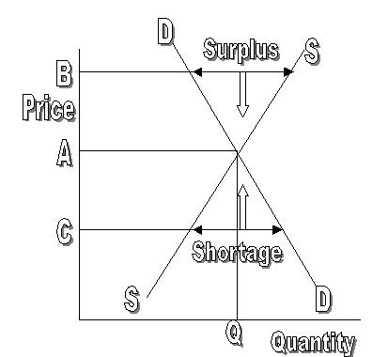
Supply and Demand Together
If the actual market price is higher than the equilibrium price, there will be a surplus of the good
Surplus – a situation in which quantity supplied is greater than quantity demanded
To eliminate the surplus, producers will lower the price until the market reaches equilibrium

Slide 55
Surplus:
0
when quantity supplied is greater than quantity demanded
P
D
Surplus
S
Example:
If P = $5,
then
Q^{D} = 9 lattes
and
Q^{S} = 25 lattes
resulting in a surplus of 16 lattes
Q

Slide 56
Surplus:
0
when quantity supplied is greater than quantity demanded
P
Facing a surplus,
sellers try to increase sales by cutting the price.
D
Surplus
S
This causes
Q^{D} to rise
and Q^{S} to fall…
…which reduces the surplus.
Q

Slide 57
Surplus:
0
when quantity supplied is greater than quantity demanded
P
Facing a surplus,
sellers try to increase sales by cutting the price.
D
Surplus
S
Falling prices cause
Q^{D} to rise and Q^{S} to fall.
Prices continue to fall until market reaches equilibrium.
Q

Slide 58
Supply and Demand Together
If the actual price is lower than the equilibrium price, there will be a shortage of the good
Shortage – a situation in which quantity demanded is greater than quantity supplied.
Sellers will respond to the shortage by raising the price of the good until the market reaches equilibrium
Law of supply and demand – the claim that the price of any good adjusts to bring the supply and demand for that good into balance

Slide 59
Shortage:
0
when quantity demanded is greater than quantity supplied
P
D
S
Example:
If P = $1,
then
Q^{D} = 21 lattes
and
Q^{S} = 5 lattes
resulting in a
shortage of 16 lattes
Shortage
Q

Slide 60
Shortage:
0
when quantity demanded is greater than quantity supplied
P
Facing a shortage,
sellers raise the price,
D
S
causing Q^{D} to fall
and Q^{S} to rise,
…which reduces the shortage.
Shortage
Q

Slide 61
Shortage:
0
when quantity demanded is greater than quantity supplied
P
Facing a shortage,
sellers raise the price,
D
S
causing Q^{D} to fall
and Q^{S} to rise.
Prices continue to rise until market reaches equilibrium.
Shortage
Q

Slide 62
Three steps to analyzing changes in equilibrium
Decide whether the event shifts the supply or demand curve
Decide in which direction the curve shifts
Use the supply-and-demand diagram to see how the shift changes the equilibrium price and quantity
  A shift in the demand curve is called a “change in demand.” A shift in the supply curve is called a “change is supply.”
  A movement along a fixed demand curve is called a “change in quantity demanded.” A movement along a fixed supply curve is called a “change in quantity supplied.”

Slide 63
EXAMPLE: The Market for Hybrid Cars
P
price of hybrid cars
S₁
P₁
D₁
Q
Q₁
quantity of
hybrid cars
Notes:
Examples of hybrid cars that exist as of August 2005:
Toyota Prius, Honda Insight, plus hybrid versions of the Ford Escape, Honda Accord, Toyota Highlander, and the Lexus RX400h SUV.

Slide 64
EXAMPLE 1: A Change in Demand
EVENT TO BE
ANALYZED:
Increase in price of gas.
P
S₁
P₂
STEP 1: D curve shifts
because price of gas affects demand for hybrids.
S curve does not shift, because price of gas does not affect cost of producing hybrids.
P₁
D₁
D₂
STEP 2: D shifts right
because high gas price makes hybrids more attractive relative to other cars.
Q
Q₁
Q₂
STEP 3:
The shift causes an increase in price
and quantity of hybrid cars.

Slide 65
EXAMPLE 1: A Change in Demand
Notice:
When P rises, producers supply
a larger quantity
of hybrids, even though the S curve has not shifted.
P
S₁
P₂
P₁
Always be careful to distinguish b/w a shift in a curve and a movement along the curve.
D₁
D₂
Q
Q₁
Q₂

Slide 66
Shift vs. Movement Along Curve
Change in supply: a shift in the S curve
  occurs when a non-price determinant of supply changes (like technology or costs)
Change in the quantity supplied:
a movement along a fixed S curve
  occurs when P changes
Change in demand: a shift in the D curve
  occurs when a non-price determinant of demand changes (like income or # of buyers)
Change in the quantity demanded:
a movement along a fixed D curve
  occurs when P changes
Notes:
“Supply” refers to the position of the supply curve, while “quantity supplied” refers to the specific amount that producers are willing and able to sell.
Similarly, “demand” refers to the position of the demand curve, while “quantity demanded” refers to the specific amount that consumers are willing and able to buy.
If you’d like to be a rebel, delete this slide and all references to the jargon it contains, and just use the terms “movement along a curve” and “shift in a curve.” Note, however, that this is not the official recommendation of Thomson/South-Western or Dr. Mankiw.
If you’d like to cover this slide but make it move more quickly, delete the text next to each little blue bullet point, and give the information to your students verbally (or rely on them to read it in the textbook).

Slide 67
EXAMPLE 2: A Change in Supply
EVENT: New technology reduces cost of producing hybrid cars.
P
S₁
S₂
STEP 1: S curve shifts
because event affects cost of production.
D curve does not shift, because production technology is not one of the factors that affect demand.
P₁
P₂
D₁
STEP 2: S shifts right because event reduces cost, makes production more profitable at any given price.
Q
Q₁
Q₂
STEP 3: The shift causes price to fall and quantity to rise.

Slide 68
EXAMPLE 3: A Change in Both Supply and Demand
EVENTS:
price of gas rises AND
new technology reduces production costs
P
S₁
S₂
P₂
P₁
STEP 1: Both curves shift.
STEP 2:
Both shift to the right.
D₁
D₂
STEP 3:
Q rises, but effect
on P is ambiguous:
If demand increases more than supply, P rises.
Q
Q₁
Q₂

Slide 69
EXAMPLE 3: A Change in Both Supply and Demand
P
EVENTS:
price of gas rises AND
new technology reduces production costs
S₁
S₂
P₁
P₂
STEP 3, cont.
But if supply increases more than demand,
P falls.
D₁
D₂
Q
Q₁
Q₂

Slide 70
A C T I V E L E A R N I N G 3:
Changes in supply and demand
Use the three-step method to analyze the effects of each event on the equilibrium price and quantity of music downloads.
  Event A: A fall in the price of compact discs
  Event B: Sellers of music downloads negotiate a reduction in the royalties they must pay for each song they sell.
  Event C: Events A and B both occur.
70
Notes:
In case it’s not clear: The royalties that sellers must pay the artists are part of the sellers’ “costs of production.” Typically, this royalty is a fixed amount each time one of the artist’s songs is downloaded. Event B is a reduction in this cost.

Slide 71
A C T I V E L E A R N I N G 3:
A. fall in price of CDs
P
STEPS
S₁
1. D curve shifts
P₁
2. D shifts left
P₂
3. P and Q both fall.
D₂
D₁
Q
Q₂
Q₁
The market for music downloads
71
Notes:
This is an extension of Active Learning exercise 1C, where we saw that a fall in the price of compact discs would cause a fall in demand for music downloads, because the two goods are substitutes.

Slide 72
A C T I V E L E A R N I N G 3:
B. fall in cost of royalties
The market for music downloads
P
S₁
S₂
STEPS
1. S curve shifts
P₁
(royalties are part of sellers’ costs)
P₂
2. S shifts right
D₁
3. P falls,
Q rises.
Q
Q₁
Q₂
72
Notes:
NOTE: Don’t worry that the text on this slide looks garbled in “Normal view” (i.e. edit mode). It works fine in “Slide Show” (i.e. presentation mode).
Event B: Sellers of music downloads negotiate a reduction in the royalties they must pay for each song they sell. This event causes a fall in “costs of production” for sellers of music downloads. Hence, the S curve shifts to the right.

Slide 73
A C T I V E L E A R N I N G 3:
C. fall in price of CDs
AND fall in cost of royalties
STEPS
1. Both curves shift (see parts A & B).
2. D shifts left, S shifts right.
3. P unambiguously falls.
Effect on Q is ambiguous:
The fall in demand reduces Q,
the increase in supply increases Q.
73
Notes:
It’s not necessary to draw a graph here. The answers to steps 1 and 2 should be clear from parts A and B. The answer to step 3 is a combination of the results from A and B.

Slide 74
CONCLUSION:
How Prices Allocate Resources
One of the Ten Principles from Chapter 1: Markets are usually a good way
to organize economic activity.
In market economies, prices adjust to balance supply and demand. These equilibrium prices are the signals that guide economic decisions and thereby allocate scarce resources.
Notes:
In the textbook, the conclusion of this chapter offers some very nice elaboration on the second bullet point.

Slide 75
