Slide 1
Principles of Management
Module 4: Environments and Strategic Management

Slide 2
Module Learning Outcomes
Explain the components and considerations of strategic management
4.1: Explain the role of strategy in management
4.2: Describe common frameworks used to evaluate the business environment
4.3: Describe common frameworks used for situational analysis
4.4: Explain the stages of strategy, and describe the common types of business strategies
4.5: Explain the key aspects of the environment that can affect strategy

Slide 3
The Role of Strategy in Management

Slide 4
Learning Outcomes: The Role of Strategy in Management
4.1: Explain the role of strategy in management
4.1.1: Explain the concept of competitive advantage
4.1.2: Explain the concept of value proposition
4.1.3: Explain how strategy relates to the overall management of a business

Slide 5
Understanding The Role of Strategy in Management
A company strategy
is a comprehensive plan to achieve a goal
keeps company aligned with customer’s needs
involves a significant commitment of resources
Competitors are firms that provide similar products or services.
Companies must “beat” competitors by striving to improve offerings to customers and be better than alternatives.

Slide 6
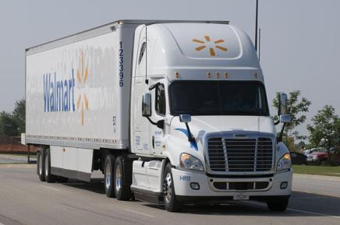
Competitive Advantage
When customers perceive the distinction as being valuable, they will prefer to purchase the business’s product over a competitor’s.
Companies strive to provide a product or service that is distinct, or differentiated, in some way from their competitors.
The best businesses provide a combination of unique attributes that competitors cannot match.

Slide 7
Creating Competitive Advantage
It may seem that the best way to create competitive advantage is to do everything well. Unfortunately, this is not possible.
Businesses create competitive advantage by doing some things better than their competitors.
Businesses that try to do too many things well often don’t succeed at doing anything extremely well and don’t produce distinction. This is referred to as being “stuck in the middle.”
The goal of companies is to create competitive advantage in ways that are difficult or costly for competitors to copy. This is called a sustainable competitive advantage.

Slide 8
The Value Proposition
Statement a company uses to convince customers that its product or service provides more value than a competitor’s
Communicates to customer main reason a product/service is the best
Communicated through webpage, advertising, or social media- must grab attention

Slide 9
Strategic Management
Process of integrating all functions in an organization into a whole
Allows organization to develop synergy
Has Two main functions:
Determine how company will create competitive advantage
Make sure people in organization support the strategy
Instils a culture of excellence

Slide 10
Industry Analysis
a method for a company to assess its market position relative to its competitors.
helps a company review various market and financial factors in its industry that affect the business, including evaluating the competition.
helps managers understand the important factors of the marketplace and how these factors may be used to gain a competitive advantage.
are an important tool for companies to assess their strategy in a shorter time frame.

Slide 11
Class Discussions: Car Company Differentiation
Consider the following car companies. Is there a particular characteristic or quality that you associate with each of them?
Porsche
Volvo
Hyundai
Toyota
Ford
What is their competitive advantage? Summarize in your own words for they differentiate from their competitors.

Slide 12
Common Frameworks for Evaluating the Business Environment

Slide 13
Learning Outcomes: Environments and Strategic Management
4.2: Describe common frameworks used to evaluate the business environment
4.2.1: Explain environmental scanning and the PESTEL checklist for a company's general environment
4.2.2: Explain the impact of Porter's "five forces" on industry profits
4.2.3: Explain competitor analysis

Slide 14
Common Frameworks for Evaluating the Business Environment
Environmental scanning
high-level, broad-based process of gathering, analyzing, and dispensing information for new strategies
helps managers avoid being taken by surprise
Entails getting both factual data and qualitative opinions
PESTEL
organizing framework that allows decision makers to understand and make connections with a mass of information
key macro-environmental factors in order to understand interactions

Slide 15
PESTEL Factors
Political: function of how much government intrudes or is involved in organization’s operations- taxation/tariffs, regulations, elections, etc.
Economic: growth, employment, inflation, and interest rates- foreign operations will worry about exchange rates
Social: demographics such as population growth, age distribution, and attitudes toward safety and health- rising rates of obesity as example
Technological: research and development, automation, and incentives
Environmental: weather, climate change, air quality, natural disasters- risks with manufacturing, agriculture, tourism, and sports entertainment
Legal: discrimination laws, consumer protection laws, and employment health and safety policies- antitrust, piracy, and copyright laws affect how organizations operate

Slide 16
Porter’s Five Forces
Michael Porter, a well-known business consultant and professor at Harvard University, identified five critical external factors that affect strategies being developed by organizations in any industry.
This system, known as Porter’s Five Forces, has become an important management strategy tool.
It measures the competitiveness of an industry and thus its attractiveness or potential profitability. An unattractive industry is one in which the combination of these five forces acts to drive down overall profitability.

Slide 17
Porter’s Five Forces
Five critical external factors that affect strategies being developed by organizations in any industry
Threat of new entrants:
threat that new competitors pose to existing business in industry
Threat of substitute products or services:
different product or service but performs the same purpose in the mind of the consumer
Competitive rivalry within industry:
intensity of competition is main force to determine profitability
Bargaining power of buyers:
amount of pressure customers can put on a seller
Bargaining power of suppliers:
limits ability of the seller to make a profit- can pressure buyers by raising prices, lowering quality

Slide 18
Competitor Analysis
A robust competitive analysis will allow you to focus on those companies that will compete for customers in your target market.
A company’s analysis looks at a competitor and inquires about:
General Background information
Financial inquiries
Products that they sell
Customers that they serve
Advertising and Sales distribution channels
Personnel and their plans for hiring

Slide 19
Practice Question 1
What resources would be valuable to a researcher to conduct a competitive analysis?
Competitor's annual report and quarterly filings.
Independant industry analysts reports.
Consumer focus groups.
Search engine analysis.
Observations from ex-employees (Glassdoor, etc.).
Social media.
Competitor press releases and public statements.
Secret shoppers.
Interviews with common vendors.

Slide 20
Class Activity: PESTLE vs Porter’s Five Forces
Compare and contrast the value of using the PESTLE process and Porter’s Five Forces for completing an environmental scan for a business. What are the negative and positive aspects of both approaches?
Use examples of businesses to discuss your answers.

Slide 21
Present: PESTLE vs Porter’s Five Forces

Slide 22
Common Frameworks for Situational Analysis

Slide 23
Learning Outcomes: Common Frameworks for Situational Analysis
4.3: Describe common frameworks used for situational analysis
4.3.1: Differentiate among five components of industry environment: customers, competitors, suppliers, regulations, and advocacy groups
4.3.2: Explain SWOT
4.3.3: Explain the resource-based view of strategy

Slide 24
Understanding Common Frameworks for Situational Analysis
Situational Analysis
Looks more closely at external and internal conditions that affect particular organization
Considers what impact these factors may have on a specific organization
Five Key Components for Situational Analysis
Customers
Competitors
Suppliers
Government
Legal issues (regulations and advocacy)

Slide 25
Situational Analysis Components
Customers: identify target customer, understand specific customer needs, show how product or service meets those needs
Competitors: must be able to identify specific competitors and assess potential for taking market share
Suppliers: supply chain is a system comprised of organizations, information, resources, etc. that brings products to consumer
Regulations: affects investment and spending, corporate image, and risk management- greater burden on small companies unless exempted due to size
Advocacy Groups: aim is to influence public opinion, public policy, and company behavior- represent political, economic, and social interests

Slide 26
What Does a Situational Analysis Provide?
A Customer Analysis :
Identifies the target customer.
Is this customer base growing or is it decreasing?
What are your customer demographics (age, income, location, gender, politics, etc.)? What is the revenue of these customers?
How much discretionary income do they have?
Builds understanding of the specific customer needs
Why do they buy certain brands?
How do make their purchasing decisions?
Do they purchase in person or online?
Shows if and how your product or service meets those needs.

Slide 27
Competitors, Suppliers, and Regulations
identify an organization’s specific competitors and assess their potential for taking market share.
be aware of future initiatives of the competition (as much as is possible)
examine the competitors’ financial and marketing performances.
The supply chain is a system comprised of organizations, information, resources, people, technology, and activities that bring products or services from a supplier to a consumer.
Complying with regulations often involves a trade-off between short-term profits and long-term public relations and social responsibility.
Advocacy groups are also known as special interest groups, public interest groups, environmental groups, or political support groups.
influence public opinion, public policy, and company behavior.

Slide 28
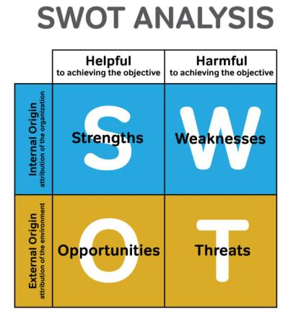
SWOT: A Situational Analysis Summary
Method that examines internal strengths and weaknesses of an organization and external opportunities/threats
SWOT
Strengths- particular skills and resources to pursue goals effectively
Weaknesses- where it is lacking resources and prevented from pursing goals
Opportunities- conditions favorable to organization
Threats- conditions that prevent organization from achieving its goals

Slide 29
Practice Question 2
To which quadrant of a SWOT analysis would this example belong?
“-Vertical Integration: competitors have control of supply and distribution channels to control the market.
-Price fluctuations: prices of ingredients are elastic and fluctuate without warning.
-Marketing costs: competitive marketing campaigns need to be extensive and are quite expensive.”
Strengths
Weaknesses
Opportunities
Threats

Slide 30
Resource-based View Strategic Approach (RBV)
The resource-based view (RBV) argues that focusing on an organization’s strengths is essential to achieve a sustained competitive advantage.
Tangible assets are physical things such as land, equipment and machines, and real estate. Although they are necessary, they aren’t unique and competitors can fairly easily acquire these kinds of assets.
Intangible assets are anything an organization can own that is not physical. Examples include brand names, intellectual property, and the organization’s reputation and goodwill. These kinds of assets are not easily acquired and usually contribute heavily toward a sustained competitive advantage.

Slide 31
VRIO Framework
VRIO stands for the four key characteristics that a resource must have if it is to produce sustained competitive advantage.
Valuable. A resource is valuable if it enables the company to take advantage of opportunities or defend against threats.
Rare. If only one or two companies can acquire a resource it is considered rare.
Inimitable. If another organization can’t copy, buy, or find a replacement for the resource, it is inimitable.
Organized to capture value. The three characteristics listed earlier are “necessary but not sufficient conditions” to achieve a sustained competitive advantage.

Slide 32
Stages and Types of Strategy

Slide 33
Learning Outcomes: Stages and Types of Strategy
4.4: Explain the stages of strategy, and describe the common types of business strategies
4.4.1: Explain the stages of strategy
4.4.2: Explain Porter's general types of competitive strategies
4.4.3: Explain e-commerce strategy

Slide 34
Strategic Management Process
Strategic Objectives and Analysis:
defines vision, mission, and values combined with PESTEL and SWOT
Strategic Formulation:
PESTEL
SWOT
Strategic Implementation
Sometimes referred to as strategic execution
Strategic Evaluation and Control

Slide 35
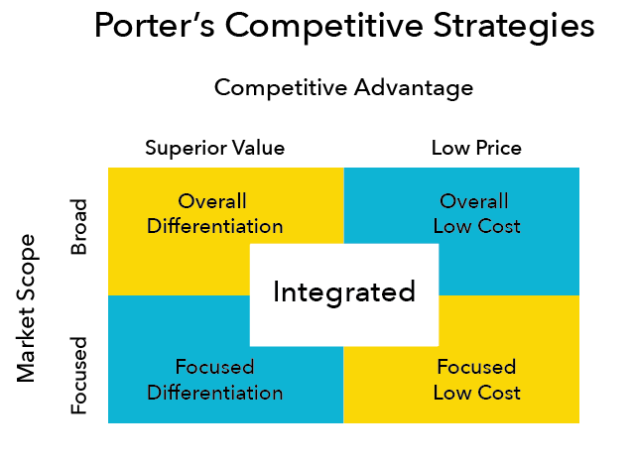
Porter’s Competitive Strategies
Low Price Leadership
Reduces buyer bargaining, forces out less efficient rivals, makes it hard for new entrants to compete
Differentiation Leadership Strategy
Buyers are less price-sensitive, rivalry is reduced, difficult for new entrants to copy product/service, uniqueness makes it hard to substitute
Integrated
Provides values to two types of customers, forces out less efficient rivals

Slide 36
E-Business and E-Commerce
E-Business is business that takes place over digital processes using computer network rather than in physical location
Relates to decreasing production costs and increasing efficiency
Creates a customer focus
Addresses internal management
E-Commerce refers to exchanges or transactions that occur electronically.
Many organizations have sales and marketing teams dedicated to devising strategies for capturing their share of the growing online market.

Slide 37
Class Discussion: Differentiation
A strategy based on differentiation (distinction) calls for goods and services that offer unique features and that have high value for the target customer. The features must be perceived by the customer to be so much better than what the competition offers that they are worth an additional cost.
What are some of the advantages and disadvantages of a differentiation strategy?

Slide 38
How Environment Affects Strategy

Slide 39
Learning Outcomes: How Environment Affects Strategy
4.5 Explain the key aspects of the environment that can affect strategy
4.5.1 Explain the key aspects of the environment that can affect strategy (e.g. stability, complexity, resource scarcity, and uncertainty)

Slide 40
Understanding How Environment Affects Strategy
Stability
The rate at which change occurs- in a stable environment, change is slow
A dynamic environment is rapidly changing
Complexity
Number of elements in organization’s environment and their connections—variables hard to identify and measure and often to understand
Resource scarcity
Availability of critical resources or those in high command
Uncertainty
How predictable environmental conditions are

Slide 41
Class Activity: Strategy and the Business Environment
Conditions of instability, complexity, resource scarcity, and uncertainty make it impossible for managers to anticipate change and make rational decisions. Instead, they must operate with incomplete data and base decisions on assumptions and best guesses.
Choose a product that you use in everyday life to discuss in small groups. Using the four factors that influence the business environment, discuss ways in which you would need to consider each in your management role.

Slide 42
Present: Strategy and the Business Environment

Slide 43
Quick Review
Explain the concept of competitive advantage and value proposition and how they relate to the overall business management
Explain environment scanning and the PESTEL checklist for a company’s general environment
Describe the impact of Porter’s “five forces” on industry profits and explain competitor analysis
Differentiate among five components of industry environment and explain SWOT/resource-based view of strategy
Explain the stages of strategy, Porter’s types of strategies, and e-commerce strategy
Explain the key aspects of the environment that can affect strategy

