Slide 1
Principles of Management
Module 2: History of Management

Slide 2
Module Learning Outcomes
Describe the work of major contributors to the field of management
2.1: Describe the contributions of Frederick W. Taylor, Frank and Lillian Gilbreth, and Henry Gantt to the field of scientific management
2.2: Describe the contributions of Max Weber and Henri Fayol to the field of bureaucratic management
2.3: Describe the contributions of Mary Parker Follett and Elton Mayo (Hawthorne studies) to the field of humanistic management
2.4: Describe current developments in management practices

Slide 3
Scientific Management

Slide 4
Learning Outcomes: Scientific Management
2.1: Describe the contributions of Frederick W. Taylor, Frank and Lillian Gilbreth, and Henry Gantt to the field of scientific management
2.1.1: Explain the concept of scientific management
2.1.2: Summarize the work of Frederick W. Taylor
2.1.3: Summarize the work of Frank and Lillian Gilbreth
2.1.4: Summarize the work of Henry Gantt

Slide 5
Basics of Scientific Management
Frederick Winslow Taylor
Known as the father of management
Examined ways to run a business efficiently and productively
Revolutionary ideas
Emphasized employee training
Implemented standardized practices to improve productivity
His method is seen as scientific management
Borrowed techniques from botanists and chemists
Employed scientific techniques such as analysis, observation, synthesis, rationality, and logic

Slide 6
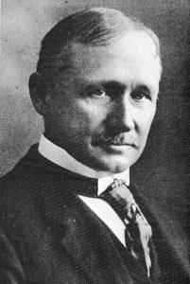
Frederick W. Taylor
Was a mechanical engineer
Interested in the type of work done in factories and mechanical shops
In 1909, he published the Principles of Scientific Management
Believed the work system could be improved
Searched for employees incentives
Everyone should get “a fair day’s pay for a fair day’s work” (no more, no less)
Employees must meet goals
Productivity would increase if jobs were simplified
Jobs should be broken down by job component and timed to check efficiency

Slide 7
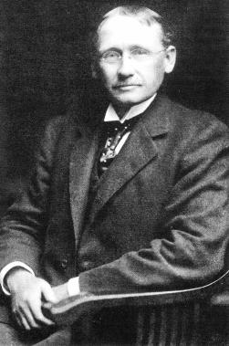
Frederick W. Taylor Theories
Concerned about worker output more than worker satisfaction/motivation
Introduced idea of systematic training and selection- encouraged owners to interact with worker
Created a “First-class worker” concept
detailed what worker should be able to accomplish
Digital Taylorism is maximizing efficiency
Updated version used by FedEx and Amazon

Slide 8
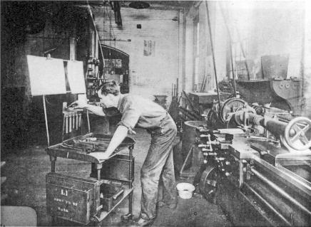
Scientific Management Core Principles
Look at each task to determine “best way” to perform job
Hire right workers for each job and train to work at maximum efficiency
Monitor worker performance and provide instruction and training
Divide work between management and labor so workers can be more efficient

Slide 9
Classical School of Management
The Gilbreths focused on worker welfare and motivation.
They believed that by reducing the amount of motions associated with a particular task, they could also increase the worker’s well-being.
Their research, along with Taylor’s, provided many important principles later incorporated into quality assurance and quality control programs begun in the 1920s and 1930s.
Eventually, their work led to the science of ergonomics and industrial psychology.

Slide 10
Benefits of Gantt’s Project Management:
The Gantt chart has multiple benefits for project management:
aids in the breakdown of tasks into specific elements
allows for the monitoring of projected timelines
identifies which tasks are dependent upon a prior task or element
identifies which tasks are which are independent and can be completed at any time

Slide 11
Class Discussion: Maximizing Efficiency
Taylor suggested that productivity would increase if jobs were optimized and simplified. He also proposed matching a worker to a particular job that suited the person’s skill level and then training the worker to do that job in a specific way.
If Digital Taylorism focuses on maximizing efficiency, then how does that influence the work of a modern day employee? What are some examples of this theory that you know from experience?

Slide 12
Bureaucratic Management

Slide 13
Learning Outcomes: Bureaucratic Management
2.2: Describe the contributions of Max Weber and Henri Fayol to the field of bureaucratic management
2.2.1: Explain the concept of bureaucratic management
2.2.2: Summarize the work of Max Weber
2.2.3: Summarize the work of Henri Fayol

Slide 14
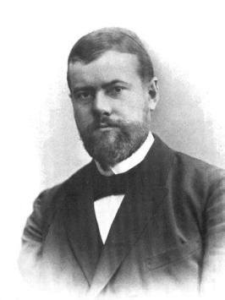
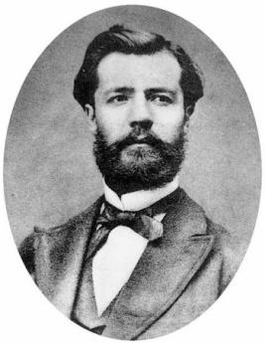
Understanding Bureaucratic Management
Looks at how government departments and large businesses operate
Examines how to manage more effectively
Influential theorists
Max Weber
Henry Fayol

Slide 15
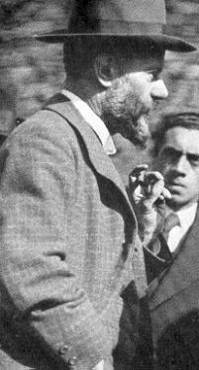
Max Weber and Bureaucratic Theory
Born in Germany during time when industrialization was transforming most aspects of society and government
Interested in industrial capitalism
Industry is privately controlled and operated for profit
Visited United States to study U.S. economy (1904)
Authority wasn’t function of experience but of social status
Based on rational authority- most authority given to most competent
Thought bureaucratic theory would result in highest level of efficiency—however negative aspects
Excessive procedures, boredom, unresponsiveness

Slide 16
Characteristics of Bureaucracy
Identified six characteristics of bureaucracy
Hierarchical Management
Division of Labor
Formal Selection Process
Career Orientation
Formal Rules and Regulations
Impersonality

Slide 17
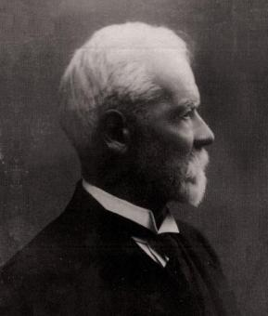
Henri Fayol and Administrative Theory
Born in Turkey 1841
Experimented with different management structures
Incorporated some of Weber’s ideas in his theories
Concerned instead with how workers were managed and how they contributed
Created the 5 duties of management

Slide 18
Five Duties of Management
Foresight: create plan of action for future
Organization: provide resources to implement plan
Command: select and lead best workers through clear orders
Coordinate: make sure diverse efforts fit together through communication
Control: verify whether things are going according to plan and correct as needed

Slide 19
Set of Management Theories and Practices
Fayol thought management principles needed to be flexible and adaptable and that they would be expanded through experience and experimentation.
Guiding principles:
Scalar chain: unbroken chain of command extends from top to bottom
Unity of command: employees receive orders from only one superior
Unity of direction: activities that are similar should be the responsibility of one person
Division of work: workers specialize in a few tasks to become more proficient

Slide 20
Class Discussion: Fayol and Weber
In small groups, discuss the two most significant contributions to management practice and theory created by Fayol and Weber? What are the characteristics of each?
How are these contributions still at work today in management theory?

Slide 21
Humanistic Management

Slide 22
Learning Outcomes: Humanistic Management
2.3: Describe the contributions of Mary Parker Follett and Elton Mayo (Hawthorne studies) to the field of humanistic management
2.3.1: Explain the concept of humanistic management
2.3.2: Summarize the work of Mary Parker Follett
2.3.3: Explain the significance of Elton Mayo's work (Hawthorne studies)

Slide 23
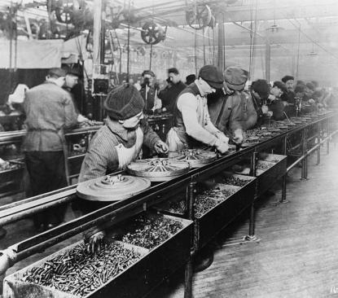
Basics of Humanistic Management
Places emphasis on interpersonal relationships
Highlights concerns about lower standards of workmanship and lower wages
Labor unions began addressing growing fear of the workers
the US government called Frederick Taylor to testify about aims of his proposals

Slide 24
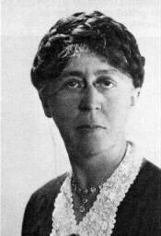
Mary Parker Follett
Considered to be the ”Mother of Modern Management”
Developed concepts applied to business and management
created a better understanding of lateral processes
noted the Importance of informal processes within organizations
applied principles of noncoercive power sharing she called integration
examined empowerment and facilitation instead of control
promoted conflict resolution in group based on constructive consultation

Slide 25
Follett: “Mother of Modern Management”
Follett devoted her life’s work to the idea that social cooperation is better than individual competition.
In her 1924 book Creative Experience, Follett wrote:
“Labor and [management] can never be reconciled as long as labor persists in thinking that there is a [management] point of view and [management] thinks there is a labor point of view. These are imaginary wholes which must be broken up before [management] and labor can cooperate.”

Slide 26
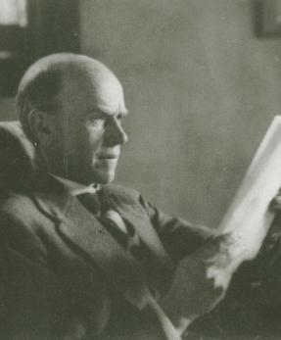
Elton Mayo and the Hawthorne Experiments
Completed a series of studies designed to isolate factors in workplace that affected productivity
If positive change was implemented, productivity increased
If negative change was implemented, productivity still increased
Employed nondirective interview method
Benefits- feeling of group cohesion, friendlier attitude of researchers, attention brought to individuals
Published findings in “The Human Problems of an Industrialized Civilization” in 1933

Slide 27
Current Developments in Management Practices

Slide 28
Learning Outcomes: Current Developments in Management Practices
2.4: Describe current developments in management practices
2.4.1: Explain the concept of operations management
2.4.2: Explain the concept of systems management
2.4.3: Explain the concept of information management
2.4.4: Explain the concept of contingency management

Slide 29
Introduction to Current Developments in Management Practices
Many argue classical practices and theories are no longer valid
Most of what we do requires us to interact with large-scale institutions
Government agencies, banks, health-care providers, insurance companies, etc.

Slide 30
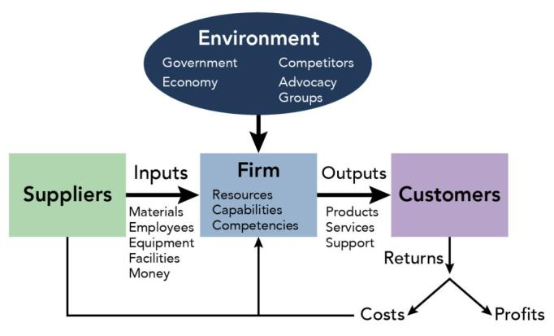
Forces Shaping Management and Current Developments

Slide 31
Forces Shaping Management and Current Developments (cont.)
Pace of Change Rate of progress x2 every decade
Technology. Primary factor driving change
Globalization. Increasing ease of flow between countries
Diversity. Tremendous resource to organizations- different perceptions, experiences, and strengths
Social Expectations. Would provide goods and services society required

Slide 32
Current Developments in Management
Becoming more specific with formation of disciplines
Also becoming more general
managers are given a toolbox, not step-by-step procedure
Operations Management. Concerned with physical processes involved
Initial product design to incorporate features
Manage supply chain
Work with marketing and sales
Information Management. Depends on accuracy to make decisions
Concerned with collection, preservation, storage, etc. of information

Slide 33
Systems Approach to Management
Gets feedback from from the market in two ways
Receives revenue
Receives information on how well organization is doing: direct information from surveys
Focuses on whole production process; usually split by specialties within company
Companies are open to environmental influence
Political instability, economic conditions, consumer tastes, etc
Must be able to detect change and respond effectively

Slide 34
Contingency Management
Not specific function—general approach
Every situation recognized as unique; managers must adapt to match situation
Might include industry in which company operates

Slide 35
Class Activity: Amazon and Management
Why learn about the history of management?
Principles developed during Industrial Revolution are still practiced today
Relatable concepts to modern experiences
Helps with the studies of successful businesses today
Let’s take a minute to review Amazon, as an example of modern day cutting- edge business practices. Amazon Prime Air: Automated Drone Delivery System
Do you see any similarities between managing a modern technology company like Amazon and managing the large industrial steel companies that dominated U.S. industry in the late 1800s and into the turn of the twentieth century?
Which of the classical management theories are the most relevant today? Which are the most non-relevant?

Slide 36
Present: Amazon and Management

Slide 37
Class Activity: Google and Management
Why learn about the history of management?
Principles developed during Industrial Revolution are still practiced today
Relatable concepts to modern experiences
Helps with the studies of successful businesses today
Review the article about Google by the International Journal of Corporate Social Responsibility which discusses the Harvard Business Review case study “Project Oxygen”.
Which of the management theories discussed in this module are the most relevant today in a organization like Google?

Slide 38
Present: Google and Management

Slide 39
Quick Review
Explain the concept of scientific management
Summarize the work of Frederick W. Taylor, Frank and Lillian Gilbreth, and Henry Gantt
Explain the concept of bureaucratic management
Summarize the work of Max Weber and Henri Fayol
Explain the concept of humanistic management
Summarize the work of Mary Parker Follett and Elton Mayo
Explain the concepts of operations, systems, information, and contingency managements

