Slide 1
Principles of Management
Module 15: Control

Slide 2
Module Learning Outcomes
Explain the methods and need for control within an organization
15.1: Explain what control means in a business setting and why it is needed
15.2: Explain the basic control process and monitoring points
15.3: Describe the different levels and types of control
15.4: Explain the need for a balanced scorecard
15.5: Explain the use of financial and nonfinancial controls in business

Slide 3
Control in the Business Setting

Slide 4
Learning Outcomes: Control in the Business Setting
15.1: Explain what control means in a business setting and why it is needed
15.1.1: Explain what control means in a business setting
15.1.2: Describe the benefits and costs of organizational control

Slide 5
What Does Control Mean in the Business Setting?
Control is device or mechanism used to regulate or guide operation of a machine, apparatus, or system
Control is in a business setting and involves the processes that regulate, guide, and protect an organization
One type of control- set of financial policies
Most common style is top-down control- decisions are made by high-level executives and passed down

Slide 6
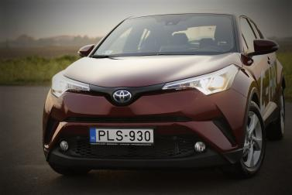
Implementing Organizational Control
Organizational control means developing rules, procedures, or other protocols for directing the work of employees and processes
Important because it helps identify errors and deviation from standards
Benefits: improved communication, financial stability, increased productivity, help in meeting goals, etc.
Employee morale may be higher when workers see that management is paying attention and knows what it is doing
Example: Toyota

Slide 7
Disadvantages
Some systems can be very expensive so management must weigh the cost versus the benefit for each control
Control mentality can lead to overstaffing and unsustainable costs for some businesses
Maintaining controls is also an expense
Controls can become blind spot for management
Rigid implementation may lead to a slowdown in the operation of the business

Slide 8
The Control Process

Slide 9
Learning Outcomes: The Control Process
15.2: Explain the basic control process and monitoring points
15.2.1: Explain the basic control process
15.2.2: Differentiate between feedback, proactive, and concurrent controls

Slide 10
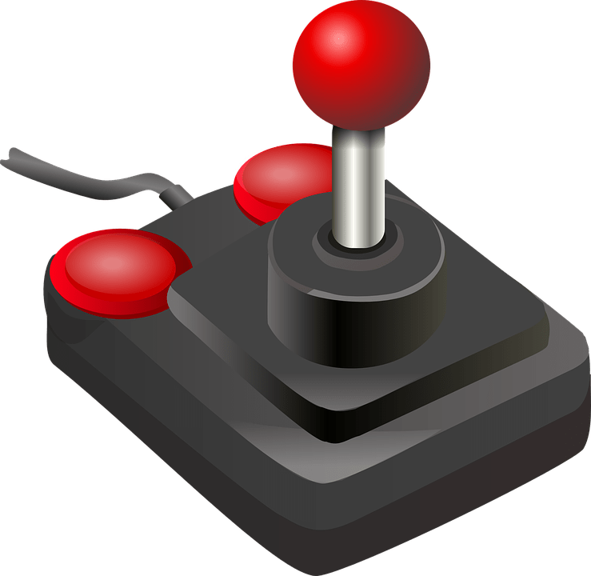
Understanding The Control Process
Setting performance standards
Measuring actual performance
Comparing actual performance with standards or goals
Analyzing deviations
Taking corrective action

Slide 11
Timing of Controls
Controls categorized according to time in which process or activity occurs
Controls related to time include:
Feedback
Proactive
Concurrent
Advantages and Disadvantages of each

Slide 12
Feedback
Occurs after an activity or process is completed
Example: Evaluating team’s progress by comparing production standard to actual production output
Example: When a sales goal is set, sales team works to reach goal for next three months, followed by review period
Disadvantage- modifications can be made only after a process has already been completed or an action has taken place

Slide 13
Proactive Control
Involves anticipating trouble rather than waiting for a poor outcome and reacting afterward
About prevention or intervention
Example: When an engineer performs tests on braking system of prototype vehicle before it is moved on to be mass produced
Looks forward to problems that could reasonably occur and devises methods to prevent problems
Disadvantage: Can’t control unforeseen and unlikely incident

Slide 14
Concurrent Control
Monitoring takes place during process or activity
May be based on standards, rules, codes, and polices
Example: Fleet tracking by GPS to allow managers to monitor company vehicles
Example: Keen Media tries to reduce employee inefficiency by monitoring Internet activity

Slide 15
Practice Question 1
In the Lean/Agile management process, a workflow staple is the “Daily Standup” where each team member quickly outlines what they are working on. This would be an example of:
Feedback control.
Proactive control.
Concurrent control.

Slide 16
Practice Question 2
Also from the Lean/Agile handbook is the process called “post-mortem” where the team evaluates their 2-week progress. This would be an example of:
Feedback control.
Proactive control.
Concurrent control.

Slide 17
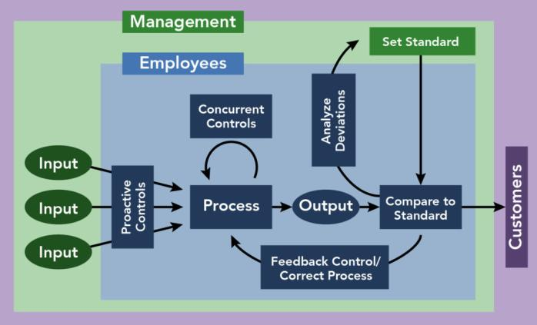
Figure 1: The Control Process

Slide 18
Levels and Types of Control

Slide 19
Learning Outcomes: Levels and Types of Control
15.3: Describe the different levels and types of control
15.3.1: Differentiate between strategic, operational, and tactical controls
15.3.2: Differentiate between top-down, objective, and normative control

Slide 20
Strategic Control
Involves monitoring a strategy as it is being implemented, evaluating deviations, and making necessary adjustments
May involve reassessment of strategy due to unforeseen event
Implementing strategy often involves series of activities that occur
Also involves monitoring internal and external events
Errors are major- failing to anticipate customers’ reaction to competitor’s new product

Slide 21
Operational Control
Involves control over intermediate term operations and processes but not business strategies
Ensure that activities are consistent with established plans
Mid-level management uses operational controls for intermediate-term decisions
When performance doesn’t meet standards, managers enforce actions such as training, discipline, motivation, or termination
Focuses more on internal sources of information and affects smaller units or aspects of organization
Errors may mean failing to complete project on time

Slide 22
Tactical Control
Tactic is a method that meets specific objective of an overall plan
Emphasizes current operations of an organization
Managers determine what various parts of organization must do for organization to be successful in the near future
Strategic control always comes first, followed by operations, and then tactics

Slide 23
Top-Down Controls
Means use of rules, regulations, and formal authority
Includes budgets, statistical reports, and performance appraisals
Advantages: Employees can spend their time performing their job duties instead of discussing direction of the company and offering input into development of new policies
Disadvantages: lower levels are in touch with customers and recognize new trends or new competition earlier than senior management- may discourage employees from sharing information or ideas up chain of command

Slide 24
Objective and Normative Control
Objective control—based on facts that can be measured and tested- measures observable behavior
Output control is another form of objective control
Normative control—govern behavior through accepted patterns of action rather than written policies and procedures
Uses values and beliefs
Reflects organization’s culture

Slide 25
The Need for a Balanced Scorecard

Slide 26
Learning Outcomes: The Need for a Balanced Scorecard
15.4: Explain the need for a balanced scorecard
15.4.1: Identify the four typical components of the balanced scorecard
15.4.2: Explain the need for a balanced scorecard

Slide 27
The Balanced Scorecard
More than 50% of large U.S. firms use the balanced scorecard- many large firms over the world use the balanced scorecard in business operations
Reaction to earlier mistakes driven by narrow focus on financial results
Adds goals for company’s customers, internal quality, and learning and growth

Slide 28
Balanced Scorecard Components
Communicate goals, align daily tasks with strategies, prioritize projects, measure performance, monitor progress
4 different perspectives:
Learning and growth: involves culture of a company
Internal business processes: focuses on how well company is running
Customers’ perspective: often measured by surveying existing customers
Financials: company must succeed financially to continue operating

Slide 29
Why a BSC Is Needed?
Without balanced scorecard, executives focus on only one or a few aspects of the organization
Company may be doing well financially but performing poorly in another area
For example, company may exceed customer expectations related to product quality, corporate social responsibility, and customer service
Forces managers to look at company as a whole to measure performance and more accurately determine company’s overall state

Slide 30
Financial and Nonfinancial Controls

Slide 31
Learning Outcomes: Financial and Nonfinancial Controls
15.5: Explain the use of financial and nonfinancial controls in business
15.5.1: Explain the use of budgets to both control and delegate authority
15.5.2: Explain the use of financial ratios (comparisons) as a control method
15.5.3: Explain the benefits of quality management
15.5.4: Explain the costs of quality management

Slide 32
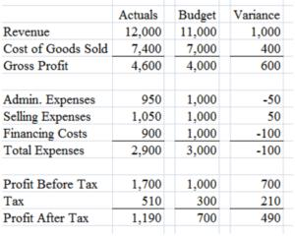
Budgetary Control
Standard financial reports are statement of cash flows, balance sheet, income statement, financial ratios, and budgets
Budget sets limit on spending and is a method of control used to help organizations achieve goals
Following a budget requires discipline
Budgets can also be used to delegate authority

Slide 33
Financial Ratios
Managers use ratios to analyze elements such as debt, equity, efficiency, and activity
Debt ratios compares organization’s debt to its assets- higher the ratio, the more leveraged the company is
Key to understanding ratios is comparing them to relevant benchmarks- debt ratio for manufacturing company is around 50% but in bank is 92%
Analyzing financial ratios helps managers determine financial health company

Slide 34
Practice Question 3
The following ratios would be helpful for which of the following industries?
DIO = 365 / (Inventory Turnover: cost of sales during period /average inventory balance during the same period)
DSO = 365 / (credit sales during period /average accounts receivable balance during the same period)
DPO = 365 / (cost of sales during period /average accounts payable balance during the same period)
Retail
Manufacturing
Banking
Hospitality

Slide 35
Quality Management
Involves controlling, monitoring, and modifying tasks to maintain desired level of quality
Benefits—helps companies please customers so company can maintain good reputation, gain competitive edge, and ultimately make a profit
Company also saves both time and money by reducing defects
Costs—regulations are type of control that society puts on companies
Drives managers great lengths to please customers which can become quite expensive
Purchase new software/equipment, hire employees, conduct studies, and consult with experts

Slide 36
Quick Review
What does control mean in a business setting?
What are the benefits and costs of organizational control?
What is the basic control process?
Can you differentiate between feedback, proactive, and concurrent controls?
Can you differentiate between strategic, operational, and tactical controls? Between top-down, objective, and normative control

Slide 37
More Quick Review
Are you able to identify the four typical components of the balanced scorecard?
Are you able to correctly explain the need for a balanced scorecard?
What is the use of budgets to both control and delegate authority?
What is the use of financial ratios as a control method?
What are the benefits of quality management?
What are the costs of quality management?

Slide 38
Class Discussion
You are one of the founders of a startup in the logistics industry. What would be the first control mechanisms that you would put in place to get your business started successfully?

