Slide 1
Principles of Management
Module 10: Leadership

Slide 2
Module Learning Outcomes
Recognize good and poor leadership and the varieties of leadership
10.1: Differentiate between leadership and management
10.2: Identify the traits, dimensions, and styles of effective leaders
10.3: Compare examples of effective and poor leadership
10.4: Summarize the situational theories of leadership
10.5: Summarize transformational and transactional theories of leadership

Slide 3
Leadership

Slide 4
Learning Outcomes: Leadership
10.1: Differentiate between leadership and management
10.1.1: Differentiate between leadership and management

Slide 5
What Is Leadership?
Leadership is about establishing a direction and influencing others to follow
Management is successfully administering the many complex details involved in business’s operation
Both are necessary skills that often overlap
Some differences include:
Leadership: influencing, change, direction, vision, creating, etc.
Management: planning, organizing, controlling, stability, etc.

Slide 6
Formal vs. Informal Leadership
Not all leadership based on official position
Individuals who are assigned titles and positions of authority are expected to provide leadership- formal leadership
Plenty of people who have formal leadership positions but don’t provide strong leadership (can leave organization lacking direction/purpose)
Individuals who don’t have official positions of leadership but exhibit leadership qualities and help create vision of company- informal

Slide 7
What Makes an Effective Leader

Slide 8
Learning Outcomes: What Makes an Effective Leader
10.2: Identify the traits, dimensions, and styles of effective leaders
10.2.1: Identify the traits of effective leaders
10.2.2: Differentiate between task-centered and employee-centered leadership behavior
10.2.3: Differentiate between autocratic, democratic, and laissez-faire styles of leadership

Slide 9
Leadership Traits
Drive: highly motivated individuals
Desire to Lead: want to have leadership roles and functions
Honesty/Integrity: essential to inspiring confidence and trust from followers
Self Esteem/Self-Confidence: lack of these creates doubts and insecurities
Open-Mindedness: recognize innovation is valuable and are open to other ideas
Intelligence: cognitive ability as well as relational and emotional intelligence
Extraversion: outgoing and social in personalities
Not all good leaders have to be extraverts (Bill Gates, Mark Zuckerberg)

Slide 10
Knowledge of the Business and Styles of Leadership
Lack of knowledge and experience is almost impossible to overcome
Trait-based analysis of leaders is common approach and analyzing leadership styles
Task-Centered or Employee- Centered
Task: focus on giving instructions to group members to reach achievement
Employee: focus less on objective actions and more on building relationships between followers

Slide 11
Autocratic, Democratic, or Laissez-faire
Autocratic: makes decisions without employee involvement- authoritarian
Democratic: involves employee team in decision-making
Laissez-faire: hands-off approach to leadership- employees make own decisions
“A good leader inspires people to have confidence in the leader. A great leader inspires people to have confidence in themselves.”
—Eleanor Roosevelt

Slide 12
Practice Question 2
Which style of leadership lends itself best with a task-centered style?
Autocratic.
Democratic.
Laissez-faire.

Slide 13
Effective vs. Poor Leadership

Slide 14
Learning Outcomes: Effective vs. Poor Leadership
10.3: Compare examples of effective and poor leadership
10.3.1: Compare examples of effective and poor leadership

Slide 15
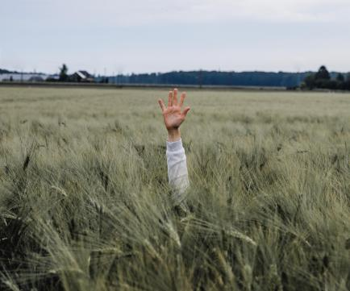
Understanding Effective vs. Poor Leadership
Compare examples of effective and poor leadership
What do these traits and styles look like in practice?
Will be looking at real-world examples of good and bad leadership to help deepen understanding
Looking at individuals with positive and negative leadership qualities in next slides

Slide 16
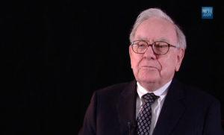
Warren Buffett, Berkshire Hathaway
One of the wealthiest men in the world through leadership of investment company
Thousands travel to hear his meetings and has become very successful
Work is to identify companies for purchase he believes are well-managed for success
Presents a vision, stands firmly behind it, and inspires others
Always truthful and an optimist

Slide 17
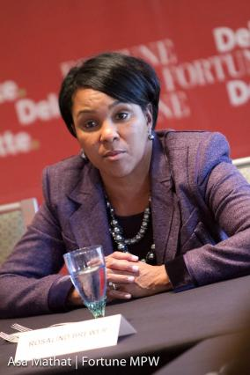
Rosalind Brewer, Starbucks
Current COO at Starbucks, the first woman and the first African-American in this role
Former CEO of Sam’s Club
Forward-thinking initiatives at Sam's Clubs, doubling the amount of organic products offered and advancing online ordering
Emphasis on diversity of hiring and implementation of racial bias training
Navigated Starbucks through negative public opinion after racially charged arrests at one of their locations

Slide 18
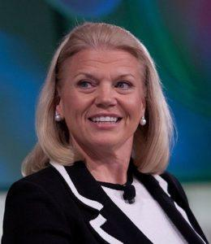
Ginni Rometty, IBM
IBM is successful tech company for over 100 years
Much of its legacy is in field of computer hardware systems
Overseen significant shift of focus for company
Democratic, soft-spoken leadership style enabled her to be successful

Slide 19
Situational Theories of Leadership

Slide 20
Learning Outcomes: Situational Theories of Leadership
10.4: Summarize the situational theories of leadership
10.4.1: Summarize the situational theories of leadership

Slide 21
Understanding Situational Theories of Leadership
Work on the assumption that the most effective style of leadership changes from situation to situation
Leader must be able to adapt his style and approach to different circumstances
Example: some employees function better under leader who is more autocratic while others prefer leader to step back and give others chance
Not all industries require same skills and leadership traits- many theories developed

Slide 22
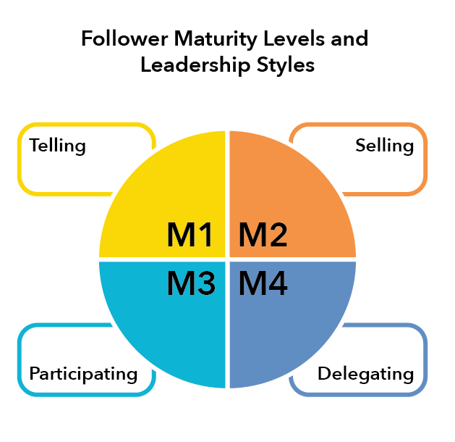
Hersey and Blanchard’s Situational Leadership Theory
Suggests need to match two key elements correctly: leadership style of the leader and maturity/preparedness of the followers
Main leadership approaches- telling, selling, participating, delegating
Four levels of follower maturity- low competence and commitment (M1), low competence and high commitment (M2), high competence and low commitment (M3), and high competence and commitment (M4)
Key to successful leadership is matching proper leadership style to maturity level

Slide 23
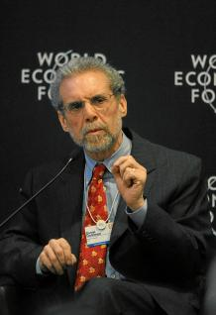
Goleman’s Model of Situational Leadership
Theory incorporates development of the concept of “emotional intelligence”
Pacesetting: sets aggressive goals and standards for each employee
Authoritative: provides direction and goals and expects team to follow lead
Affiliative: praises and encourages employees refraining from criticism
Coaching: focuses on helping individuals build skills and develop talents
Democratic: involves followers in process by seeking their opinion
Coercive: ultimate authority and demands immediate compliance

Slide 24
Normative Decision Theory
Guide in determining optimum amount of time and group input that should be committed to a decision
Number of options for leader
Key Questions: is decision quality important? Does the leader have enough information to make a decision? Is the problem structured and easily analyzed? Do members have high levels of competence in working as a group?

Slide 25
Practice Question 3
What do all of the leadership theories we have just reviewed have in common?
They reflect the democratic style of leadership.
They require industry knowledge.
They match leadership style with the environment.
They incorporate the concept of emotional intelligence.

Slide 26
Transformational and Transactional Theories of Leadership

Slide 27
Learning Outcomes: Transformational and Transactional Theories of Leadership
10.5: Summarize transformational and transactional theories of leadership
10.5.1: Summarize transformational theories of leadership
10.5.2: Summarize transactional theories of leadership

Slide 28
Transformational and Transactional Theories of Leadership
Transactional Leadership
Transformational Leadership
Motivation is derived from an arrangement whereby employees are rewarded for accomplishing goals set for them
When sales representatives are paid on commission or given bonuses
Assume that the desires of the leader and the follower are not the same- must provide motivation
Four categories:
idealized influence
inspirational motivation
intellectual stimulation
individualized consideration

Slide 29
Class Discussion: What makes a leader?
Are leaders born and not made? Review the list of leadership traits and discuss which of them you think can be learned versus those that are inherent in one’s personality make-up. What about management traits/duties? Are these learned versus inherent?

Slide 30
Quick Review
How does one differentiate between leadership and management?
Can you identify the traits of effective leaders?
Are you able to differentiate between task-centered and employee-centered leadership and behavior? Between autocratic, democratic, laissez-faire, relationship-oriented, task-oriented, and people-oriented styles of leadership?
Are you able to compare examples of effective and poor leadership?
Please summarize the situational theories of leadership.
Can you summarize transformational and transactional leadership theories?

