Slide 1
HERITAGE TOURISM
Prof. dr Djurdjica Perovic
Summer School “Entrepreneurship in heritage tourism”
17. 10. 2022

Slide 2
OUTLINE
Introduction to heritage
Heritage tourism
Cultural heritage traveller
Heritage tourism: Opportunities and challenges
Heritage tourism: Entrepreneurial perspective
Innovations in heritage tourism

Slide 3
INTRODUCTION

Slide 4
HERITAGE
Heritage - “mosaic of cultural and creative expressions, our inheritance from previous generations of Europeans and our legacy for those to come” (European Commission 2018)
Heritage - shared cultural values, memories and events which are inherited from the past and transmitted through objects, sites or cultural performances (Peckham 2003)
Heritage - “a tangle of ideology and expectation; an analytic term and a tool of governance; a category that allows us to understand the power dynamics involved in the selective recognition of identity, often in material form.” (Geismar 2015, p.71)
Heritage - regulation and negotiation of the multiplicity of meaning of the past, it is about the arbitration and mediation of the cultural and social politics of identity, belonging and exclusion (Smith and Waterton 2009, p. 295).

Slide 5
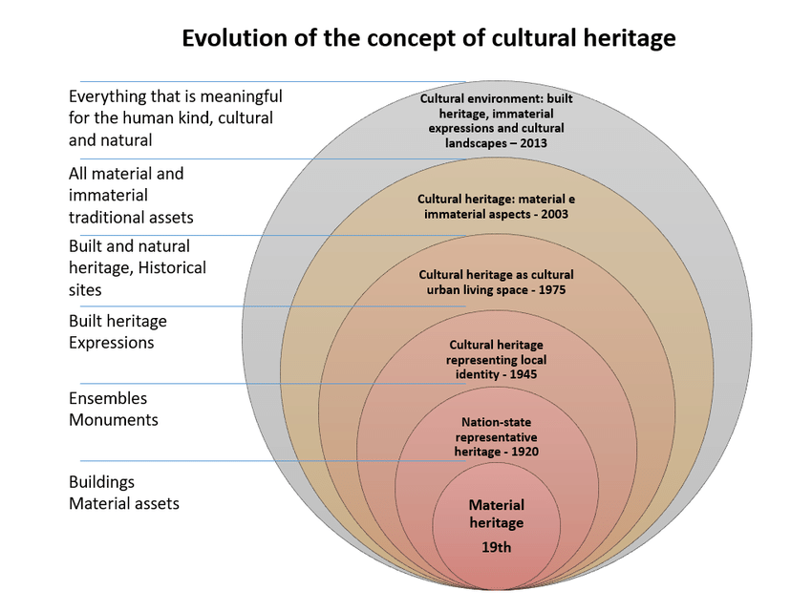
WORLD HERITAGE CONVENTIONS
History of conservation can be traced back to the ancient Egypt, Rome and Greece (Wienberg 2021) and first Charts were drafted already in XIX century
Athens Charter (ICOMOS 1931) recommends the steps to establish urban order through, amongst other things, protection, conservation and restauration of historic sites and monuments of public interest
The Venice Charter: International Charter for the Conservation and Restoration of Monuments and Sites (ICOMOS 1964)
UNESCO adopted in 1972 the influential Convention Concerning the Protection of the World Cultural and Natural Heritage (UNESCO 1972), aiming to elevate heritage protection from national to international context

Slide 6
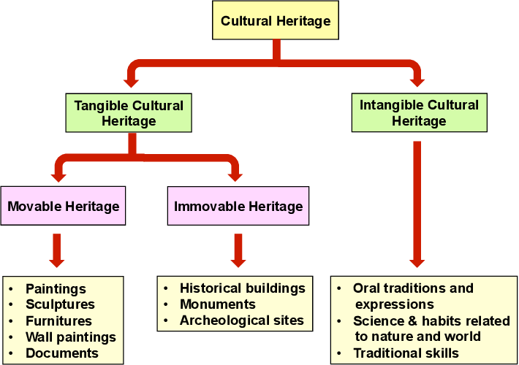
HERITAGE CLASSIFICATION
Source: UNESCO

Slide 7
HERITAGE TOURISM
”Traveling to experience the places, artifacts and activities that authentically represent the stories and people of the past” (The National Trust for Historic Preservation in the United States)
Architectural and historic monuments, local traditions and customs represent a major factor of the attractive tourist destination for overseas visitors
Economic benefits: source of revenues for revitalizing heritage places, creating jobs for local population, providing new business opportunities, strengthening local economies, increasing property values
Social benefits: reinforcing cultural identity, preserving traditions and folklore, promoting community pride, fostering social cohesion

Slide 8
CULTURAL HERITAGE TRAVELLER
Older
More Affluent
Highly educated
Frequent traveler
Spending more than regular tourists
Prefers educational leisure travel
Wants to engage with locals
Uses online tools to plan the trip and engage with community

Slide 9
Heritage tourism: opportunities
Conservation of cultural and artistic heritage
Local prosperity for non-traditional tourist destination
Building connections between different cultures
Strengthening local economies, creating jobs
Reinforcing local identities
Diversifying tourism experience
Supporting small businesses
Helping increase a customer base for local business
Allowing tribes and indigenous communities to have their voices heard

Slide 10
Heritage tourism: CHALLENGES
Commodification and cheapening of traditions
Gentrification and displacement of local residents
Undermining local traditions
Conflict over loss of land rights and access to resoources
Alienation and loss of cultural identity
Damage to heritage attractions
Loss of authenticity
Environmental degradation
Congestion and overuse of community facilities

Slide 11
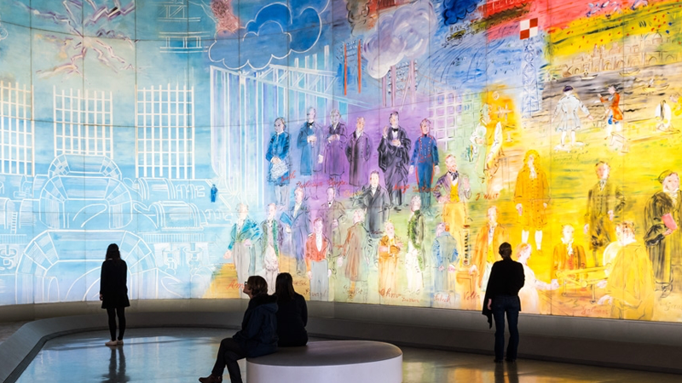
Heritage tourism: entrepreneurial perspective
Heritage tourism offers opportunities for local communities in terms of supporting entrepreneurial development
Heritage tourism entrepreneurship is related to the development of businesses in the field of heritage tourism
Cultural Heritage Entrepreneurs should be creative in order to find suitable solutions for financing different tourism activities, such as:
Sponsoring local heritage events and attractions
Providing information to tourists
Diversification and upgrading of heritage experience
Developping Mobile Applications for booking heritage attraction visits, online audio guides, recommendation tools, etc.
Digtalisation of heritage

Slide 12
INNOVATIONS IN HERITAGE TOURISM
Digitalisation of heritage (virtual museums, virtual tours of heritage attractions)
Thematic cultural routes across countries
Free guided walking tours
Airbnb Experiences
Local arts/crafts festivals and shops
Circular tourism
Public-private heritage partnership

Slide 13
EXERCISE
Visiting historic sites
Visiting art museums/galleries
Shopping in local malls
Attending an art/craft festival
Exploring local gastronomic offer
Visiting state/national parks
Shopping in museum stores
Exploring urban neighbourhoods
Subathing at local beach
Which of the following represents Heritage tourism activities?

