Slide 1
Conversation

Slide 2
Introduction
Understanding concepts
Exchange moves and IRF
Conversation analysis
Interactional sociolinguistics

Slide 3
Introduction
BM You do you do Language Planning don’t you?
DM Yeah. I’ve stopped doing that though. I did stop doing that last week. SLA?
BM I’m not doing that.
DM Ah. We haven’t got many things in common then.
BM Wow. We’ve parted ways.
DM That’s right. That’s right. Yes. (2)
BM We’ll have to go out sometime.
DM Yeah.
BM Before we forget each other’s faces. // (heh heh) It’s true.
DM // (heh heh heh)

Slide 4
Introduction
Two approaches to looking at the structure of discourse:
Exchange structure – the conventional overall patterns that occur when people are talking
Conversation analysis- the way that what speakers say dictates the type of answer expected, and that speakers take turns when they interact.

Slide 5
Introduction
Difference between the two approaches:
Exchange structure starts with a model and sees how real data fit it;
Conversation analysis starts by observing real data and describes what patterns emerge.

Slide 6
Exchange structure
Sinclair and Coulthard (1985)
Birmingham School of Discourse Analysis
They studied primary school lessons and found a regular structure.

Slide 7
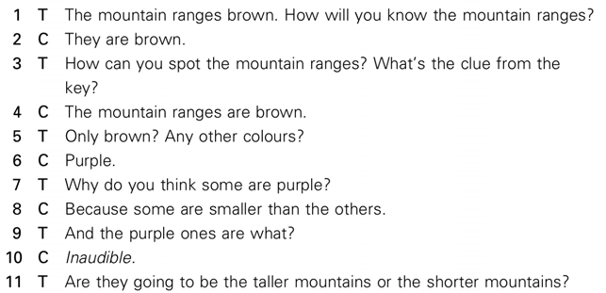
Exchange structure

Slide 8
Exchange structure

Slide 9
Exchange structure
Act - the lowest rank.
Sinclair and Coulthard’s acts cover, among other things, the following:
‘messiness’ of spoken discourse, including fillers as in ‘You know’, and ‘I mean’, and backchannels as in ‘Was it?’ and ‘Oh really?’
expressions that mark a boundary between ideas or topics as in ‘Well’, ‘OK’ and ‘Right’
expressions such as ‘Hands up’ and ‘Don’t call out’ which encourage a hearer to contribute
expressions that evaluate a hearer’s answer as in ‘Good’ and ‘Interesting’.

Slide 10
Exchange structure
Fixed order of moves
Three basic moves:
Initiation from the teacher
Response from the student
Follow-up

Slide 11
Exchange structure Move acts

Slide 12
Exchange structure Move acts

Slide 13
Exchange structure
Exchange- the combination of moves in the IRF structure.
The exchange is the series or chain of moves in the interaction.
Exchanges combine to make the transaction, the next rank up.
Lesson- the highest rank. It is the speech event that consists of combinations of transactions.

Slide 14
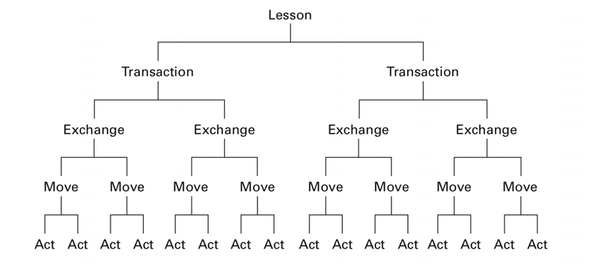
Exchange structure

Slide 15
Limitations of IRF
As a model of classroom transactions, it does not accommodate easily to the real-life pressures and unruliness of the classroom.
It reflects the traditional teacher-centered classroom.

Slide 16
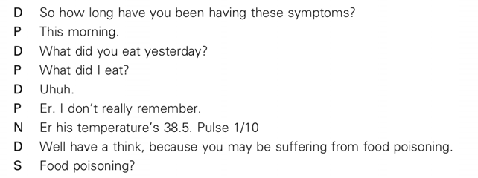
IRF model and other speech events

Slide 17
Conversation analysis
CA - takes a ‘bottom-up approach’: starting with the conversation itself, it lets the data dictate its own structure.
CA looks at conversation as a linear ongoing event, that unfolds little by little and implies the negotiation of cooperation between speakers along the way, thus viewing conversation as a process.
Conversation is discourse mutually constructed and negotiated in time between speakers.
It is usually informal and unplanned.

Slide 18
Conversation

Slide 19
CA patterns
Turn-taking
Cooperation in conversation is managed by all participants though turn-taking.
Transition relevance place (TRP) - a point in a conversation where a change of turn is possible.
Interruption - when speakers do not want to wait until the TRP.

Slide 20
CA patterns: Turn-taking
Interruption
The moment when the interruption begins is indicated with a //.
B yes. Tell, tell me what it // is you want
A // umm. Um, may I first of all request the introduction first?

Slide 21
CA patterns: Turn-taking
Overlap - when hearers predict that the turn is about to be completed, and they come in before it.
The overlap is indicated with a =.
Interviewee But not no more. Yeah =
Interviewer = What happened to them?

Slide 22
CA patterns: Adjacency pairs

Slide 23
CA patterns: Adjacency pairs Dispreferred response

Slide 24
Sequences
Sequences - stretches of utterances or turns that emerge in conversation.
Pre-sequences
Insertion sequences
Opening sequences
Closing sequences

Slide 25
Sequences
Pre-sequences prepare the ground for a further sequence and signal the type of utterance to follow.
Pre- invitations (‘I’ve got two tickets for the rugby match…’)
Pre-requests (‘Are you busy right now?’)
Pre-announcements (‘You’ll never guess’)
A You know that French film that’s on in the Odeon?
B Yes?
A Do you want to go and see it tonight?
B Yeah, why not?

Slide 26
Sequences
Insertion sequence
A You know that French film that’s on in the Odeon?
B Yes?
A Do you want to go and see it tonight?
B What time does it start?
A Eight thirty five.
B Yeah, why not?

Slide 27
Sequences
Opening sequences:
greeting, an enquiry after health and a past reference (as in ‘How did it go last night?)
Pre-closing and closing sequence
A Anyway, I’m gonna have to go.
B Yeah. See you.
A See you tomorrow.
C What time is it?
D. Oh. I’ve left my lights on.
E Half past three.
C Three.
E Tarrah.

Slide 28
Limitations of CA
Lack of systematicity
CA sets out to be a qualitative not a quantitative approach.
CA does not take into account pragmatic and sociolinguistic aspects of interaction.
For CA analysts, text is context.
CA sees contexts as something created in talk, rather than talk as something created by context.

Slide 29
Interactional sociolinguistics
This approach takes into account:
pragmatic and sociolinguistic aspects of interaction
adjacency pairs, turn-taking and sequences
situational context
shared knowledge about speakers, their history and their purpose in speaking
grammar
social structure
cultural patterns.

Slide 30
Recommended reading
Cutting, J. (2002). Pragmatics and Discourse. London and New York: Routledge.
Hatch, E. (1992). Discourse and Language Education. Cambridge: Cambridge University Press.
Levinson, S.C. (1983). Pragmatics. Cambridge: Cambridge University Press.
McCarthy, M. and R. Carter (1994). Language as Discourse: Perspectives for Language Teaching. London: Longman.
Mey, J. (1994). Pragmatics: An Introduction. Oxford: Blackwell.

