Slide 1
Context. Analysing the discourse in context

Slide 2
Introduction
What is context?
Why is it important to discourse analysis?
Discourse analysis studies the meaning of words in context.
Discourse analysis analyses the parts of meaning that can be explained by knowledge of the physical and social world, and the socio-psychological factors influencing communication, as well as the knowledge of time and place in which words are uttered or written.
(Cutting 2002: 2)

Slide 3
Introduction
Understanding concepts
Situational context
Background knowledge context
Co-textual context

Slide 4
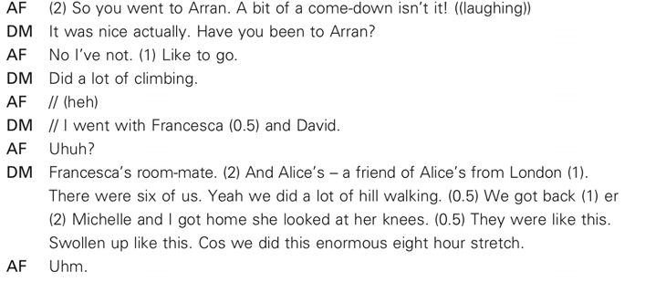
Introduction

Slide 5
Introduction
Three types of context:
the situational context, what speakers know about what they can see around them
the background knowledge context, what they know about each other and the world
the co-textual context, what they know about what they have been saying.

Slide 6
Situational context
The situational context is the immediate physical co-presence, the situation where the interaction is taking place at the moment of speaking.
In the excerpt about hill walking in Arran, are there words taking on meaning in the situational context?
‘They were like this. Swollen up like this.’

Slide 7
Background knowledge context
cultural general knowledge that most people carry with them in their minds, about areas of life
interpersonal knowledge, specific and possibly private knowledge about the history of the speakers themselves.

Slide 8
Background knowledge context
Cultural
Do AF and DM share any cultural background knowledge?
Does the excerpt point out to speakers’ different attitudes to the cultural context?
the community of people
discourse communities
Interpersonal
Shared interpersonal knowledge is knowledge acquired through previous verbal interactions or joint activities and experiences, and it includes privileged personal knowledge about the interlocutor.
Does the excerpt contain instances of interpersonal background context?

Slide 9
Referring to context
Reference
Referring expressions
Referent
DM // I went with Francesca and David.
AF Uhuh?
DM Francesca’s room-mate. (2) And Alice’s – a friend of Alice’s from London (1). There were six of us. Yeah we did a lot of hill walking.
Exoforic reference vs. endophoric reference

Slide 10
Deixis
Person deixis – I, you, he, she, it, we and they
We are not amused.
So you went to Arran.
Spatial or place deixis – there, here, this, that, these, those
They were like this.
That was great.
Time deixis – next day, then, now
Now look, the picture shows …

Slide 11
Intertextuality
When a referring item refers to entities in the background knowledge, whether cultural or interpersonal, that have obviously been mentioned in a previous conversation or text, or have occurred in a previous shared situation or activity, we call this intertextuality.
‛That was great!’

Slide 12
Recommended reading
Brown, G. and G. Yule. (1983). Discourse analysis. Cambridge: Cambridge University Press.
Grundy, P. (2000). Doing Pragmatics. London: Edward Arnold.
Cruse, A. (2000). Meaning in Language. An Introduction to Semantics and Pragmatics. Oxfrord: Oxford University Press.
Cutting, J. (2002). Pragmatics and Discourse. London and New York: Routledge.
Mey, J. (1994). Pragmatics: An Introduction. Oxford: Blackwell.
Verschueren, J. (1999). Understanding Pragmatics. London: Edward Arnold / New York: Oxford University Press

