Slide 1
Co-text

Slide 2
Introduction
Understanding concepts
Grammatical cohesion
endophoric reference
substitution and ellipsis
Lexical cohesion
repetition
synonyms
superordinates
general words

Slide 3
Grammatical cohesion Reference
Endophoric reference/Endophora
We have been established by an Act of Parliament as an independent body to eliminate discrimination against disabled people and to secure equal opportunities for them. To achieve this, we have set ourselves the goal of: A society where all disabled people can participate fully as equal citizens.

Slide 4
Grammatical cohesion
We have been established by an Act of Parliament as an independent body to eliminate discrimination against disabled people and to secure equal opportunities for disabled people. To achieve the aim of eliminating discrimination against disabled people, we have set ourselves the goal of: A society where all disabled people can participate fully as equal citizens.
Endophora avoids unnecessary repetition.

Slide 5
Grammatical cohesion Endophora: anaphora
Anaphora links back to what was mentioned in the preceding text.
My cousin is a real success; she has three advanced degrees.
Monica was thrilled at the prospect of helping to cook for a man of private means who was himself a capable cook… She questioned Patricia about how long she had known him…

Slide 6
Grammatical cohesion Endophora: cataphora
Cataphora links forward to a referent in the text that follows.
Students (not unlike yourselves) compelled to buy paperback copies of his novels - notably the first, Travel Light, though there has lately been some academic interest in his more surreal and ‘existential’ and perhaps even ‘anarchistic’ second novel, Brother Pig- or encountering some essay from When the Saints in a shiny heavy anthology of mid-century literature costing $ 12.50, imagine that Henry Bech, like thousands less famous than he, is rich. He is not.

Slide 7
Grammatical cohesion

Slide 8
Grammatical cohesion
Associative endophora
Students are almost twice as likely to get top degree grades if they are taught by good university teachers, new research shows. The study suggests that the wide differences in numbers of firsts and upper second class degree awarded at universities comes down in large part to the work of inspirational lecturers, not just extra spending on students for books, libraries or computers.

Slide 9
Grammatical cohesion
Substitution
Little boxes on the hillside,
Little boxes made of ticky-tacky,
Little boxes, little boxes,
Little boxes, all the same.
There’s a green one and a pink one
And a blue one and a yellow one
And they’re all made out of ticky-tacky
And they all look just the same.

Slide 10
Grammatical cohesion
Substitution
Self-confidence should not be a gender issue. Boys are not born more confident than girls. Society makes them so because it traditionally values their skills and aptitudes above those of women.
Ellipsis
‘He’s afraid of you,’ Yossarian said. ‘He’s afraid you are going to die of pneumonia.’ ‘He’d better be afraid,’ Chief White Halfoat said. A deep low laugh rumbled through his massive chest. ‘I will, too, the first chance I get. You just wait and see.’

Slide 11
Grammatical cohesion
Substitution
Ellipsis
Ambiguity
Genres
FOR SALE: Very unique home in downtown Craigsville. Large lot. Many trees. One you will enjoy living in.

Slide 12
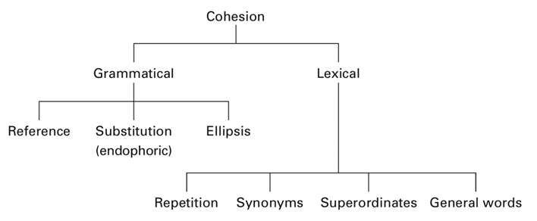
Cohesion

Slide 13
Lexical cohesion
Repetition
The child put the pale chrysanthemums to her lips, murmuring:
‘Don’t they smell beautiful!’
Her mother gave a short laugh.
‘No,’ she said, ‘not to me. It was chrysanthemums when I married him, and chrysanthemums when you were born, and the first time they ever brought him home drunk, he’d got brown chrysanthemums in his button-hole.’

Slide 14
Lexical cohesion
Synonyms
At some 75 cm across and capable of cracking open a coconut shell with its formidable claws, the land-dwelling coconut crab is your beach lounger’s worst nightmare. Fortunately for the sunbather, the world’s largest terrestrial arthropod has seemingly always been confined to tropical islands across the Pacific and Indian oceans.

Slide 15
Lexical cohesion
Superordinates
The candle-light glittered on the lustre-glasses, on the two vases that held some of the pink chrysanthemums, and on the dark mahogany. There was a cold, deathly smell of chrysanthemums in the room. Elisabeth stood looking at the flowers.

Slide 16
Lexical cohesion
General words
…and so he went off to Wolverhampton Poly which he selected for, you know, all the usual reasons, reasonable place, reasonable course, a reasonable this a reasonable that t-term to do computer science which of course all the kids want to do now erm twentieth centu- no it isn’t it’s a sort of nineteen eighties version of wanting to be an engine driver.

Slide 17
Recommended reading
Brown, G. and G. Yule. (1983). Discourse analysis. Cambridge: Cambridge University Press.
Cook, G. (1989). Discourse. Oxford: Oxford University Press.
Cruse, A. (2000). Meaning in Language. An Introduction to Semantics and Pragmatics. Oxford: Oxford University Press.
Cutting, J. (2002). Pragmatics and Discourse. London and New York: Routledge.
Halliday, M.A.K and R. Hasan. (1976). Cohesion in English. London: Longman.

