Slide 1
afroamerička književnost-PREGLED

Slide 2
The Stories of African American Literature
We younger Negro artists who create now intend to express our individual dark-skinned selves without fear or shame. If white people are pleased we are glad. If they are not, it doesn’t matter. We know we are beautiful. And ugly too.... If colored people are pleased we are glad. If they are not, their displeasure doesn’t matter either. Langston Hughes, “The Negro Artist and the Racial Mountain,” 1926
The Negro writer who seeks to function within his race as a purposeful agent has a serious responsibility. In order to do justice to his subject matter, in order to depict Negro life in all of its manifold and intricate relationships, a deep, informed, and complex consciousness is necessary; a consciousness which draws for its strength upon the fluid lore of a great people, and moulds this lore with the concepts that move and direct the forces of history today. Richard Wright, “Blueprint for Negro Writing,” 1937
I would like to write novels that were unmistakably mine, but nevertheless fit first into African American traditions and second of all, this whole thing called literature. Toni Morrison, interview, 1993
These days I find myself wanting to avoid being pigeon-holed, ghettoized, held in a different category [from] other authors. And when people ask me if I’m a black writer, or just a writer who happens to be black, I tend to say that it’s either a dumb question or a question which happens to be dumb. I’m an African-American writer, I’m a lazy writer, I’m a writer who likes to watch The Wire, I’m a writer who likes to eat a lot of steak. Colson Whitehead, interview, 2013

Slide 3
essay “The Negro Artist and the Racial Mountain” Hughes, 1926.
Hughes celebrates black American life and acknowledges that it is different from white American life: not inferior, but different. The quotation above is a clarion call not only to black artists, but also to all African Americans. Hughes hopes for a celebration of black culture and identity. But the words “fear” and “shame” at the beginning of it are significant.
Why are fear and shame associated with blackness in America? Why does it take an exhortation like this one from Hughes to rally black artists to express themselves honestly? Why did some black readers in 1926 favor what Hughes called “ordinary” white books over the exuberant expressions of their own culture? Why did they need art to teach them how to appreciate their own beauty?

Slide 4
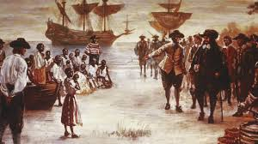
Historical and Literary Overview

Slide 5
Historical overview
African American history begins with the importation of African slaves by European colonizers into the “New World” beginning in the seventeenth century. The story continues through the abolition of slavery into an unstable period toward the end of the nineteenth century when black Americans no longer had slave status, yet faced abhorrent discrimination
Following the two world wars, black Americans concentrated on attaining what came to be known as civil rights, and the passage of anti-segregation legislation in 1954 and voting rights legislation in the mid-1960s were steps in the direction of long overdue racial equality. Still, there was considerable turbulence in the 1960s as is evident in the assassinations of prominent black leaders Malcolm X and Martin Luther King, Jr., as well as race riots in many major cities.
The 1970s and 1980s saw less violent and less urgent demonstrations arising from the desire for harmony
The election of Barack Obama as America’s first black president in 2009 indicates a level of racial cooperation unimaginable even a half-century earlier,

Slide 6
Literary overview
Most of the earliest works of African American literature were slave narratives: non-fiction works by slaves about the slave experience. As the genre evolved in the early nineteenth century, virtually all of these narratives shared a few common features: they were framed by the testimonies of white authors about the veracity and character of the author; they were overtly committed to the cause of abolition and often spoke directly to their intended audiences who were presumed to be sympathetic whites;
The Harlem Renaissance marked an out- pouring of creative expression and a flourishing of artistic spirit that had not occurred earlier.
As riots erupted on the streets in 1960s America, there was also a riot going on in the literary world. The Black Arts Movement, led by Larry Neal, Amiri Baraka, Addison Gayle, Jr., Sonia Sanchez, and Askia Touré, sought to settle once and for all what black literature should be, and what it should do

Slide 7
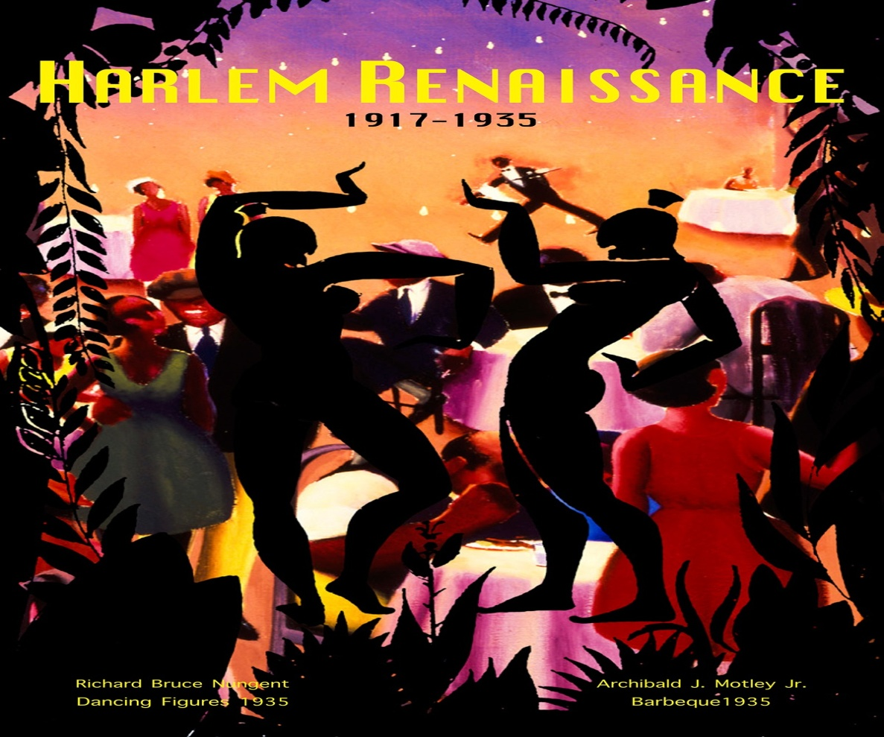
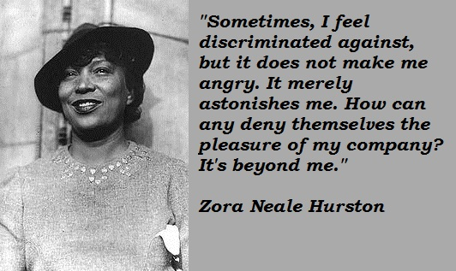

Slide 8
What Makes Black Literature “Black”?
Hughes acknowledges a difference between literature by black Americans and white Americans circa 1926
An assumption was firmly in place at that time: black writers wrote about black experiences, black themes, black history, etc.
Clearly many readers throughout history have expected black and white writers to stay on their side of the color line
What are the presumed acceptable subjects for black writers, though? And should writers feel a strong obligation to write about those subjects only or should they rebel against expectations?
many writers in the last half-century have also written about slavery: Ishmael Reed, Ernest J. Gaines, Alex Haley, Toni Morrison, Octavia Butler, Edward P. Jones, Thylias Moss, and many more. Slavery is the ignoble aspect of the American story – and the fact of African American history – that must not be forgotten

Slide 9
It is not uncommon for black writers to be sensitive to post-slavery injustices, such as racial discrimination, segregation, hate crimes, and the preponderance of crime and poverty in black communities, particularly urban ones, even if these subjects are not necessarily features of these writers’ lives
Over time, some black authors have argued that black literature need not be solely a grim catalog of oppression
There is no single “story” of African American literature

Slide 10
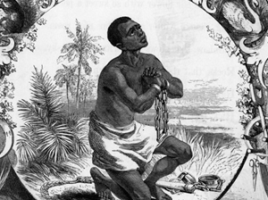
The Oral/Vernacular Tradition
The word “vernacular” is a broad term often used in discussions about African American cultural production to refer to many expressions that are not strictly literary
“What, then, is the African American vernacular? It consists of forms sacred – songs, prayers, and sermons – and secular – work songs, secular rhymes and songs, blues, jazz, and stories of many kinds. It also consists of dances, wordless musical performances, stage shows, and visual art forms of many sorts:”

Slide 11
The Oral/Vernacular Tradition
The role of utterance or speech is not necessarily secondary to the role of writing or inscription. Speaking and writing are interlocked frequencies of a single formal phenomenon
Storytelling
Blues
To connect oral literature and the blues may seem to conflate two distinct modes of expression (speech and music), but in fact the black vernacular does not draw a hard line between them
Langston Hughes titles a story “The Blues I’m Playing” and a famous poem “The Weary Blues;” James Baldwin’s most famous story is “Sonny’s Blues,” and he titled his poetry collection Jimmy’s Blues(1983) and a play Blues For Mister Charlie (1964)

